Slide 1
The world system Capitalism, hegemony, conflicts
Mario Pianta
Scuola Normale Superiore
SNS Summer school War, peace, the world order, 29 Sept 2025

Slide 2
Approach and concepts
War and peace issue have to be conceptualised in their structural context
No geopolitical determinism: geography, peoples, leaders, religion, etc: some role but limited
No simple logic of International Relations: States as main actors, rational interests, strategies
The political economy of the world system shapes the world order.
Political dimens: hierarchy of States, other actors
Economic dimension: capitalism

Slide 3
The world system
Economics
Capitalism
Accumulation of capital
National vs. global economy
Capital vs labour
Profits vs wages
Politics
State system
Power, Centre-Periphery
Inter-state relat., hierarchy
Intra-state political process
Democracy, conflict
Production
Goods→Profits
Finance
Money→Profits
Distribution
Income,wealth
Classes, other groups, indiv.
Policies on
Role of states
Context for accumulat.
Citizens’ rights
Nat’l, global
Inequalities
Cycles of
accumulation
Cycles of
hegemony
Reproduction of the system

Slide 4
The world system
Politics
States
Political power logic
Hegemony and hierarchy
Intl Relations, Diplomacy, Alliances, Soft power
Domestic/Int’l Democracy
Authoritarianism.
Failed States.
State-capital
relations
Govt-military
relations
Economics
Capitalism
Profit logic
Econ power supports pol/mil/tech power
Political power supports accumul/extractivism
Privatisation
Military
Conflicts/Wars
Armed power logic
Political goals: protection, security. Military means: strategies, type of conflicts arms races, forces, econ/tech base
Milit-industr
complex

Slide 5
The war system
Economics
Capitalism
Profit
Military economy
Extraction of gains from
positions of intl power
Politics
State system
Power
Inter-state relations,
Hegemonic order
Military alliances
Mil. expendit, Arms industry Human, natural, tech, econ, fin. resources, Milit-ind complex,
Debt, Short/long term effects
Arms races,
War preparations
threats, cold wars
Conflicts
Economic power
Cycle of accumulation
Intl. power
Cycle of hegemony

Slide 6
1. The World systems approach
How econ, pol, milit power have been combined?
Giovanni Arrighi, The long XX century,
With Fernand Braudel, Immanuel Wallerstein, Samir Amin, André Gunder Frank, Beverly Silver
Genoa and Spanish Empire (1600)
The Netherlands (1700)
British Empire (1800)
United States (1900)
long periods of transition/conflict/ systemic chaos

Slide 7
The evolution of the world system
Historical succession of:
cycles of accumulation in capitalism, with phases of material expansion and financial expansion, crises are structural
cycles of political hegemony in the world order, that develop in parallel
The centres of accumulation and political power change: crises open periods of systemic chaos
Arrighi-Silver, Chaos and governance in the modern world system, 1999

Slide 8
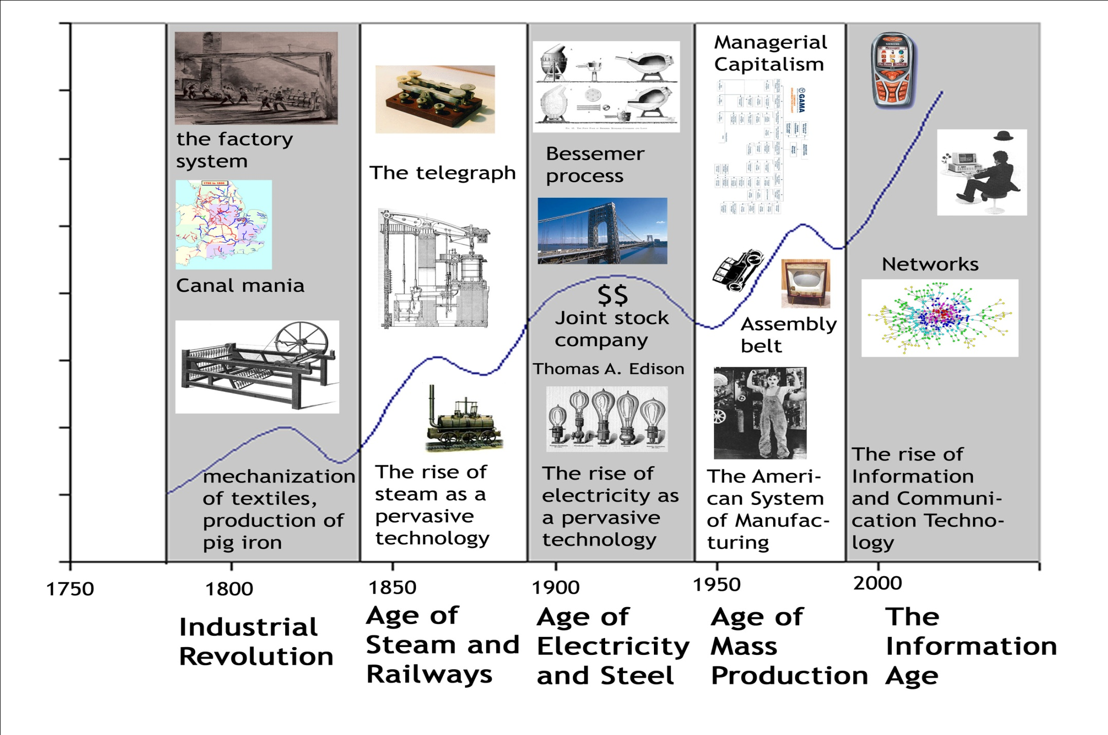
Technological paradigms, capitalist development

Slide 9
Dutch
British
US

Slide 10
Phase of material expansion
The centre of the world economy grows due to: new technologies, production systems, markets, high monopolistic profits (Schumpeter), gains in productivity (Smith), wages (Marx)
The accumulation of capital is driven by a material expansion
This attracts new investment of capital (for high profits), new countries (for natl development): competition and national rivalries reduce profits → ‘signal crisis’ ends the phase of material expansion

Slide 11
Phase of financial expansion
After the “signal crisis” capital stays in more liquid form: finance, looking for financial profits and rents, extracted from productive activities (conflict between industrial and financial capital) and from the periphery. Finance develops in new forms, extends in new activities, bubbles
The accumulation of capital is driven by a financial expansion
Lack of material basis for capital accumulation: → ‘terminal crisis’ of the cycle of accumulation
New cycle of accumulation (different centre)

Slide 12
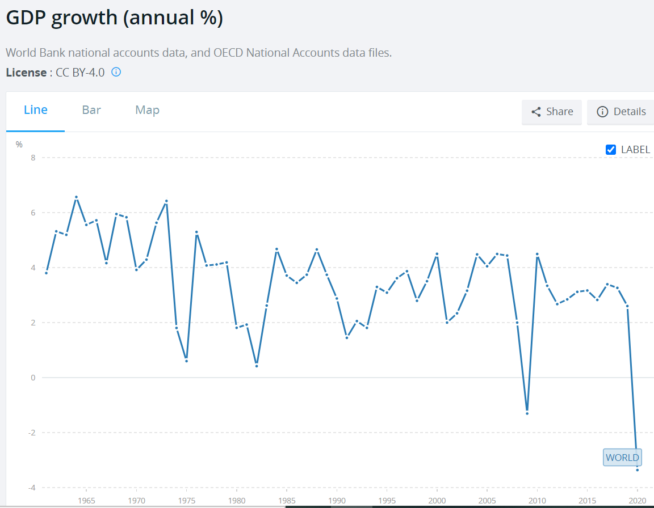
Material expansion
Higher growth
Financial expansion
World slow growth

Slide 13
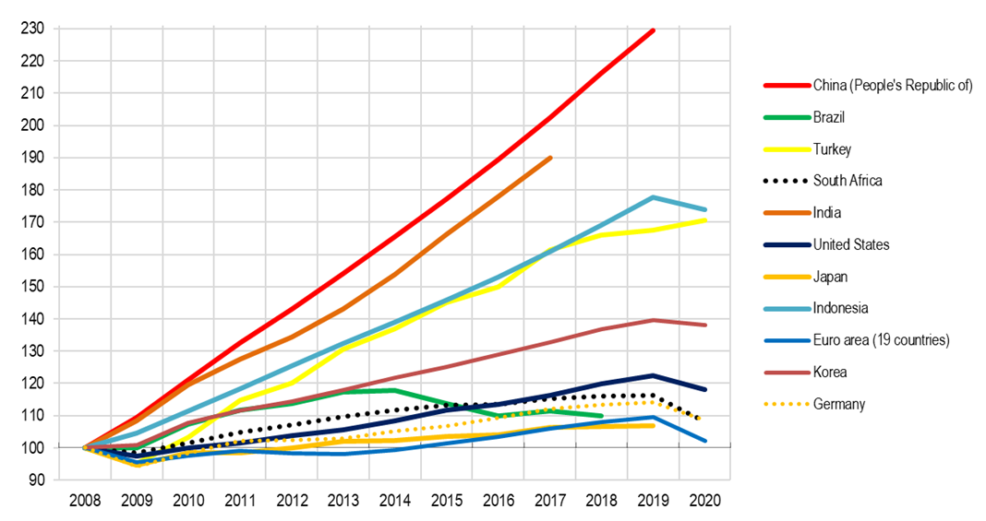
GDP trends, 2008-2020
Annual data, constant prices, constant ppps, index 2008=100 (OECD)
Relative decline of the centre (US, EU)
New locations of rapid growth
China, India, Asia as areas
of material expansion

Slide 14
Finance
Capital accumulation in money form (M-M’)
Elements: Stock markets, public debt for public expenditure, private debt of firms and households (housing mortgages, consumer debt), extension to different activities, pervasive nature
International dimension: liberalised capital flows flows to financial centres, Wall Street and City
Financial accumulation is concentrated in the centre of the world system
Less room for labour gains: higher inequality

Slide 15
Financial accumulation
Where do financial profits come from?
Extraction from productive activities and from centre-periphery relationships (Value question)
Expectation of rising asset values, attracting more capital flows in search of short term gains
Key role of monetary policy: zero inflation, expansion of money supply, free capital flows
How do crises happen? 1929 Great crash, Bubble bursting. Why rapid recovery after 2008 crisis?

Slide 16
2. Hegemony
Gramsci (within a country)
When a ruling class exercises a political, intellectual, and moral leadership, shaping the direction of change of country, organising consent rather than enforcing domination
Ideology, common world-view, intellectual and moral reform
Econ, pol structures, institutions are reshaped
Context: Liberal and Fascist Italy

Slide 17
Hegemony in world system
Intl context based on inter-State relations,weak institutions, no (democratic) political process
Power matters: consent vs domination by force
The most powerful State can shape direction of change of the world system: intl order – econ, pol – designed for its advantage
Hegemony has to create order and space for expansion of (some) other States and capitals
World system with a hegemon, a centre and periphery

Slide 18
Hegemonic cycles
Accumulation cycles develop in parallel to hegemonic cycles where:
The dominant State has an hegemonic role in the world system, obtains the benefits of accumulation and power
No “State vs Market”: the State creates the conditions for accumulation in the centre
When an hegemony ends, systemic chaos and then new order

Slide 19
Systemic chaos and wars
Current intl disorder is the decline of old hegemony and complex process of transition:
Systemic chaos (Arrighi Silver 1999)
Opening for new States/actors to challenge order
Return of wars
Use of military power/wars for short term gains by regional actors (Russia, Israel)
Risk of escalations/general conflicts/systemic challenges

Slide 20
3. Conflicts, Wars, States
What are the roots of wars and States?
Tilly, 1985, War Making and State Making as Organized Crime
Payne and Silver, 2023, Domination without hegemony
War, State and capitalism formation (Braudel)
Beyond liberal theories, geopolitics
Contexts, power, balance of forces, conflicts

Slide 21
Charles Tilly
War making and State making as organised crime, 1985, from EU history, time of Cold War, but relevant for new wars and Trump times
If protection rackets represent organised crime at its smoothest, then war risking and state making – quintessential protection rackets with the advantage of legitimacy – qualify as our largest examples of organised crime. Without branding all generals and statesmen as murderers or thieves, I want to urge the value of that analogy.

Slide 22
How do we explain war making?
At least for the European experience of the past few centuries, a portrait of war makers and state makers as coercive and self-seeking entrepreneurs bears a far greater resemblance to the facts than do its chief alternatives: the idea of a social contract, the idea of an open market in which operators of armies and states offer services to willing consumers, the idea of a society whose shared norms and expectations call forth a certain kind of government

Slide 23
What do States do?
1. War making: neutralizing their rivals outside the territories in which they have clear and continuous priority as wielders of force
2. State making: neutralizing their rivals inside those territories
3. Protection: Eliminating or neutralizing the enemies of their clients
4. Extraction: Acquiring the means of carrying out the first three activities
Plus external relations

Slide 24
Tilly on Europe’s history
Governments organize and, wherever possible, monopolize violence
War making, extraction, and capital accumulation interacted to shape European state making. Power holders did not foresee that nation states would emerge from this
Symbiotic relationship existing between the state, military power, and the private economy's efficiency in the age of absolutism. Behind every successful dynasty stood an array of opulent banking families.

Slide 25
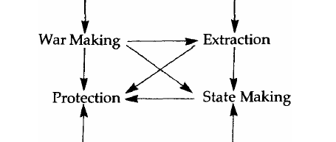
Tilly’s history of Europe
Armed power, expans
intern/external wars
Tributes, taxes, plunder
debt, war-related
To selected econ actors,
classes, growth, conflict
Centr. power, bureaucr., tax,
Support for accumulation

Slide 26
Balance State-military-society
European states built up their military apparatuses through sustained struggles with their subject populations and by means of selective extension of protection to different classes within those populations
The agreements on protection constrained the rulers themselves, making them vulnerable to courts, to assemblies, to withdrawals of credit, services, and expertise.
Democratisation mattered

Slide 27
Third world States and the military
Formed through decolonization or reallocations of territory, they have acquired their military organization from outside, without the internal forging of mutual constraints between rulers and ruled typical of Europe. To the extent that outside states continue to supply military goods and expertise in return for commodities, military alliance or both, the new states harbor powerful, unconstrained organisations. The advantages of military power become enormous, the incentives to seize power over the state very strong.

Slide 28
Lessons
Worries about the increasing destructiveness of war, the expanding role of great powers as suppliers of arms and military organization to poor countries and the growing importance of military rule in Third World

Slide 29
4. US hegemony, world system, wars
Payne and Silver, 2023, Domination without hegemony, Arrighi 2007, Arrighi Silver,1999
The case of US declining hegemony
Post-1945: US hegemony offering ‘legitimate protection’: wide econ growth, consensus, low costs of protection, stable state system, limited wars (in periphery)
Post-1990, US decline, assertion of global power →Move to ‘protection racket’: US creates threats, asks client States for tributes, payment

Slide 30
Hegemonic decline
In phases of decline, the world system is characterised by:
Econ: Slower material expansion of system Rise of finance: expanded liquid capital, more competition for capitals, more rents, highly concentrated gains, bubbles, more instability, uncertainty, inequality
Pol: challenges to hegemonic power, new regional powers, new coalitions, (local?) wars

Slide 31
Hegemonic decline
Within States of Centre, national changes:
Econ: financial capital vs real economy, concentr gains, ind decline, weaker labour, poors
Pol: breakdown of hegemonic consensus, political coalitions, weaker democracy. Alternat: restoration of power vs acceptance of decline; nat’l vs multilateral responses; rise of right
Social: end of social bloc: decline of status/income/need for protection, higher inequality, new types of conflict

Slide 32
Old hegemony
Crises and Transition
Towards a
New hegemony
World system is
shaped by econ, pol
advantage/leadership
of a State
Hegemony creates the
intl econ, pol order
allowing benefits
for Centre, expansion
of the world system
Consensus/emulation
in the Centre
Control/acceptance
in the Periphery
Hegemonic power is
eroded by:
Economic success of
other States of Centre,
more competition,
lower profits →
Accumulation crisis
State political rivalry
Social conflict in the
Centre and Perihery
Hegemonic crisis
Systemic changes,
strategies of the
old Hegemon
Systemic chaos: econ
pol disorder, wars
Centralisat/reorganiz
of systemic power
Emergence of a new
advantage/leadership
of a State able to offer
order and expansion

Slide 33
How transitions happened?
Scale of system/power
What are the key activities/functions that the Hegemon provides to the system? They expanded over time
Military power (Dutch)
Industrial production/economic power (UK)
World economy integration (US)
Reproduction od nature and society (next?)

Slide 34
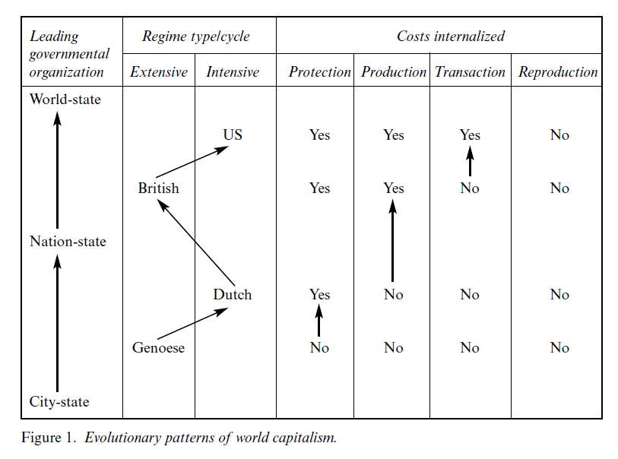

Slide 35
The reproduction of the system
Capitalism needs to create the conditions for its reproduction: accumulation has to allow the recreation of the capital and labour needed for production (otherwise it is extraction of value)
Economic: output needs demand (high wages?)
Social: labour and society have to be reproduced: family, welfare, role of the state
Environmental: natural processes have to go on, the destruction of nature destroys the system

Slide 36
The decline of US hegemony
Neoliberalism as strategy for the phase of financial expansion
Economic decline but resilient financial expansion even after 2008 crisis: can global finance last long? Prolonged decline
Politics: Weaker State power with Neolib globalisation, more power of capital, intl’ instit, recovery of intl’ power of US with diff tools
Militarisation: New Cold War 1980s, New wars 2020s

Slide 37
Key aspect 1
Finance and hegemonic transition
“The global financial expansion…is not a new stage of world capitalism ... is a sign that we are in the midst of a hegemonic crisis. The expansion ... will end more or less catastrophically depending on how the crisis will be addressed by the declining hegemonic power ... The only question ... is not whether, but how soon and how catastrophically the current global dominance of unregulated financial markets will crumble”

Slide 38
Key aspect 2
Economic/Financial vs military power
The US has an unprecedented concentration of military power but weak economic, political power
US military alliances extended (NATO, Asia etc)
But military power do not win wars
Bifurcation btw econ-pol vs mil power: how can this be managed?
Risks of war?

Slide 39
US responses to decline
Neoliberalism: power of finance, concentration of accumul, reduced opportunity for growth, inequality, less consensus
After 1990 US ‘single superpower’
Expansion of NATO to East → more US clients
1991 Gulf war, 2001 Afghanistan, 2003 Iraq: allies asked to contribute, less consensus
Paid by external debt (finance flows in US): $2,000 bn war related debt, extraction in Iraq

Slide 40
Trump’s US
Continuity of US policy
Trump 1, Biden, Trump 2
Confrontation with China: hard or soft?
Weakening of EU (NATO power, Ukraine war)
Challenge to BRICs
Change with intl order: less intl rules and more bilateral power relations
Combination of mil, pol, econ, business, tech actions for preserving power positions
Domestic conflicts: authoritarian rule?

Slide 41
Trump’s economic racketeering
90 countries with 15% tariffs (EU, Japan) UK 10%, Canada, Mexico clashes
Political fight with Brazil, India
Systemic challenge with China, negotiations
Issues: Tech, chips, Nvidia, drugs
Dollar, finance, US debt
Short term acquiescence
China patient confrontation
Long term weakening of US power

Slide 42
An age of systemic chaos
World system matters: capitalism, states, wars
Today: US hegemonic decline and the responses shape the context of conflicts: Systemic chaos
Wars: US threat of military force (intern/extern) spread of long-terms wars, Ukraine, Middle East
Politics: Instability, populism, lack of consensus
Economics: crisis, uncertainty,
What hegemonic transition and new world order?
A multipolar system?
Rise of China as new hegemonic power?

Slide 43
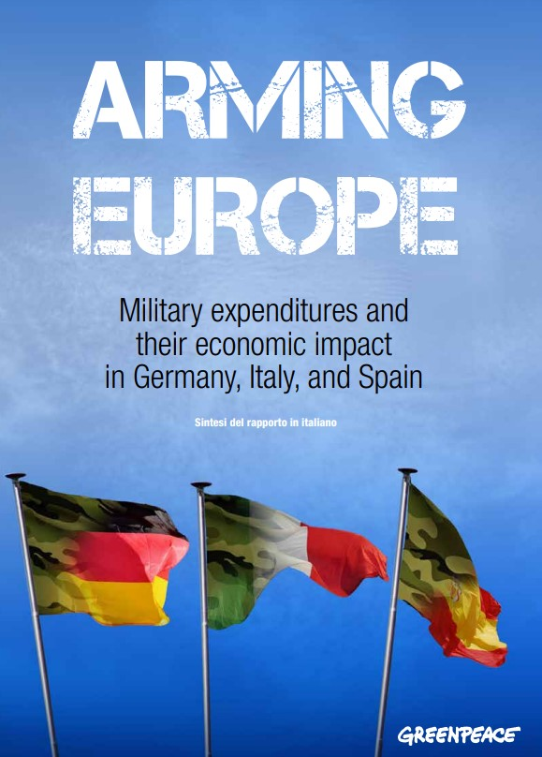
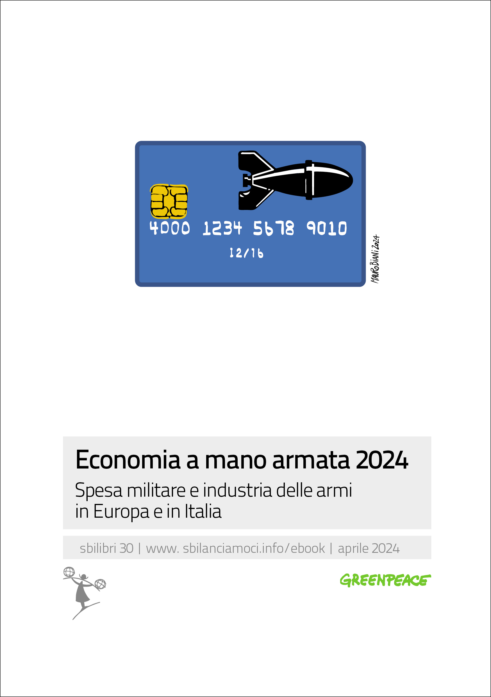
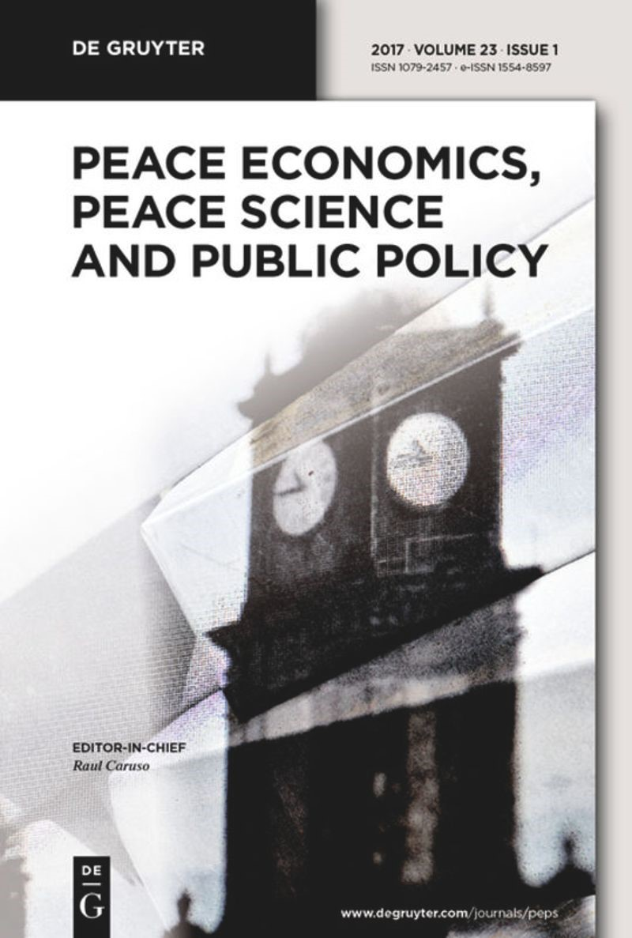
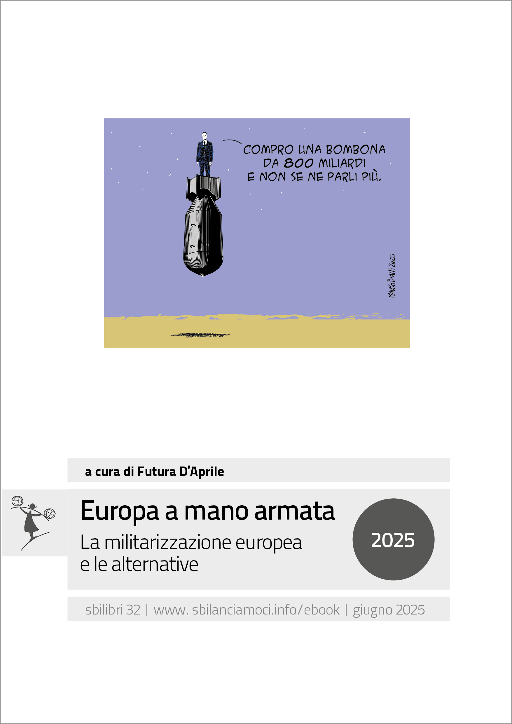
NATIONAL PHD IN PEACE STUDIES – SAPIENZA COORD.
https://phd.uniroma1.it/web/national-phd-in-peace-studies_nd4085.aspx

