Slide 1

The War System: (Dis)armaments and International Relations
Military Spending, Procurement Trends, and Deterrence Today
Francesco Strazzari –
Scuola Universitaria Superiore Sant’Anna - Pisa

Slide 2
Introduction
intensifying confrontation between the great powers, which weakened arms control and made diplomacy less effective.
Return of high-intensity warfare: Ukraine, Gaza, Indo-Pacific tensions.
Continuation of civil wars (Sudan, Myanmar)
Rebalancing of the defense industry: from peace dividend to rearmament.
Global military spending in 2024: USD 2.46 trillion (+7.4% from 2023).
How to read all this?
US hegemony challenged in an increasingly multipolar world? Transition to what?

Slide 3
Do you remember the liberal international order?
Roots: mid-1940s, US works to shape the postwar settlement in more structured, collaborative and rule-bound ways
global organizations to promote collective problem-solving, avert protectionist impulses, and stabilize the world economy
global institutions, processes, habits, rules, and norms inspired the rise of regional organizations
Core founding members include the states of North America, Western Europe and Japan; these states form a security community
Principles: Human equality, free trade/open markets, security cooperation, liberal democracy in former fascist, communist, authoritarian countries
Neoliberalism, crisis of state and society in the South and the defeat of the Soviet bloc in the East

Slide 4
70 years on, the crisis
identifiable socialization effects: incomplete but significant hints of an international community that has emerged among the order’s leading member states.
Multilateralism, humanitarian intervention, peacebuilding & stateguilding virtual disappearence of UNSC veto
Traumas: 2001 terror attacks & the war on terror, ISIS), 2008 financial crisis, 2020 Covid pandemic, 2022 Ukraine, 2023 Gaza
Problematic response tothe Arab Spring (e.g. Responsibility to protect)
the order comes under unprecedented strain, both within the societies of its leading members and from revisionist countries.
Key challengers to the order, Russia and China, initially do not seek to destroy it so much as gain additional influence in its operation (Rand Corporation 2018)

Slide 5
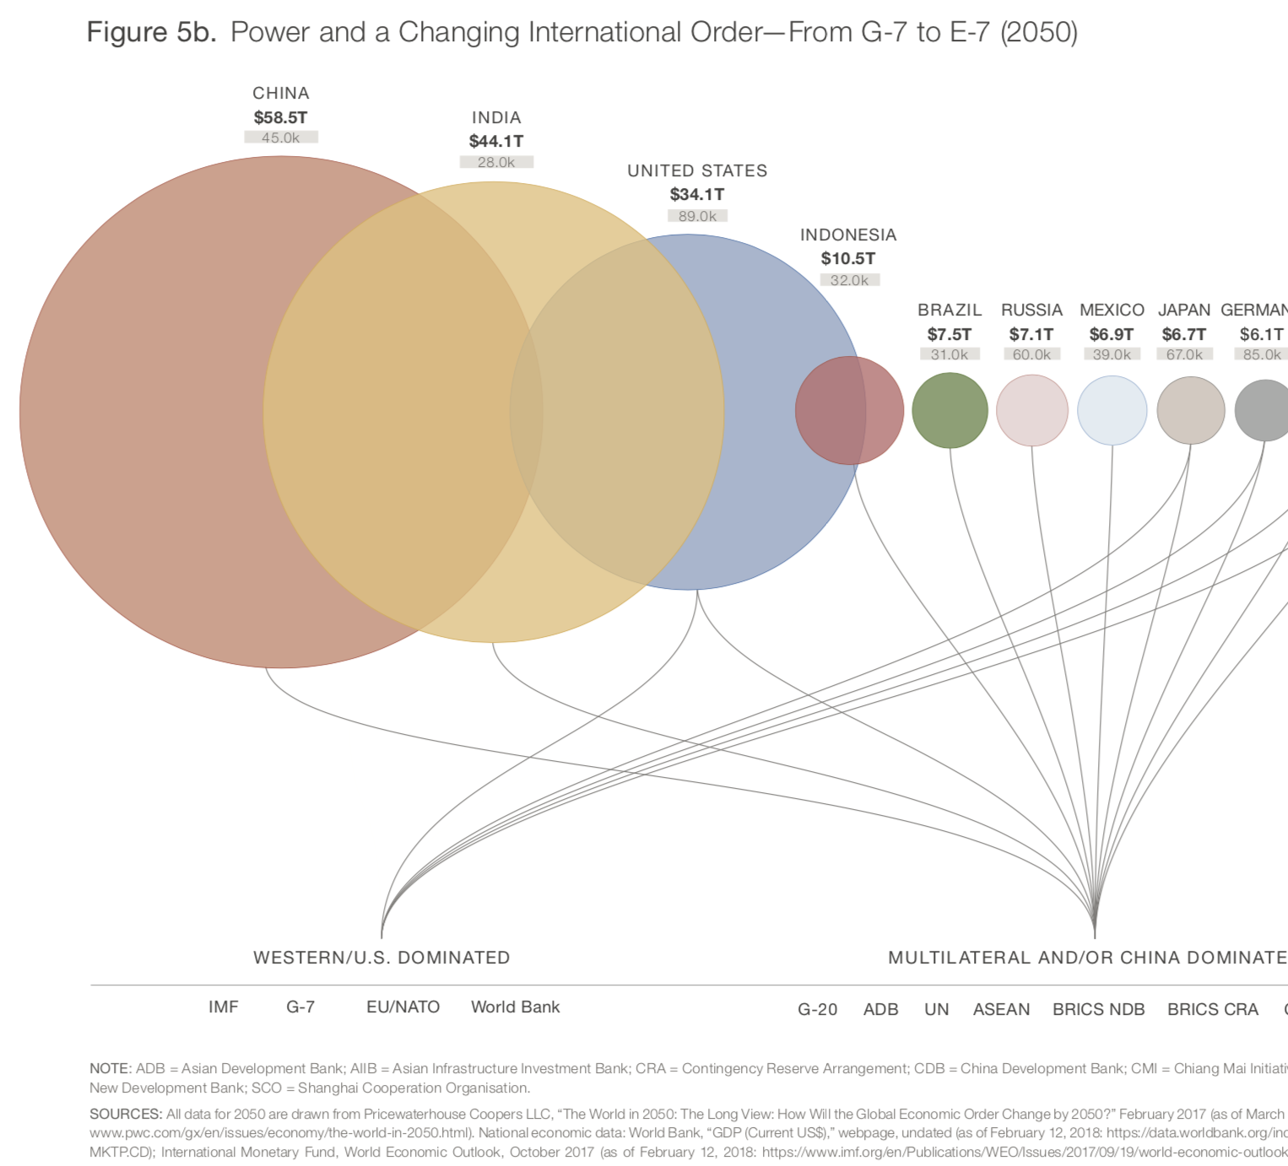
summits of the ‘Global South’: India, South Africa, Indonesia pursuing national interests while securing consensus recognition that the prevailing ‘international rules-based order’ is inadequate and unacceptable India’s refusal to play along with the collective West on Ukraine, ignoring sanctions and profit from buying Russian crude oil low, and seeking reconciliation with China China’s trade with the countries of the global south (including BRICS) now surpasses its trade with the US, EU, and Japan combined
Global multipolarity continues to take shape.
Notes:
Global South Summits: South Africa, Indonesia and India all successfully discharged their custodial duties in hosting their respective gatherings of national leaders and their delegations. «India is safe.» For now. The West needs it as a bulwark against the so-called ‘China threat’. the West’s elite have been uncharacteristically silent when it came to (1) the growing spate of religious persecution and violence in India against Muslims and Christians in particular; (2) the reality that India is home to the most slaves in the world, with estimates ranging from a low of 8 million to a high of 16 million; (3) the plight of child labourers who are found in all sorts of industries; (4) the increasing repression of media inquiry and public dissent; and (5) the persistence of lawful matrimonial rape.

Slide 6
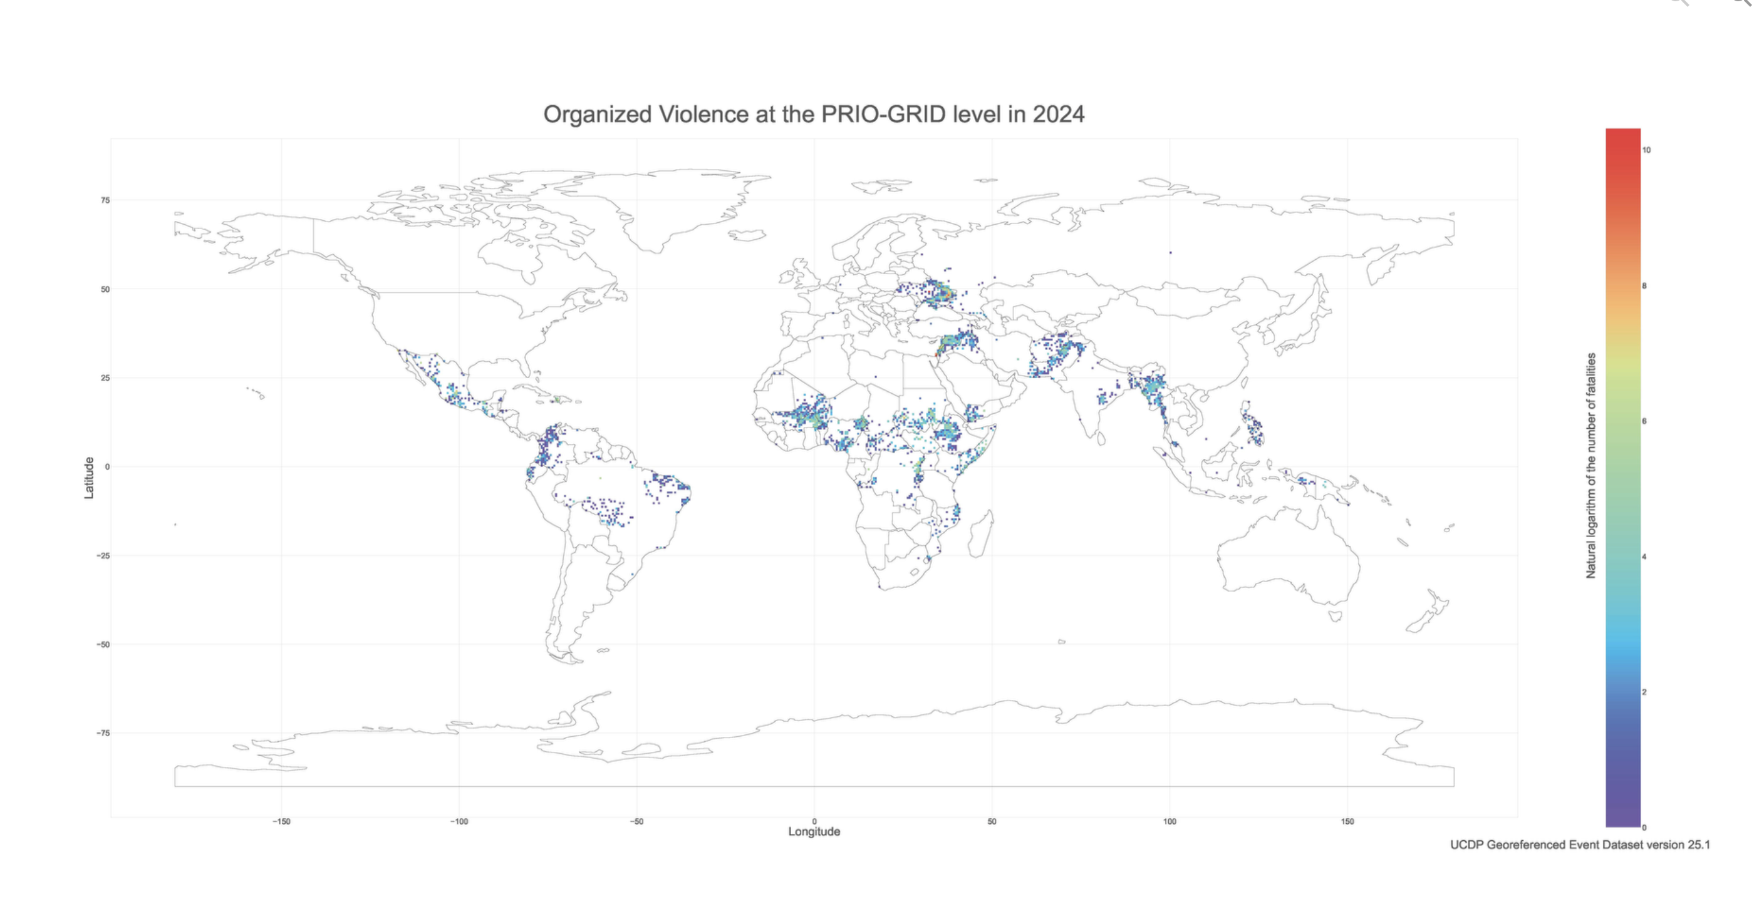
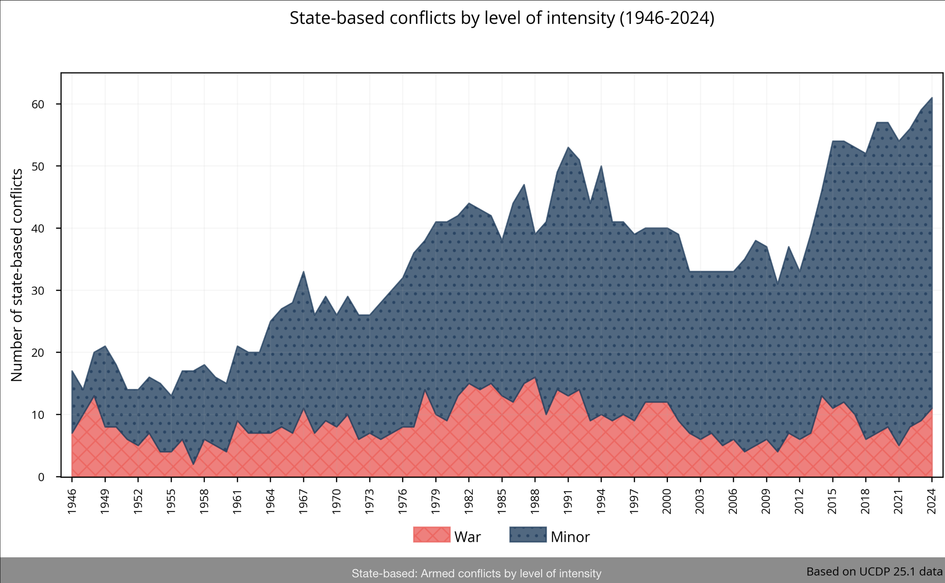

Slide 7
Global Military Spending
United States: USD 968 bn
China: USD 242 bn
Russia: USD 145.9 bn (+41.9% YoY)
Share of global GDP: from 1.59% (2022) to 1.94% (2024).

Slide 8
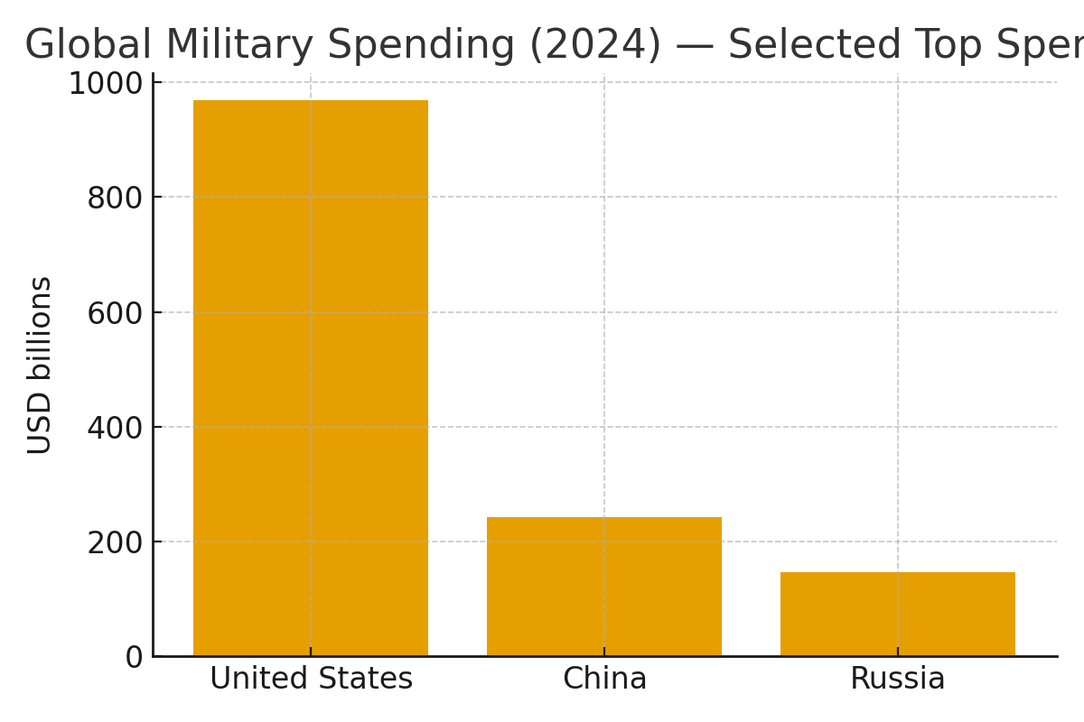
Global Military Spending — Visual
Source: IISS, The Military Balance 2025 (selected figures).

Slide 9
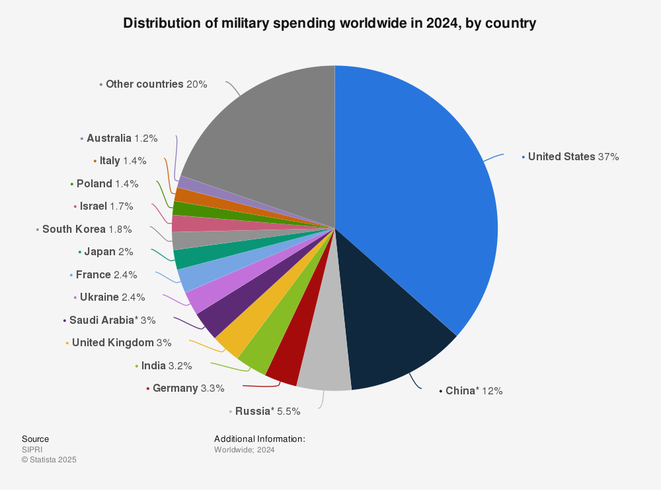

Slide 10
The Decline of Cold War Arms Control
Collapse of New START (2023–24): no binding U.S.–Russia nuclear limits remain.
INF Treaty already abandoned (2019); Open Skies Treaty unraveled (2020–21).
CTBT not ratified by key states; risk of resumed nuclear testing.
Decline of transparency & confidence-building measures.
Emerging technologies (hypersonics, AI-enabled C2, dual-capable missiles) complicate future treaties.
Looming challenge: managing multipolar deterrence (USA, Russia, China, regional nuclear actors).
Sources: SIPRI Yearbook 2025; IISS Military Balance 2025; arms control expert commentary.

Slide 11
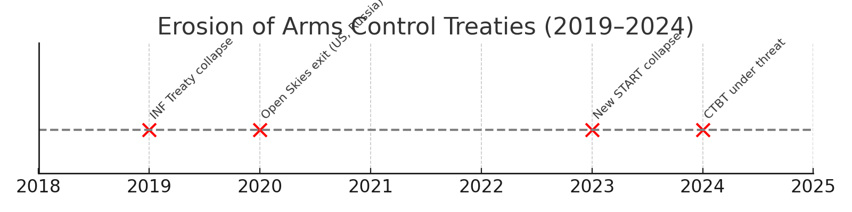
Timeline: Decline of Cold War Arms Control
Sources: SIPRI Yearbook 2025; IISS Military Balance 2025.

Slide 12
Europe Rearms
Real growth: +11.7% in 2024 alone.
Germany: +23.2% (now 4th largest).
Poland: entered the global top 15 spenders.
European aggregate spending today >50% higher than in 2014.

Slide 13
Europe’s Rearmament — 2025 Snapshot
All NATO Allies expected to meet or exceed 2% of GDP on defence in 2025.
New NATO investment concept under discussion: ~5% of GDP (3.5% core defence + 1.5% resilience/infrastructure).
EU ASAP: ramp-up toward 2 million 155mm shells/year by end‑2025; funding allocated and projects underway.
EDIS/EDIP: first-ever EU Defence Industrial Strategy to scale EDTIB capacity and joint procurement.
Industrial build-out: new ammunition plants and lines across Europe; multi-country JVs and expansions.
Sources: NATO; European Commission (EDIS/EDIP, ASAP); industry announcements (2024–2025).

Slide 14
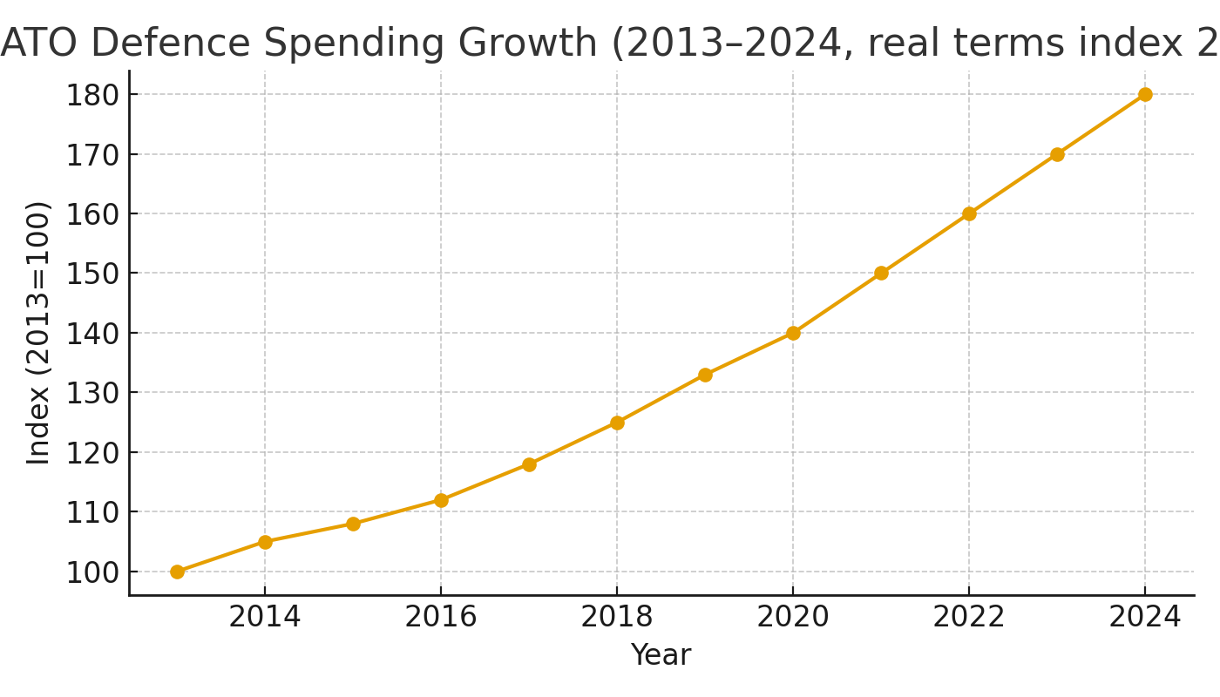
EU NATO Defence Spending Growth (2013–2024)
Source: Sbilanciamoci! Special Report 2025【44†Trends of European militarisation】

Slide 15
European Militarization Trends (Sbilanciamoci 2025)
NATO EU countries’ defence spending (2024): €346 bn – +66% in real terms vs 2013.
Increase 2023–24 alone: +17% in real terms.
Arms acquisitions absorbed ~1/3 of budgets: €77.9 bn in 2024, +223% vs 2013.
EU-level military programmes (EDF, EPF, ASAP, EDIRPA): +350% 2021–2024.
ReArm Europe / Readiness 2030: €800 bn in defence tech & industry investment.
SAFE initiative: up to €150 bn raised via capital markets.

Slide 16
Industrial Innovation
New production techniques: 3D printing, automation, robotics.
Startups like Anduril reshape procurement cycles.
Rheinmetall: 700,000 artillery shells annually (x10 vs 2021).

Slide 17
How Warfare is Changing: Drones, EW & AI
Mass, cheap, networked drones: FPV swarms for ISR, strike, and loitering missions.
Electronic warfare saturation: jamming GNSS/links; rapid counter‑UAS kill chain.
Fiber‑optic and hard‑to‑jam links extend control ranges; autonomous nav to defeat GPS denial.
AI‑enabled targeting: faster sensor‑to‑shooter cycles; auto‑identification with human on the loop.
Camouflage, deception, dispersion: signature management to survive in drone‑rich battlespace.
Logistics as target set: deep‑strike drones against refineries, ammo depots, repair hubs.
Further reading: CSIS, ISW updates, Foreign Policy analyses (2024–2025).

Slide 18
Arm races, security dilemma and escalation to war
Defensive, they risked triggering an arms race due to misperceptions, exemplifying the security dilemma
European states, particularly those bordering Russia dramatically increased military spending in response to perceived Russian aggression.
Steady increase in Chinese military spending for the 29° consecutive year: mutual suspicion and strategic rivalry (+Taiwan)
A broad multivariate analysis shows that mutual military buildups significantly increase the chances of disputes escalating to war (Sample 1998)
The effect of the pervasive realist culture (GEOPOLITICS!) in the modern state system is to affect policy choices
Sample, S. (1998). Military Buildups, War, and Realpolitik. Journal of Conflict Resolution, 42, 156 - 175.

Slide 19
Nuclear Forces Today
Estimated global stockpile 2025: 12,241 warheads.
9,614 in military stockpiles, 2,100 on high operational alert.
USA and Russia hold nearly 90% of global nuclear weapons.

Slide 20
Nuclear Modernization
United States: Sentinel ICBM, Columbia-class SSBN, B-21 bomber.
Russia: Sarmat ICBM, Avangard HGV, Borei-A SSBNs.
China: from 500 to 600 warheads in one year, 350 new silos.

Slide 21
Emerging Weapons
Multiple independently targetable re-entry vehicles (MIRVs).
Hypersonic missiles: USA, Russia, China.
Dual-capable systems blur nuclear/conventional boundaries.

Slide 22
Nuclear Sharing and Doctrines
Russia 2024 doctrine: lower threshold for nuclear use.
USA/NATO: B61-12 nuclear bombs deployed in Europe.
Debates on extending nuclear sharing to Finland and Sweden.

Slide 23
Regional Deterrence
India and Pakistan: expanding nuclear triads.
North Korea: ~50 assembled warheads, up to 90 possible.
Israel: nuclear ambiguity (~90 warheads).

Slide 24

Trends
Return of nuclear weapons: universal modernization.
Multipolar deterrence: USA, Russia, China, India? + regional actors
Entanglement: dual-use systems increase risk of escalation.

Slide 25
trends
Proliferation of new weapon systems (hypersonics, drone swarms, electronic warfare)
Undermines traditional deterrence
Space-based systems expand the battlefield beyond borders,
make escalation harder to contain
Deterrence is no longer US-Russia: China, India, Pakistan, N. Korea, Israel
Risk of entangled crises: regional wars (e.g. Middle East, South Asia, Korean Peninsula) may have global nuclear spillovers.

Slide 26
scenarios
Military balances will increasingly shape diplomacy, trade, and alliances, especially in contested regions like Eastern Europe and the Indo-Pacific
Rising defence budgets (US, China, Russia, Europe) > global system where hard power resurfaces as the main currency of IR

Slide 27

scenarios
U.S. hegemony is transforming amid growing multipolarity.
Military-industrial complex consolidation = industry lobbies increasingly shape policy
Strategic resource competition will spill into trade disputes and geopolitical rivalries
Ad hoc crisis management

Slide 28
Conclusion
Military and nuclear build-ups accelerating worldwide.
Deterrence today: less stable, more complex.
Arms control weakening: decline of multilateral governance.
Challenges: rethinking peace

