Slide 1
Conflict trends
Siri Aas Rustad
Summer School War, peace and the world order
September 30. 2025, Firenze

Slide 2
Overview over lecture
Reflect on what is conflict
Definitions
Conflict trends (statebased conflicts)
Challenges with the conflict data
Other types of conflict
Coding exercises
Battle deaths
Notes:
Aim of the lecture – to reflect around what conflict is, and what it can mean in different settings. The term conflict is used everyday in a variety if settings. However, when doing research we need to be quite specific about what it means and what it doesn’t mean.
This goes for both qual and quant. But the definitions when we use quant methods is much for rigid, which it has to be. This means that we know exactly what is included and what is not. We will discuss the benefits of this. We will also focus on some areas what becomes a bit difficult when we in particularly use quant methods
This will be a very interactive lecture as the aim to make you reflect on conflict, and not to teach you that one definition is right or wrong. The importance is to gain an understanding that different people and different researchers define conflict differently, and when we read their research (or listen to their opinions), we need to take their definition as the starting point of understand what they are saying, and not dismiss it because we don’t agree with the definition. If we don’t agree we can challenge then on their results and opinions by asking: what if we included X, what if this was the cut off point ect

Slide 3
Take away from the lecture
In order to understand research on conflict we need to understand how each researcher define conflict, and what that means for what is included and what is not included.

Slide 4
Definitions of armed conflict
Internation law:
International Armed Conflict: This occurs when two or more states engage in armed hostilities against each other. It doesn’t require a formal declaration of war or specific reasons; any armed force between states qualifies
Non-International Armed Conflict: Here, governmental forces clash with non-governmental armed groups, or such groups fight among themselves. Examples include civil wars or insurgencies
Notes:
These are the definitions of what armed conflict is in international law. It makes sense and we can all understand what it means.
However, if you are going to code this in a dataset you will see that this is not sufficient.
If you remember back from the lecture with Henrik, what are some of the features that researchers need to take into account which this definition doesn’t include?

Slide 5
UCDP conflict data
State-based conflicts​
At least 25 battle deaths (1,000 = War)​
Two organized parties of which at least one is a government​
Politically motivated (government/territory)​
Notes:
These types of rigid definitions is needed for us to run quantitative analyses. We need to know that when we add the variable conflict, all of the conflicts coded is treated in the same way, and it is not based on people perceptions. Still this type of coding of course has its challenges.

Slide 6
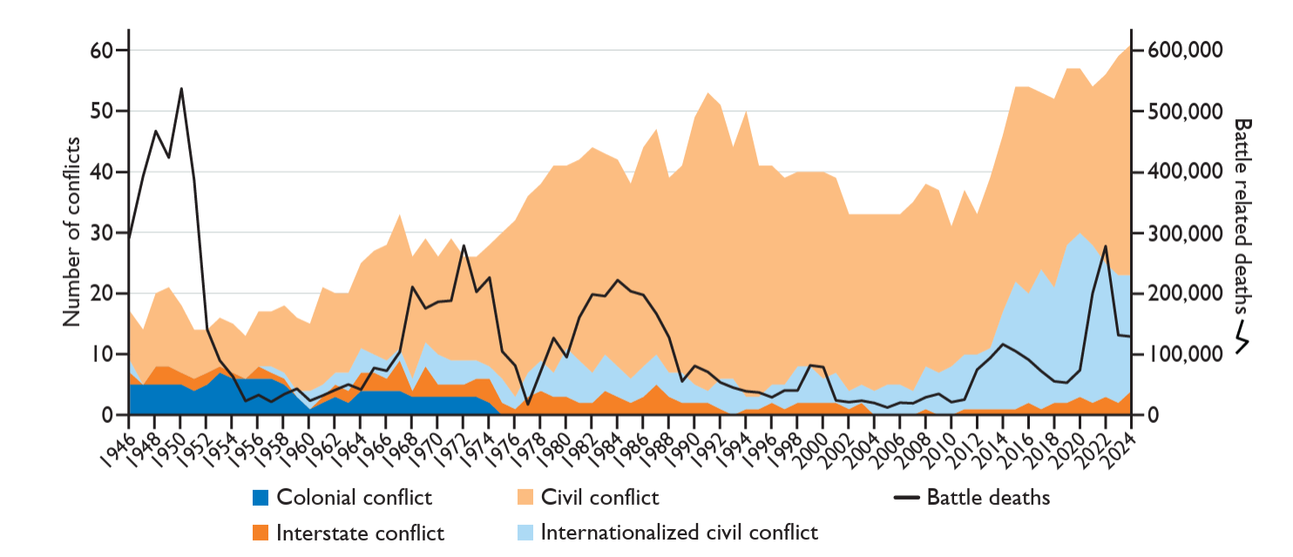
UCDP Conflict Data 1946-2024
61 conflicts
4 interstate
38 civil wars
19 int’n civil wars
Notes:
Disclaimer, these data are not public yet, will be next week, so please don’t go sharing this with the media for the next week

Slide 7
IS and JNIM conflicts
Notes:
Actor based – the increased number of conflicts when we include IS

Slide 8
Number of conflict countries

Slide 9
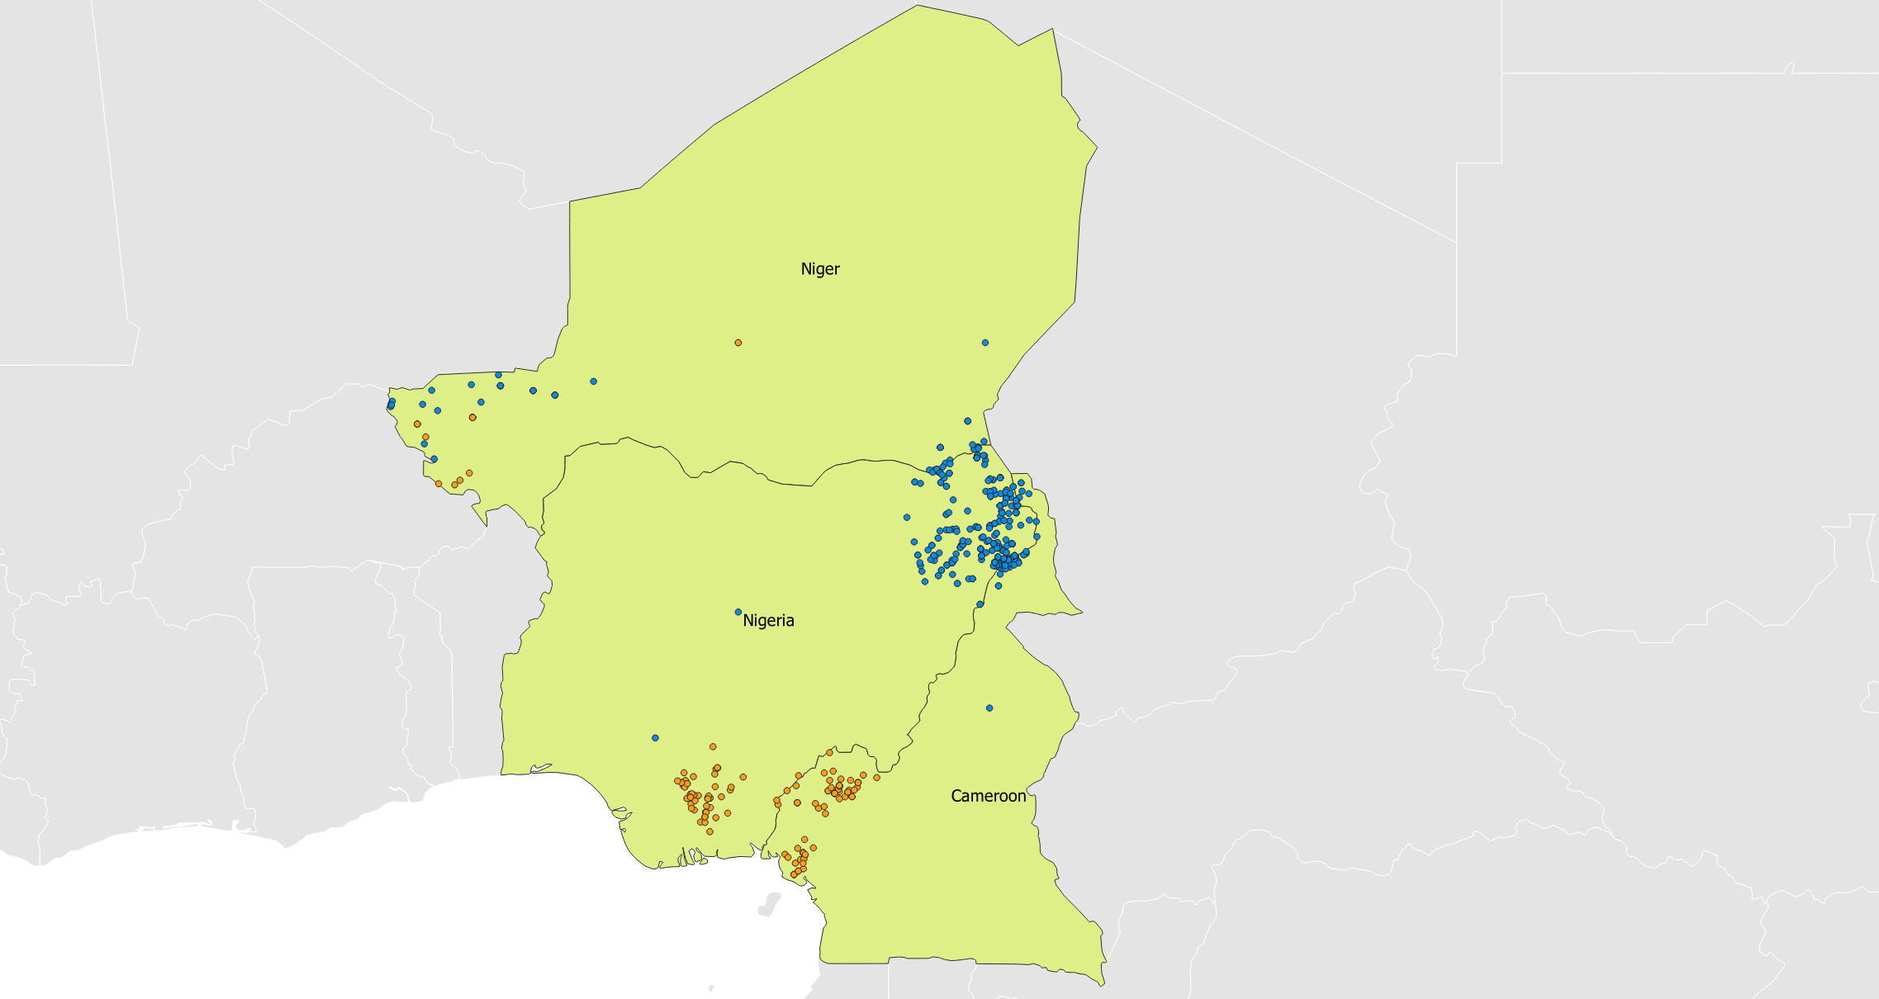
Nigeria, Niger and Cameroon 2023
8 conflicts
(13%)
5 conflicts
Notes:
Cameroon – IS
Cameroon - Ambazonia insurgents
Cameroon – Boko Haram
Niger - IS
Niger –JNIM
Nigeria – IS
Niger – Boko Haram
Nigier – IPOB (indigenous people of Biafra)
Similar in 2024

Slide 10
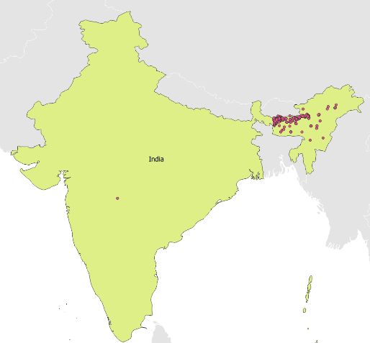
Conflict duration and ending
Notes:
The Bodoland conflict concerns the territorial status of the area north of the river Brahmaputra in Assam, situated in northeast India. Separatist demands have been fuelled by demographic changes and a sense of economic, political and cultural marginalisation among local tribal groups. The conflict emerged in 1989, when ABSU (All Bodo Student Union) launched an insurgency. ABSU later signed a peace agreement with the government, but the conflict was restarted by NDFB (National Democratic Front of Bodoland) in 1993. Fighting between the NDFB and the Government of India persisted for over a decade until the two sides signed a ceasefire in 2004. Fighting broke out again in 2009, 2010 and 2013 between Indian Security forces and two different factions of the NDFB.
How do we measure conflict onset, incident, ending, occurrence and duration
2 – year lull?

Slide 11
Other types of conflict

Slide 12
Non-state conflicts
Use of armed force between two organized armed groups, neither of which is the government of a state, which
At least 25 battle-related deaths in a year
Three types of NSC
There is no requirement for an incompatibility in the non-state conflict data

Slide 13
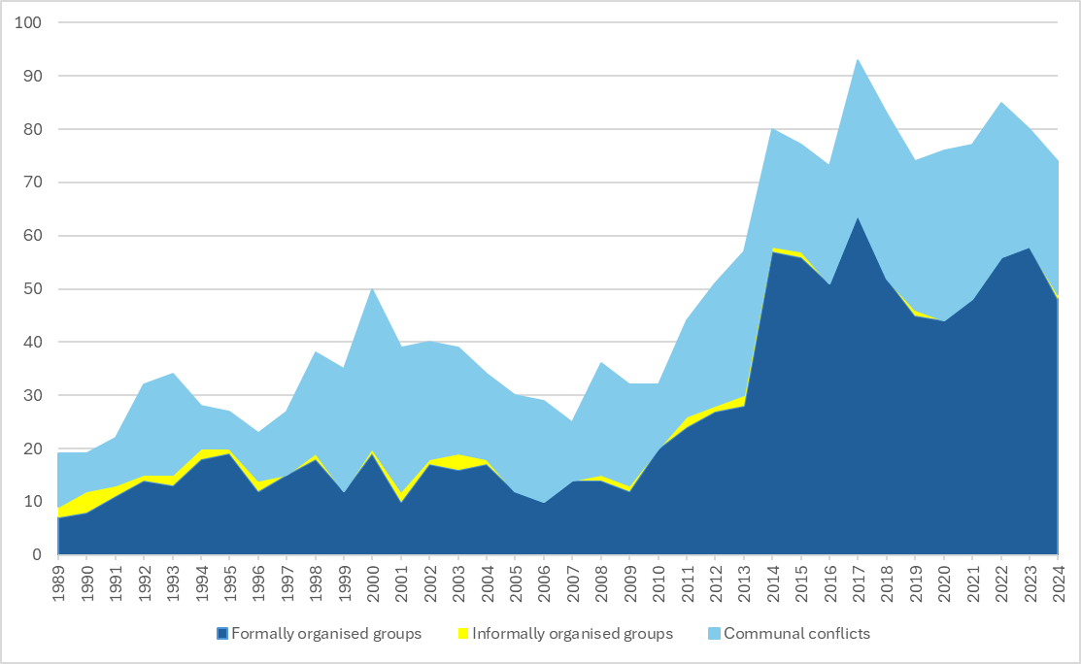
Non-State Conflicts

Slide 14
One-sided violence
Use of armed force by the government of a state or by a formally organized group against civilians
At least 25 deaths.
Extrajudicial killings in custody are excluded.

Slide 15
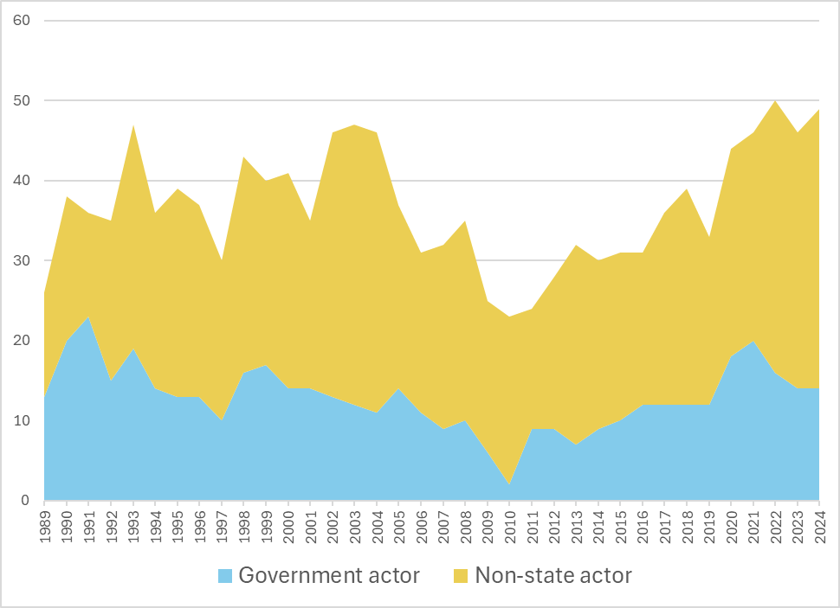

Slide 16
Where are the conflicts?

Slide 17
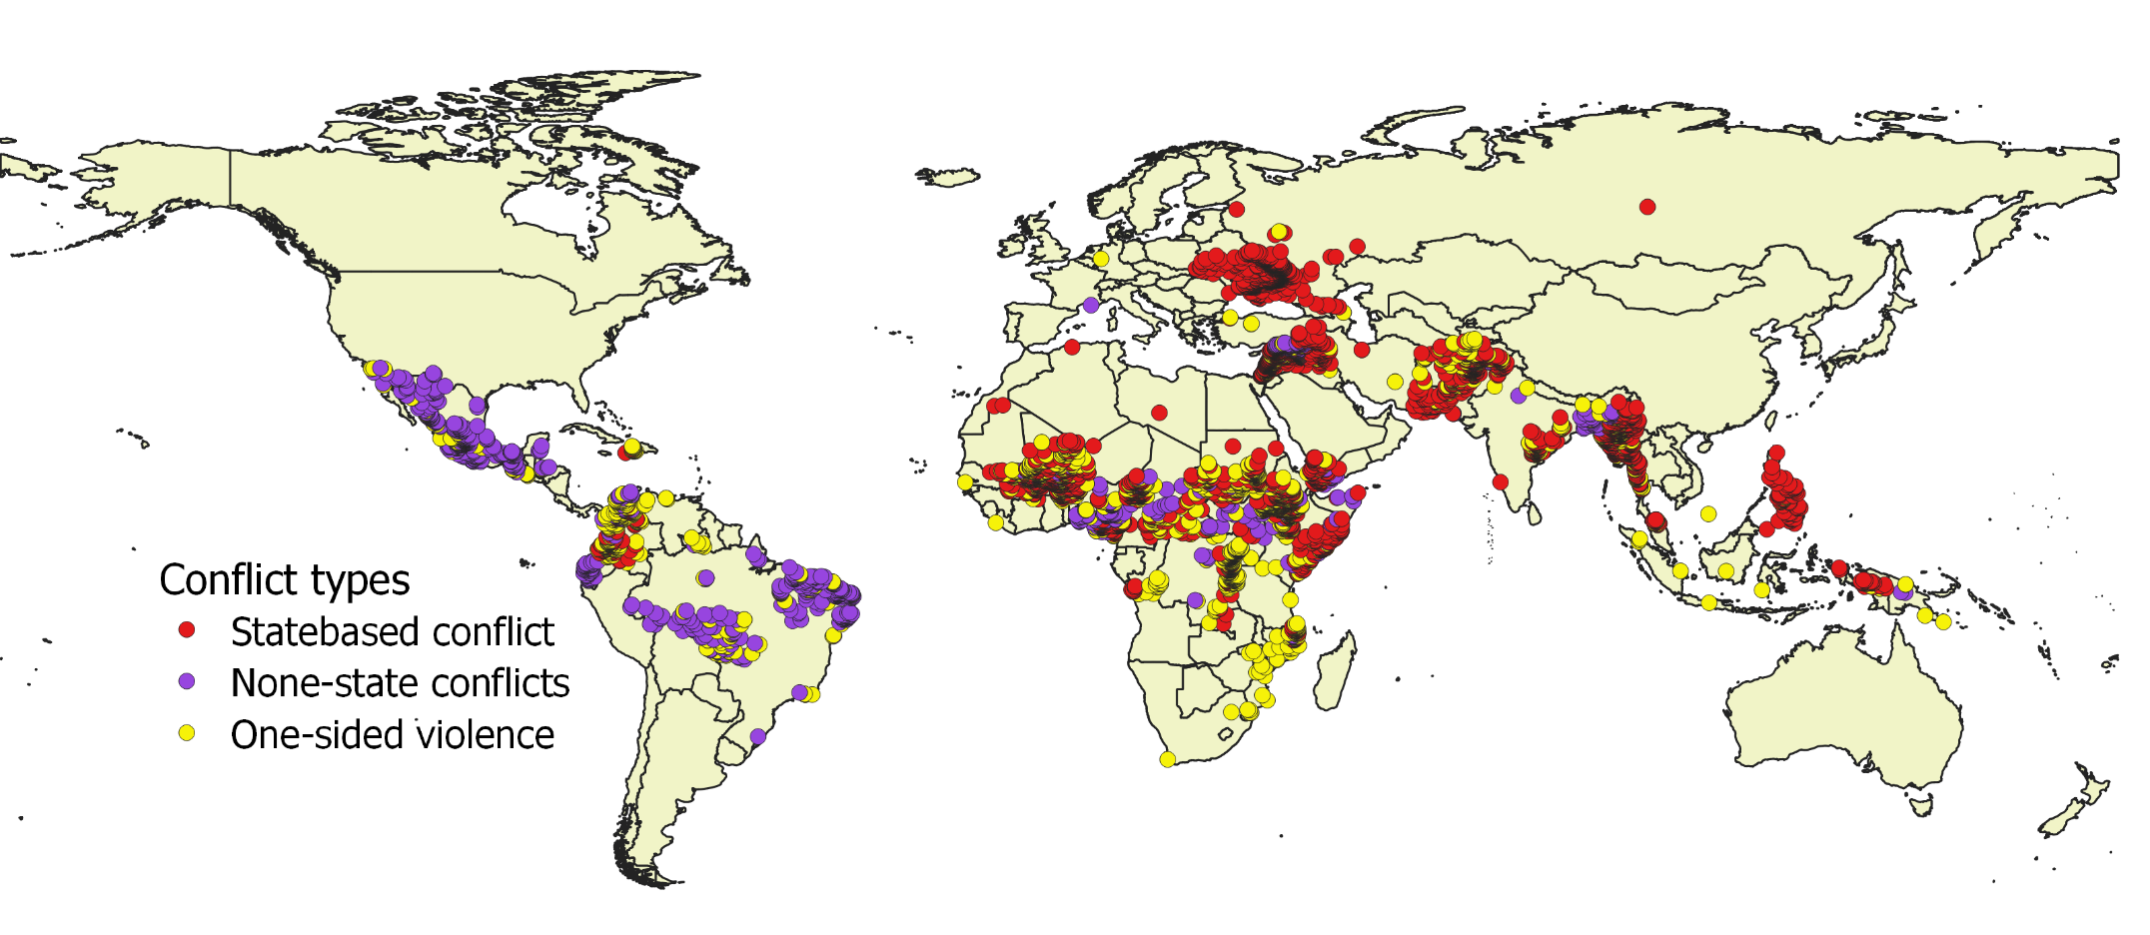
Conflict events 2024

Slide 18
Conflict exposed population

Slide 19
People exposed to conflict

Slide 20
Exposed people intensity I

Slide 21
Exposed people intensity II

Slide 22
Concequenses

Slide 23
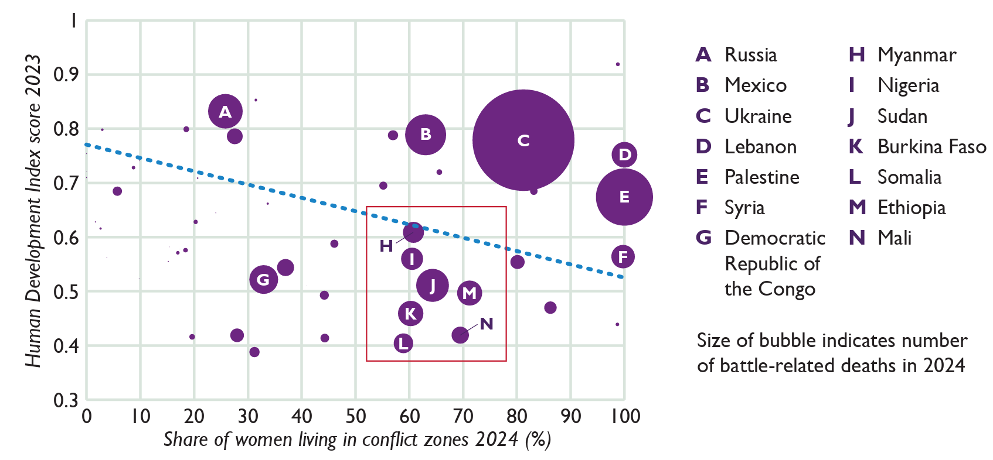
The forgotten conflicts

Slide 24
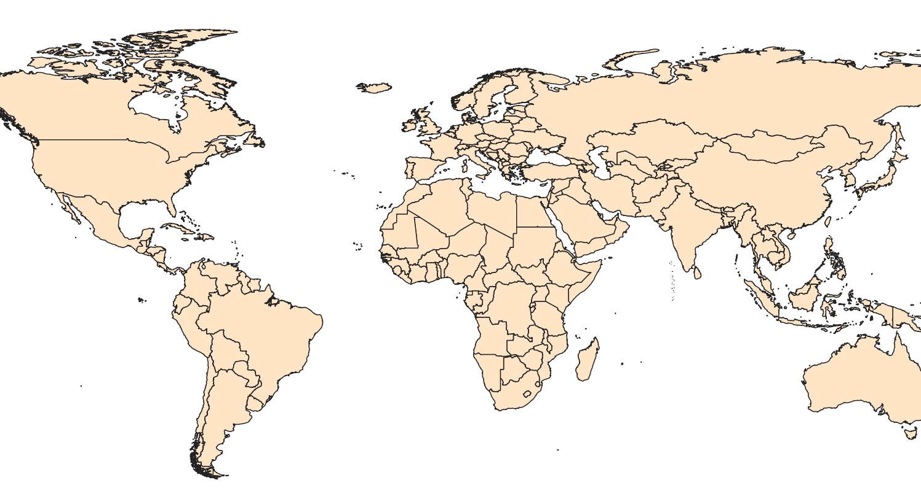
International conflicts 2025

