Slide 1
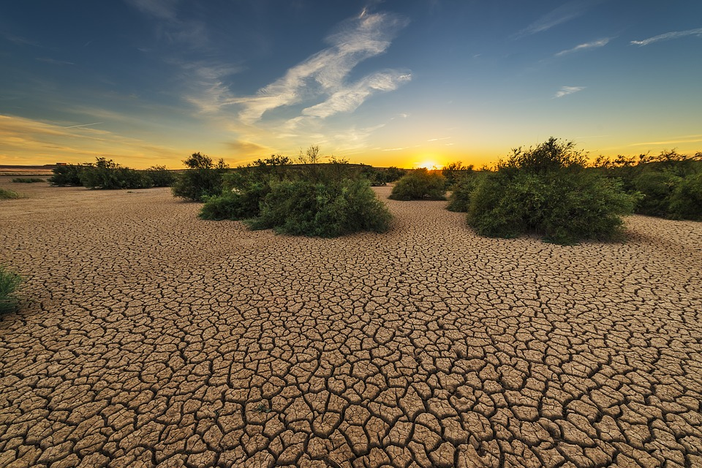
Climate security and African conflicts:
a problematic nexus with policy implications
War, Peace and World Order
SNS, 1/10/25
Luca Raineri
Sant’Anna School of Advanced Studies

Slide 2
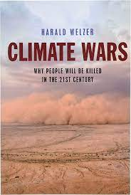
The climate-security nexus narrative
“Many conflicts are triggered, exacerbated or prolonged by competition over scarce natural resources; climate change will only make the situation worse. That is why protecting our environment is critical to the founding goals of the United Nations to prevent war and sustain peace”
(Antonio Guterres, cited in UNEP 2017).

Slide 3
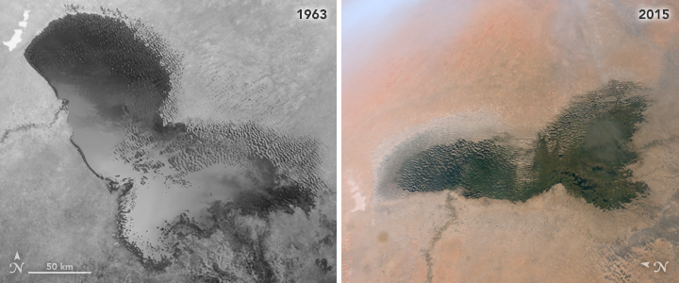
A compelling case?
“The Lake Chad Basin region is a clear example of this; indeed, a large part of the conflict, beyond the Islamic terrorist factor, has been fuelled by migrations forced by climate change. The same is true with the success of Boko Haram in the region and the change of use of certain lands in north-eastern Nigeria. We are therefore very clearly seeing in these areas the consequences for insecurity — and, in a way, for the emergence of new conflicts — of a climate agenda that has gotten out of control” (Emmanuel Macron, 2021)
Notes:
A case in point is the Lake Chad climate security narrative. It suggests that Lake Chad has been drying, shrinking and even disappearing; that this is attributable to global anthropogenic climate change; and that this has been a significant causal or contributory factor in the on-going security crisis. This narrative has been advanced by heads of all four of the states bordering Lake Chad, by the African Union; by the key regional institution, the Lake Chad Basin Commission (LCBC); by Barack Obama, John Kerry, Emmanuel Macron, by UNSGs Ban Ki-moon and António Guterres, e da molti think tanks.
Iconic image taken from NASA satellites of the lake chad shrinking appear to provide ample illustration of the impact of climate change on fragile sahelian environment, and contribute to shaping the imaginary that underpins the climate security narrative
The idea that terrorism and climate change are some­how connected is a seductive one. It offers interna­tional donors the opportunity to kill two birds with one stone by addressing jointly what are arguably the most pressing issues facing the international community, thereby overcoming political divides. And it provides local governments with a narrative that depoliticises conflicts and downplays their own responsibilities.

Slide 4


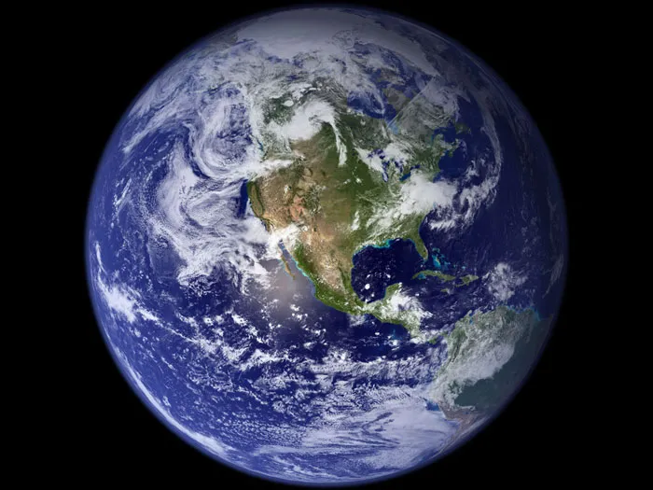
The genealogy of the climate-security narrative (I): the 1960s
Notes:
Satelliti geostazionari cominciano a andare in orbita since 1964 (7 anni dopo sputnik).
secondo Hans Blumemberg la visione della terra dallo spazio rende finalmente la Terra ri-conoscibile. Fino a prima era sempre stata invisibile, essendo sotto i piedi anziché davanti agli occhi era ovvia e inavvertita. Mancava appunto la negazione come condizione di appariscenza: la terra vista dallo spazio, un’isola blu in un oceano di nulla. È quindi un “miracolo di eccezione, l’unico pianeta blu nel mezzo del deludente deserto celeste”, che finalmente appare ai suoi abitanti come oggetto di pregio, pieno di vita e di valore.
Secondo Vegetti (L’invenzione del Globo, Einaudi 2017), pensiero proto-ecologista e quello ecumenico-umanitarista devono molto a diffusione di immagini della Terra diffuse dallo spazio, specie via riviste di controcultura americane di quegli anni. Pensiero verde e pacifista, basato su visione olistica del mondo, “per costruire comunità animate da una nuova coscienza etica post-nazionale. Su questo vedi anche Jasanoff, S., ‘Image and imagination: The formation of global environmental consciousness’, In: Miller, C. and Edwards, P. (eds.), Changing the Atmosphere: Expert Knowledge and Environmental Governance (MIT Press: Cambridge, MA, 2001.
rivista “Whole Earth Catalog”, pubblicato since 1968 (!), e molto diffuso in avanguardie californiane anni ’60 e ’70 (per scambio di stili di vita, Steve Jobs la definirà prototipo di google). Secondo numero pubblica in copertina immagine Earthrise, che esprime idea di ricerca di condivisione e sostenibilità sulla terra fragile.
in dicembre 1972 si diffonde moltissimo famosa immagine della Terra scattata da Apollo 17, la cosiddetta Blue Marble, una delle foto più diffuse al mondo (insieme a rising flag iwo jima, marylin monroe windy skirt, che guevara.
Nota che in 1968 Sweden esprime per la prima volta idea di fare conference on environment (anche per overcome divisioni e stalmate di guerra fredda: Sweden era paese neutrale, e in divisioni ci ha già perso un hammerskjold). E alla fine conferenza si realizza in 1972 (cioè in piena crisi petrolifera), con slogan Only One Earth. Sebbene si manifestino subito conflitti, legati a partizione globale di guerra fredda – paesi est boicottano con non-invito a germania est, cina protesta per presenza sud vietnam e sud corea, india contesta principio di limiti allo sviluppo
A proposito di movimenti ecologisti e pacifisti, in 1971 nasce a Vancouver Greenpeace.
The Club of Rome is a nonprofit, informal organization of intellectuals and business leaders, founded in 1968 at Accademia dei Lincei in Rome, su iniziativa di industriale Aurelio Peccei (studia economia a UNITO, in anni in cui arguably ci insegnava Einaudi; partecipa a resistenza; diventa dirigente FIAT, poi in 1964 amministratore delegato Olivetti) e Alexander King, direttore scientifico di OECD, organizzazione votata allo sviluppo!. Commissionano a MIT un rapporto sui limiti della crescita, che usa early capacity of computer modelling, pubblicato a March 1972, pochi mesi prima di conferenza Stoccolma. They examined the five basic factors that determine and, in their interactions, ultimately limit growth on this planet – population, agricultural production, non-renewable resource depletion, industrial output and pollution. Rapporto sarà poi molto criticato da Amartya Sen. Oggi fanno parte di Club un centinaio di esperti, fra cui in Italia Gianfranco Bologna (ex presidente WWF) e Vincenzo Fioramonti (ex ministro università). Co-presidente è una filosofa argentina allieva di Borges.

Slide 5


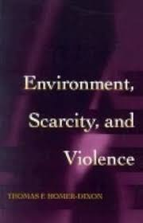
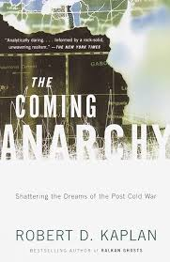
The genealogy of the climate-security narrative (II): the 1990s
1987 UNGA report Our Common Future (Bruntland report) articulates “environmental security”
1990 1st IPCC report in 1990
1990s Early research programmes on climate and security (Homer-Dixon, Dalby)
1992, UN Conference on Environment and Development, Rio de Janeiro
Adoption of key UN conventions: FCC, CBD, CCD
Notes:
Sebbene approccio di determinismo ambientale sia ampiamente screditato in accademia, rimane – proprio per via di sua semplicità – grande successo di pubblico e di policy impact up to date, come dimostra popolarità di teorie di Jared Diamond (Armi Acciaio e Malattie, molto determinista su differenze di sviluppo fra europa e resto; ma che anche riporta conflitto in Rwanda a de facto conflitto ambientale per risorse) o di Geoffrey Sachs (The End of Poverty, e nota che anche Mark Bassin considera Sachs come reinterprete contemporaneo di teoria deterministiche della natura, già sollevate da early geopolitics). Nota libro di Homer-Dixon published by princeton UP.

Slide 6

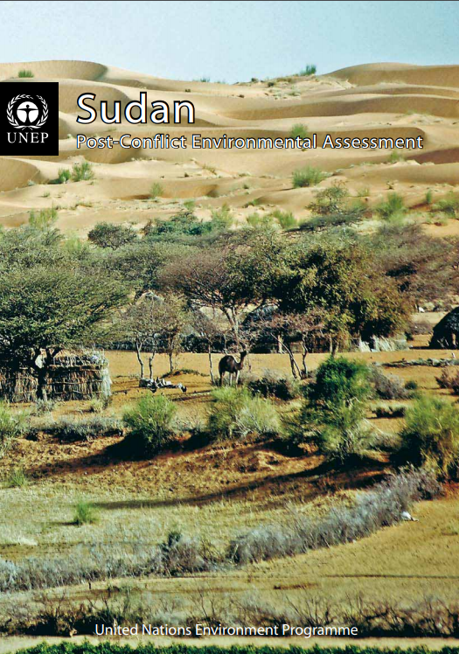
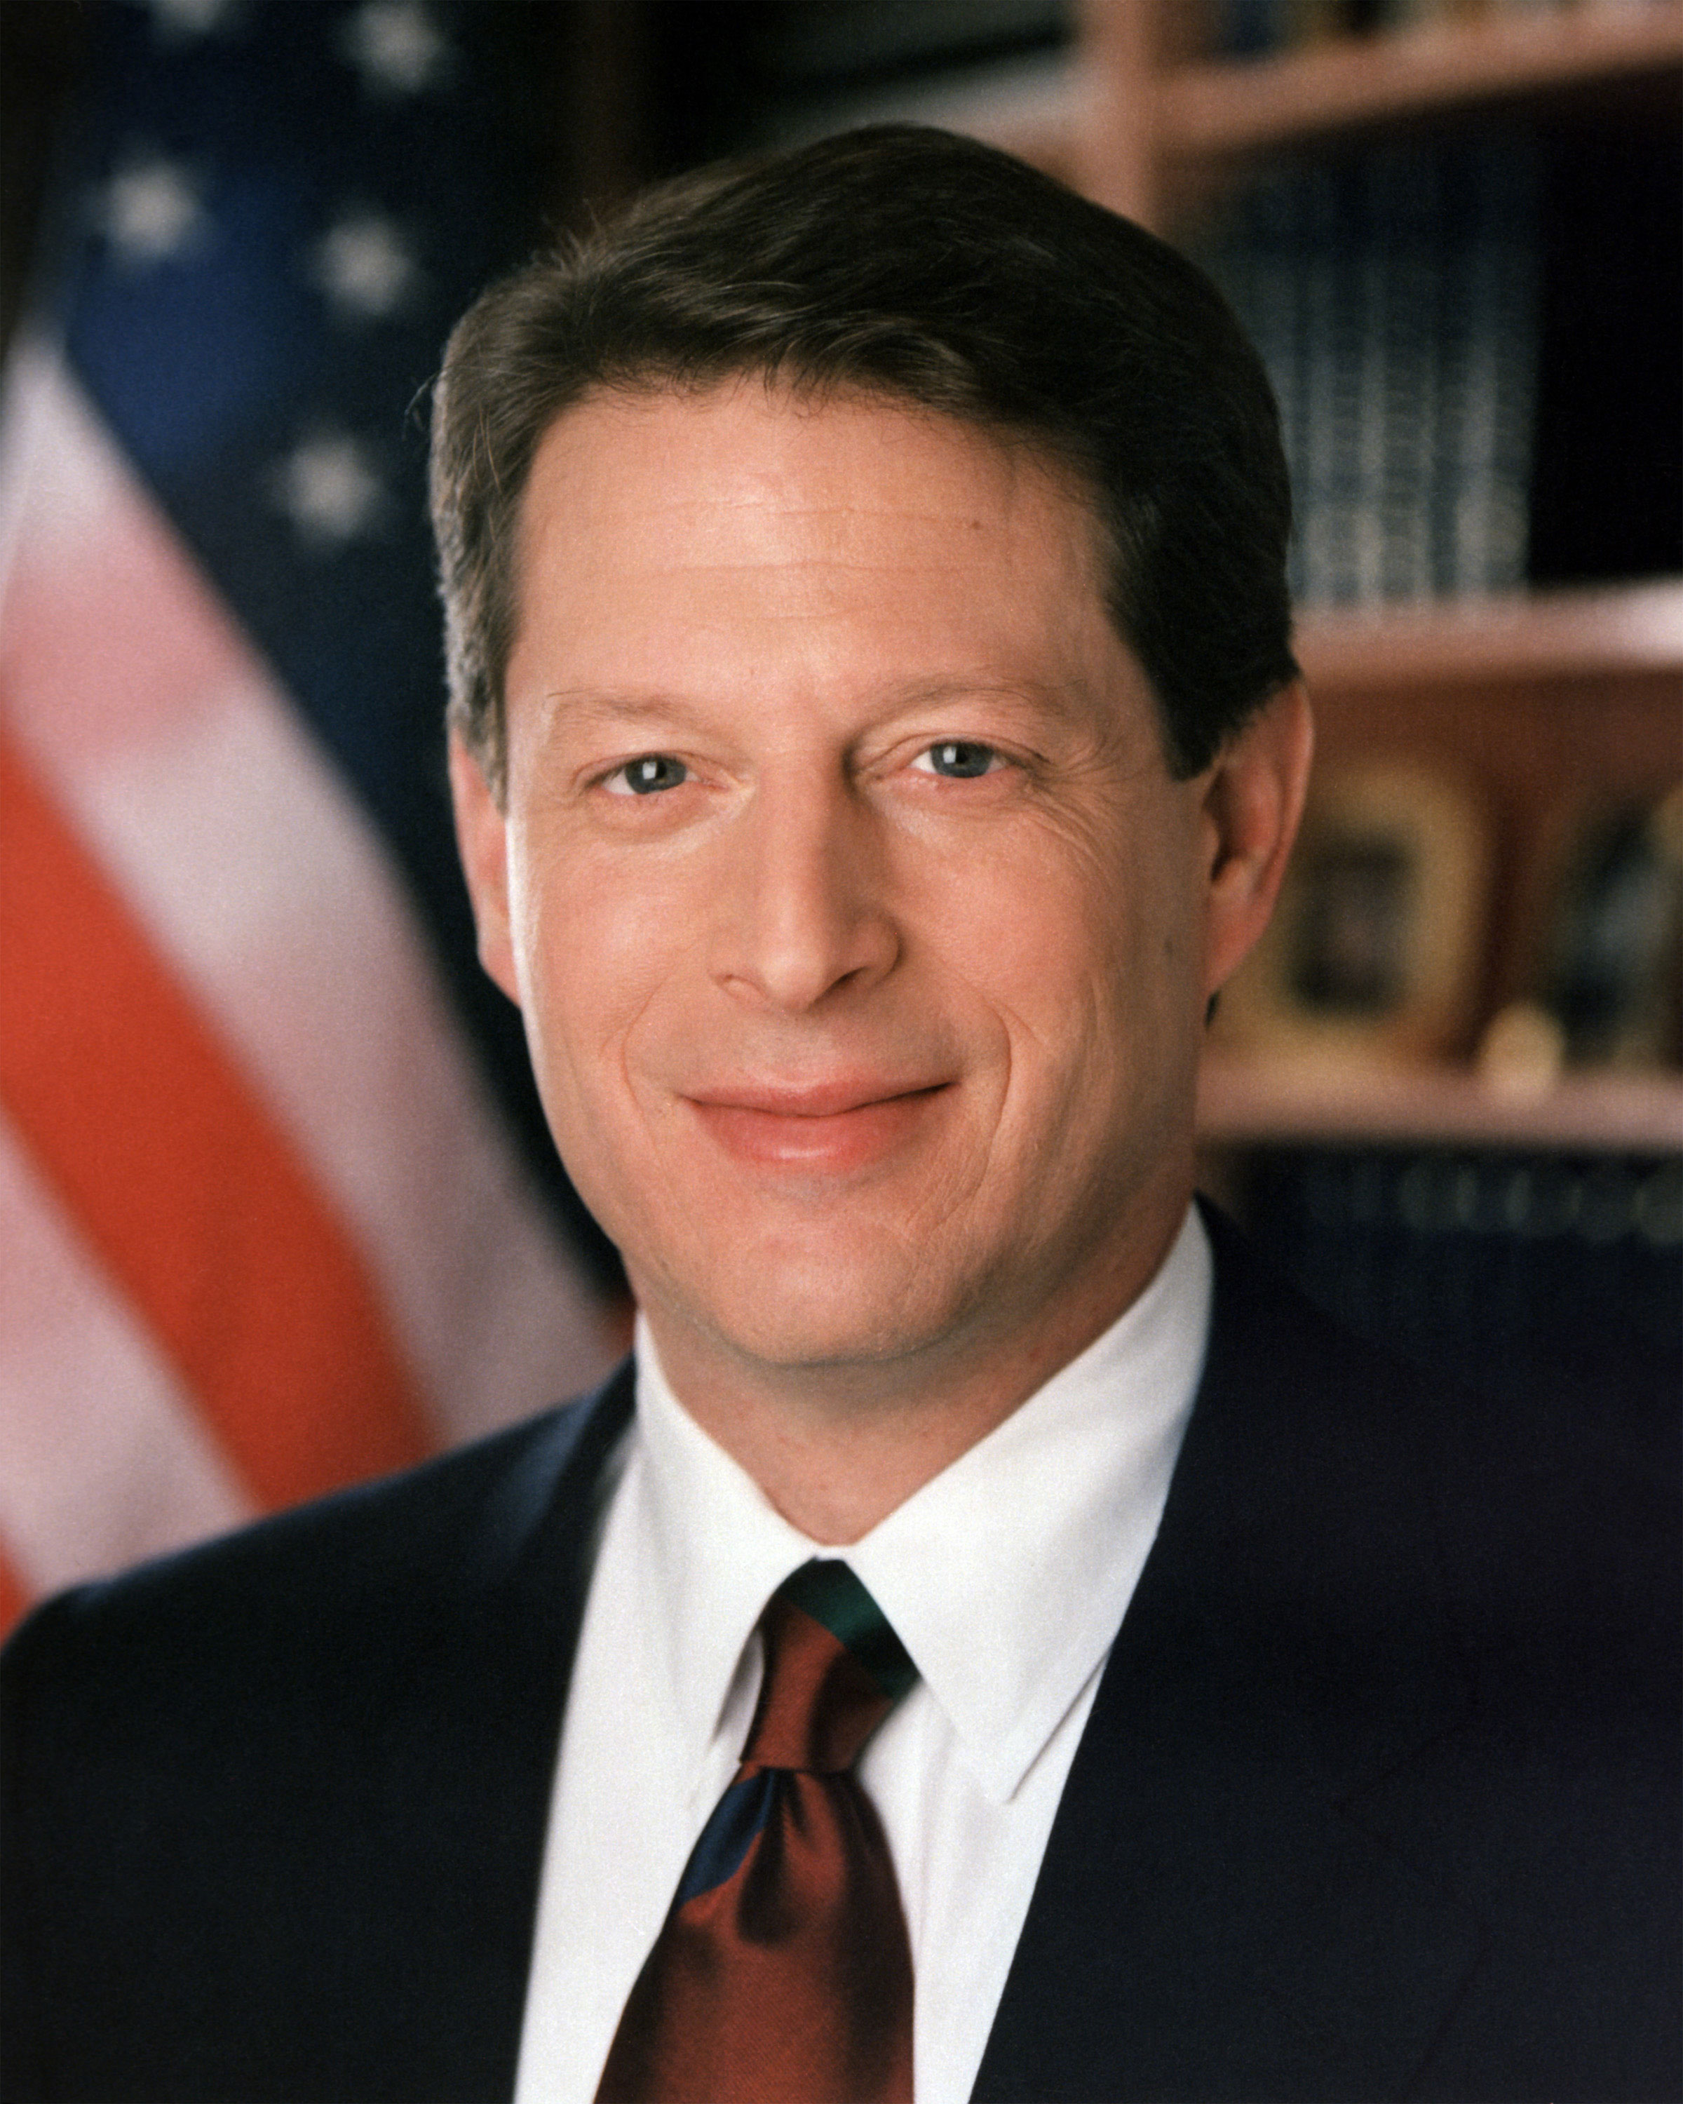
The genealogy of the climate-security narrative (III): the 2000s
Notes:
But 2007 turning point: british FCO Margaret Beckett, the one who famously argued that “a failing climate means more failed states”, in April UK ha rotating presidency di UNSC, e promuove an unprecedented UNSC debate on the subjects of climate change, energy supplies and security.
In June 2007 esce UNEP report suggesting that the conflict in Darfur had in part been driven by climate change and environmental degradation, stating that “there is a very close link between land degradation, desertification and the conflict in Darfur”
in October 2007: Nobel peace price per IPCC e Al Gore of An Inconvenient Truth.
Nota che wave of securitization of climate-change in 2007 è anche perché a Novembre 2007 c’è COP meeting di UNFCCC che per la prima volta comincia a discutere il post-kyoto, due to expire in 2012. E quindi c’è increasing urgency to take action. In tutto processo c’è forte pushbacks by african countries, che essenzialmente demand loss and damage compensation mechanisms.
Apex of the decade is Resolution 63/281 (2009), in which UNGA ‘[i]nvite[d] to intensify their efforts in considering and addressing climate change, including its possible security implications’ – introduces threat multiplier framework

Slide 7
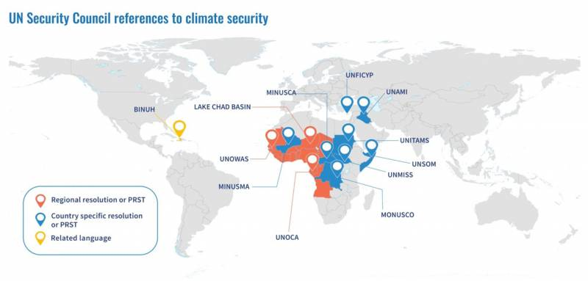
Notes:
Initially african countries were quite reluctant to endorse the climate security narrative, and were instead more focused on demanding loss and damage compensation mechanisms. That’s very clear if one reads the delcarations made in the subsequent UNSC and UNGA debates on climate and security which happened in the subsequent years.
But then things changed, and african countries eventually appropriated this narrative. To the point that in 2021 Niger, recently elected at UNSC, was among the main proponents of the 1st ever general thematic resolution draft on Climate Change and Security, alongside UK and Ireland; rejected (Russia and India against, China abstains).
Why has this changed occurred? One hypothesis suggests that the focus on environmental drivers of insecurity can (more or less inadvertently) promote a depoliticised understanding of conflict situations and divert attention from the responsibility of domestic political actors. As sholars have aptly stressed “making nature [i.e. climate change] the villain” provide elites with a convenient narrative to normalize the harm and injustice to which they give rise. It has been used by African leaders to deflect blame for their deeds (Brown et al. 2007), and by leaders in the Global North to rationalize, prolong, repurpose and legitimize counterinsurgency interventions abroad (Duffy 2016; Charbonneau 2022).

Slide 8

The climate-security nexus, in essence: the scarcity argument
Climate change
Environmental degradation
Sustained population growth
Unsustainable livelihoods
Increasing competition to access dwindling natural resources
Conflicts exacerbation and radicalization
Notes:
allude to a common argument, that environmental security scholars have dubbed the “scarcity” argument. According to this view, worsening climatic trends (often compounded by other environmental stressors, such as demographic growth and/or unsustainable livelihoods) contribute to the progressive depletion of valuable natural resources on which people's livelihoods depend. Increasing resource scarcity exacerbates competition, which could escalate and lead to violent conflicts.

Slide 9
Scarcity: interrogating the mechanism
What is scarcity? A relational approach
What is the correlation between scarcity and climate change?
Notes:
La "rareté" ne fait pas référence à une quantité objectivement limitée de ressources, mais plutôt à une situation dans laquelle certains individus ou groupes ont moins que d'autres (socialement), ou qu'ils n'ont dans d'autres endroits (spatialement). Par exemple, la « malédiction des diamants » a souvent été associée à la guerre civile dans des pays comme l'Angola et la Sierra Leone, mais l'"abondance" locale dans ces pays n'existe que par rapport à la "pénurie" mondiale et, dans cette mesure, tous les conflits liés aux pierres précieuses et aux minerais sont autant liés à la pénurie qu'à l'abondance. Le défi n'est donc pas tant de comprendre si c'est la rareté ou l'abondance des ressources qui est la plus associée aux conflits, mais plutôt de traiter ces deux concepts comme étant essentiellement appariés - "rareté-abondance" Vedi conflitti per oil in middle east, che non esistevano finché oil non aveva valore economico fondamentale. Si la rareté-abondance est un facteur causal important dans les conflits, ce n'est pas parce qu'elle détermine mécaniquement les comportements, mais dans la mesure où elle est jugée et interprétée comme importante par les parties au conflit...
Correlation: climate change can sometimes lead to more rainfall: vd caso regreening sahel. scarcity main well not depend on climate change: vd lake chad, o syrian case
the overall agricultural output of Sahelian countries has significantly increased in recent years, keeping pace with (and often exceeding) the sustained population growth of the region. In in the Mopti region, for instance, cereal production has tri­pled over the last 15 years. These observations contribute to questioning the idea that environmental degradation interacts with popu­lation growth to fuel conflicts over access to dwin­dling resources.

Slide 10

Scarcity: problematizing the framing
Referent object = fragile states: https://gain.nd.edu/our-work/country-index/rankings/
Fear of vulnerable becoming dangerous
Orientalist clichés
Detracts attention from responsibilities of the Global North and fossil fuel-based capitalism
Notes:
Climate security literature reproduces Orientalist images of the global south as incompetent and violent: è ovvio che ‘people in poor countries do not respond to bad weather by attacking each other’, rather ‘climate change and ecological stress is treated as a problem to be solved, not [a] harbinger of apocalyptic violence’…
the climate security narrative runs the risk of securitsing African way of life, while de-securitizing the “American way of life».

Slide 11
Scarcity: testing the mechanism
Correlation does not hold (Nordås and Gleditsch 2007; Salehyan 2008; Buhaug 2010; Benjaminsen et al. 2012; Theisen et al. 2013; Selby 2014; Buhaug et al. 2015; Mach et al. 2019; von Uexkull and Buhaug 2021)
Qualitative studies on farmer-herder conflicts suggest that disputes for access to natural resources are frequent, but peaceful settlement is the norm, violent escalation is sporadic (Stucki 2005; Moritz 2010; Benjaminsen and Ba 2021)
IPCC WG2 AR5 (2014): “collectively the research does not conclude that there is a strong positive relationship between warming and armed conflict”.
Mach et al. (2019).“state capacity and socioeconomic development generally represent the main causes of conflicts, while climate variability potentially only plays a secondary role”
IPCC WG2 AR6 (2022): “compared to other socioeconomic factors the influence of climate on conflicts is assessed as relatively weak (high confidence)”.
Notes:
Aiming to illuminate the actual nature of the alleged nexus between climate change and security, many studies have been carried out to investigate weather, how and to what extent climate factors are causally linked to dynamics of (in)security, including instability and armed conflicts. Remarkably, the large majority of these studies find that evidence of such a causal link – whether deterministic, probabilistic or other – is tenuous at best, often contradictory and largely inconclusive.
This is not to imply a skeptical view on the reality of climate change. But while there is overwhelming evidence on the evolution of geophysical trends and its expected disruptions, their impact on human societies is far more difficult to predict. In spite of considerable scientific progress in this domain, in fact, methodological challenges continue to undermine our confidence in the observation of a robust causal linkage between climate and conflict events, including A) temporal and spatial mismatch between variables (Selby 2014; Selby and Hoffmann 2014), and B) the extrapolation of future projections from past records which unscrupulously assumes the undisrupted continuity of existing climate trends (Werrell and Femia 2019).

Slide 12
Scarcity: questioning the methodology
Spatio-temporal correlation
Choice of the baseline
How about agency
Extrapolating future projections from the past
=> Not a cause, but a “threat multiplier … that may exacerbate security threats caused by poverty, weak institutions, mismanagement of natural resources, and ethnic clashes”
The articulation of macro-level climate change and micro-level conflicts is non-linear, and leads to complex, hardly predictable outcomes.
Less focus on abstract variables, more on fine-grained context and conflict sensitivity
Notes:
This is not to imply a skeptical view on the reality of climate change. But while there is overwhelming evidence on the evolution of geophysical trends and its expected disruptions, their impact on human societies is far more difficult to predict (Hulme 2011). In spite of considerable scientific progress in this domain, in fact, methodological challenges continue to undermine our confidence in the observation of a robust causal linkage between climate and conflict events,: temporal and spatial mismatch between variables (Selby 2014; Selby and Hoffmann 2014), and the extrapolation of future projections from past records which unscrupulously assumes the undisrupted continuity of existing climate trends (Werrell and Femia 2019).
climatologists tend to agree that the Sahel’s climate is one of extremes: this implies that exceptional weather and climatic events are paradoxically the norm, especially if longer time-spans are examined. Historical records and geological data both confirm that multi-decadal droughts have occurred quite regularly throughout the Sahel’s history, leading climatologists to conclude that “there is no such thing as ‘normal’ rainfall in the Sahel”. Lack of a baseline undermines comparisons, making the detection of variations highly dependent on the arbitrary choice of the time period selected. Compared to the past decade, for instance, rainfall has significantly increased in some parts of the Sahel, including in the region of Agadez.
Researchers have also disputed that the Sahel is undergoing a process of desertification. While desertification was noticeable in the 1970s, more accurate evidence made available by satellite sensing has suggested that the process is reverting. The Sahelian strip south of the Sahara is reportedly much greener than it used to be 30-40 years ago, and possibly than at any point in history for which data is available, with denser tree cover and an increase in water bodies
Agentevitié: l’exemple de napoléon ou dello sbarco in normandia (landing in normandy)…
Departing from the Malthusian assumptions of early studies, then, recent research approaches conceptualise climate variability and change less as direct drivers of conflict than as threat multipliers, interacting in complex ways with pre-existing vulnerabilities. This has led to a greater focus on the governance issues that mediate between environmental stressors and societal outcomes.
The narrow focus on abstract variables privileged by large-scale big data studies may then be inappro­priate. A more qualitative, fine-grained account allow­ing for contextualisation and socio-political nuance may be better suited to grasping the complex interac­tions between climate variability and conflict escala­tion. That such an approach inhibits generalisations may be after all good news for policymaking: lacking context-sensitivity, one-size-fits-all responses to security challenges are recipes for failure.

Slide 13
Case study: the conflict in Darfur (2003-04)
“There is a very close link between land degradation, desertification and the conflict in Darfur” (UNEP, 2007).
Inadequate natural resources...
Sudan as a whole is not short of water (‘low risk’ of water insecurity according to the FAO).
In Darfur, 2003-2005 and previous years were characterised by above-average rainfall.
The desert is retreating
...or socio-political inadequacy?
Land availability is declining, not for climatic reasons, but for political ones (land grabbing).
Access to water is limited for livestock farmers due to the canals used by the agri-food industry.
Notes:
Narrative environmental insecurity fostered anche da Bashir, of course. Les dirigeants locaux ont soutenu ce récit, qui a contribué à attirer l'attention et les fonds, tout en détournant le blâme de leurs propres actes. Le fait d'accuser le changement climatique a permis aux autorités soudanaises de présenter la brutalité du conflit au Darfour comme ayant des origines essentiellement socio-environnementales et externes, plutôt que comme un problème dont elles sont responsables... Bashir est ainsi devenu un partisan actif du discours sur la sécurité climatique, alors qu'il n'a cessé de réprimer et de violer les droits de l'homme. Le discours sur la sécurité climatique aide les acteurs étatiques régionaux à "se présenter comme des victimes»… l'accent mis sur les questions climatiques tend à faire oublier les questions politiques, voire géopolitiques, y compris les opérations d'infiltration de Khartoum et l'ingérence de la Libye et du Tchad, qui ont toutes leurs racines à 1 000 km du Darfour et n'ont pas grand-chose à voir avec les précipitations au Darfour ipse.
La région des monts Nouba est depuis longtemps la cible de l'État soudanais et de l'élite reverine, qui souhaitent s'approprier les terres agricoles pluviales pour la production de coton. Cette situation a atteint son paroxysme au début des années 1990, lorsqu'environ 20 à 30 000 Noubas ont été déportés dans des camps de réinstallation connus sous le nom de "villages de la paix" et contraints de travailler dans des exploitations agricoles mécanisées à grande échelle (Salih, 1995, p. 76), les terres qu'ils s'étaient appropriées étant ensuite vendues aux enchères à des entreprises et des colons arabes par le ministère soudanais de la Planification. Va notato che questi progetti si inseriscono in contesto di liberalizzazione forcibly implemented by Sudan government since the 1970s, che cercano di fare del Sudan African breadbasket, con massicci trasferimenti terra per usi da export crops

Slide 14
Thanks for your attention!
luca.raineri@santannapisa.it

