Slide 1
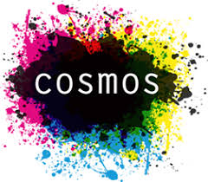
Peace protests in social movement studies
Donatella della Porta
Scuola Normale Superiore

Slide 2
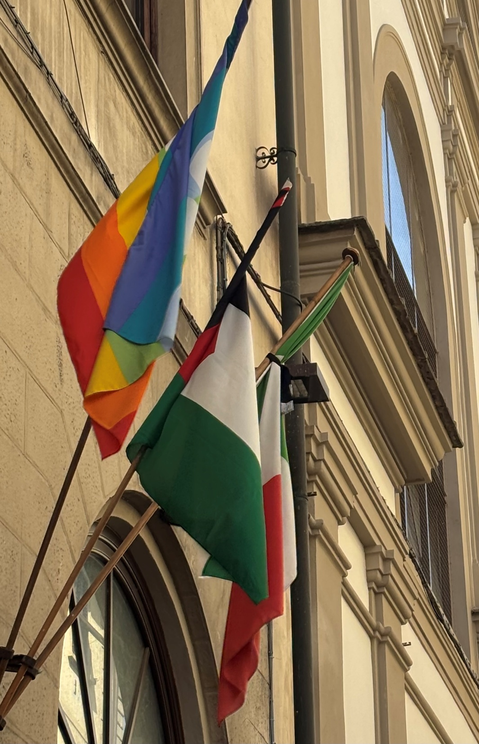
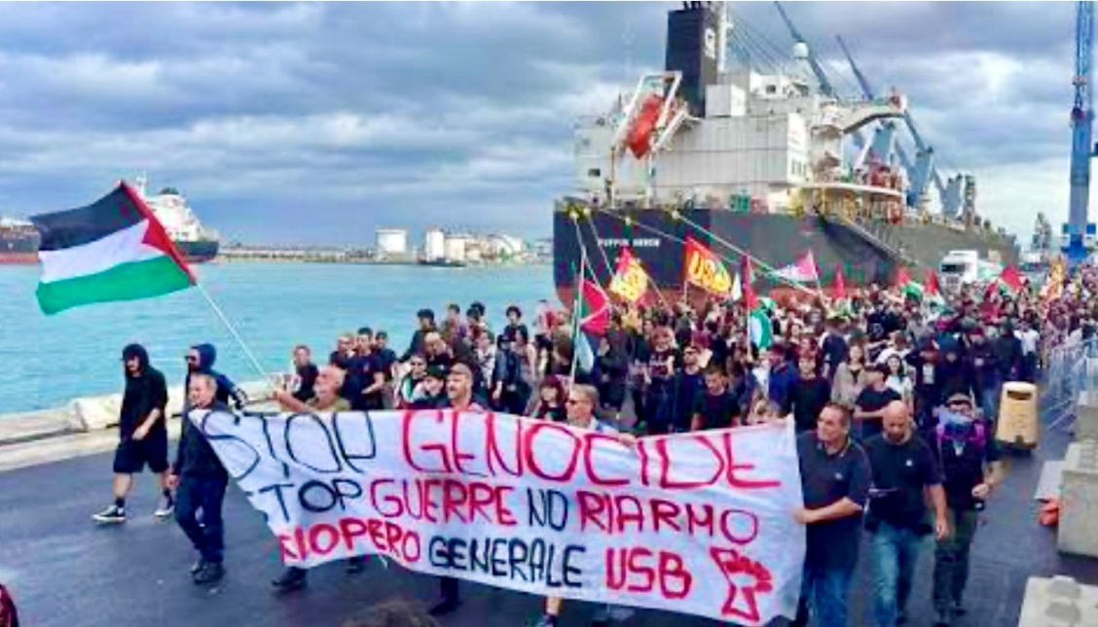
Peace and Free Palestine

Slide 3
Peace movement and anti-war campaigns
Peace movement as a core, mobilization as multi-actors
"Successful mobilizations rely on the co-optation of substantial resources from other movements typically not involved in peace politics." — Maier & Marullo (2004)

Slide 4
Challenges to mobilize
Need to build coalition among broad and diverse memberships
Need to brige different frames
Need multiple repertoires of actiom

Slide 5
effects
Often immediate failures to block wars/armaments
Challenges of finding political alliance face to rightwing backlash and center-left betrayal
But also: long-term cultural effects and generational effects

Slide 6
Distinguishing quiet and intense time
Quiet times | Intense times
Structure | Agency
High predictability | Low predictability
Routines | Conjuncture
Slow pace | Accelerated speed
Objective | Subjective
Normal | Extra-ordinary

Slide 7
Conceptual developments
Protest cycles as hightened conflicts (Tarrow)
Eventful temporality as events breaking structures (Sewell)
Transformative events: as catalizers (McAdam and Sewell)
Eventful protest: as producing effects on those who participate in them, the movement, and its environment through relational, cognitive and affective mechanisms (della Porta)

Slide 8
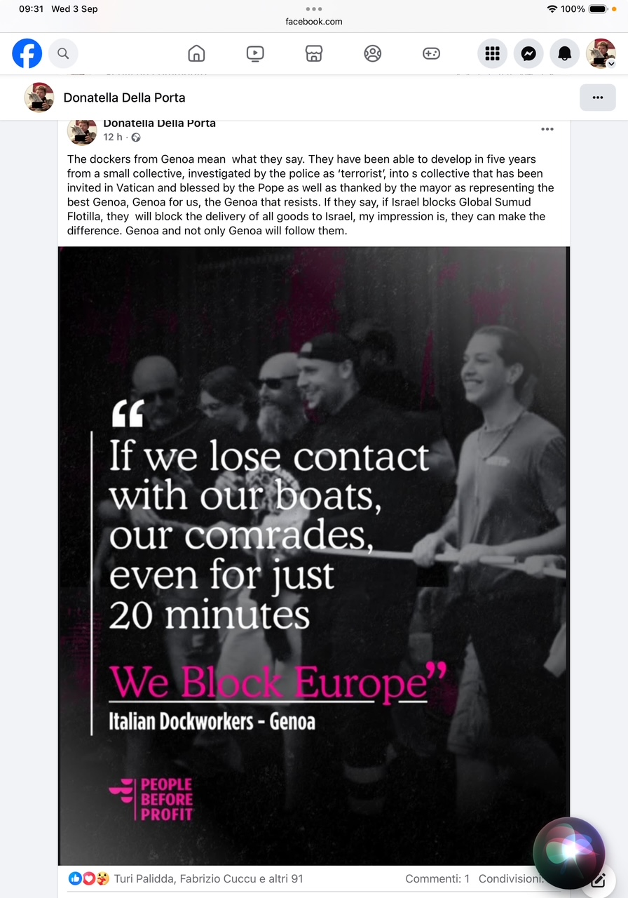

Slide 9
”If Israel will not let this humanitarian help be delivered to the Palestinian population in Gaza, not a single nail will any longer go to Israel from this harbour”. A vessel from the Global Sumud Flotilla, including 40 vessels from different countries, will sail from Genoa. The dockers-with their Calp and the unions— are at the core of a mobilisation against war which turned into one for Free Palestine. The protest has triggered a coalition of organizations of very different types, from labour (overcoming competition among unions) to the educational system (putting together different student groups), catholic and lay pacifist associations. In support of the flotilla, one hundred thousands of citizens brought more than ten times the expected amount of humanitarian help that had been planed. The mayor went several times to encourage the protestors and was present when the ship will start sailing (with, on board, some of the dockers); so was the archibishop. Even the counterpart of the unions inside. The harbour is mobilized to help the flotilla.

Slide 10
On the day the vessel bringing food to Gaza left the harbor, as many as 40000 genovesi went to wish the Flotilla fair winds. The local and national media have given mostly sympathetic coverage. The moral shock of the genocide resonate with a long tradition of solidarity from Genoa and its harbour. So, a CGIL unionist recalled the ship who left Genoa in 1973 with humanitarian help for the Vietnamese population, reaching Hanoi after months of navigation. And an activist of the Calp mentions the historical commitment by the dockers to block arm traffic, At the demonstration, the mayor of Genoa stated how pride she was to be the mayor of Genoa, a city that was awarded a golden medal for its resistance to Nazi-fascism. What is more, she said she is proud of the new wave of resistance against a new genocide. She praises the courage of those who will sail to bring food to Gaza, but also the solidarity on the tens of thousands who donated food and the voluntary association that coordinated the event. In particular, she mention the Calp, the collective of the dockers, that has been at the core of the civil disobedience against arm trafficking, refusing to load weapon to be delivered to Israel.

Slide 11
Figure 1. Pro-Palestine protest events in Italy and Spain, October 2023- June 2024
della Porta, Mendoza Sandoval, Portos and Stagni 20254

Slide 12
Multiple forms of action
Marches
Boycott
Camps
Hunger strikes
Blockades
Flash mobs
Strike

Slide 13
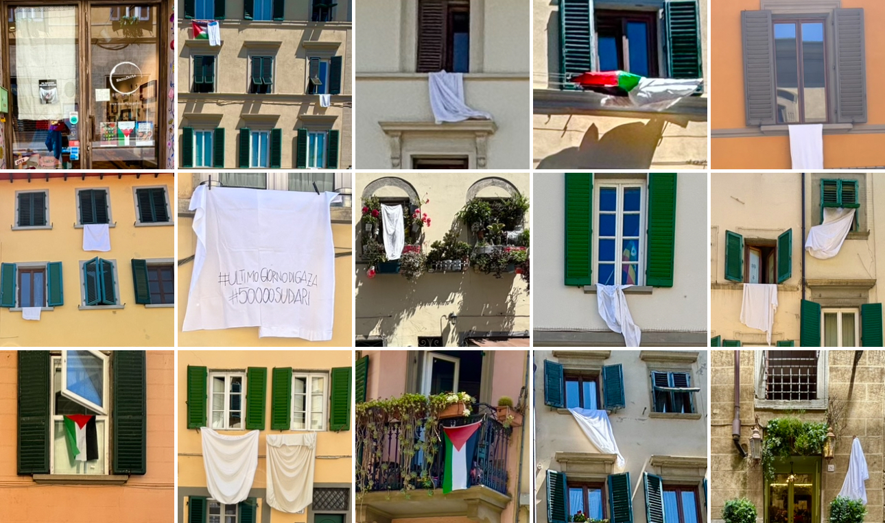
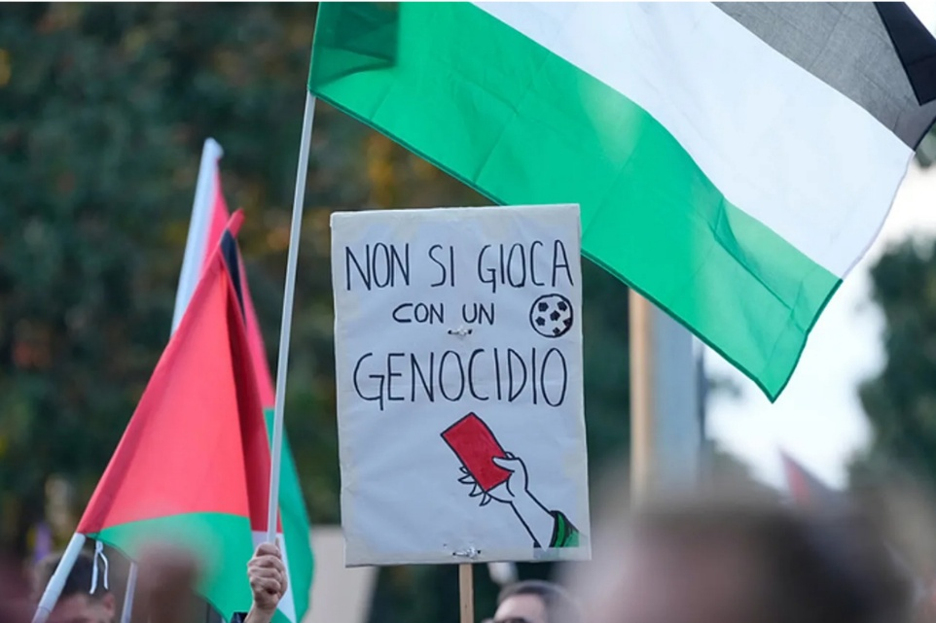
Partecipative expansion

Slide 14
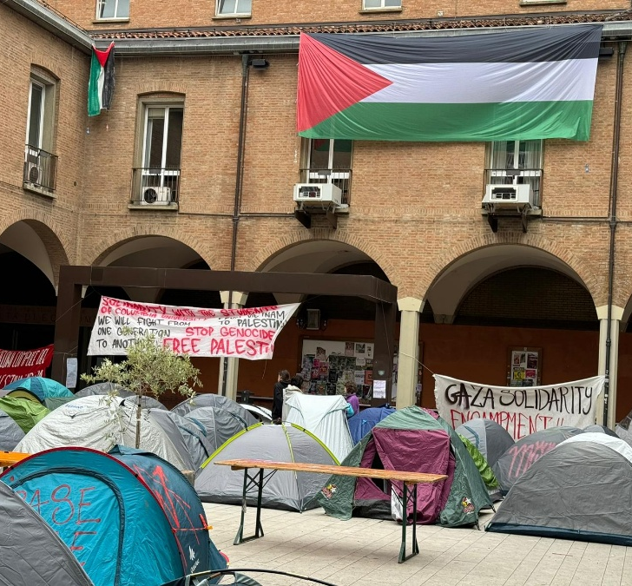
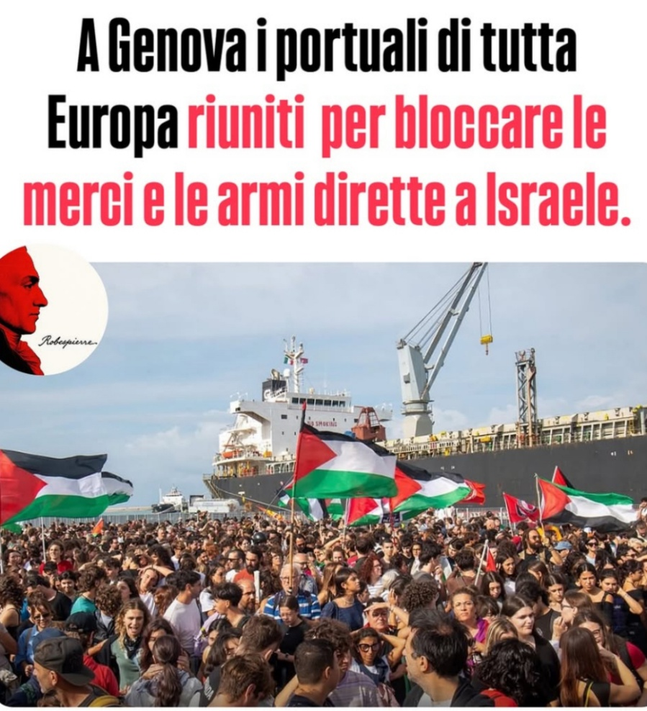
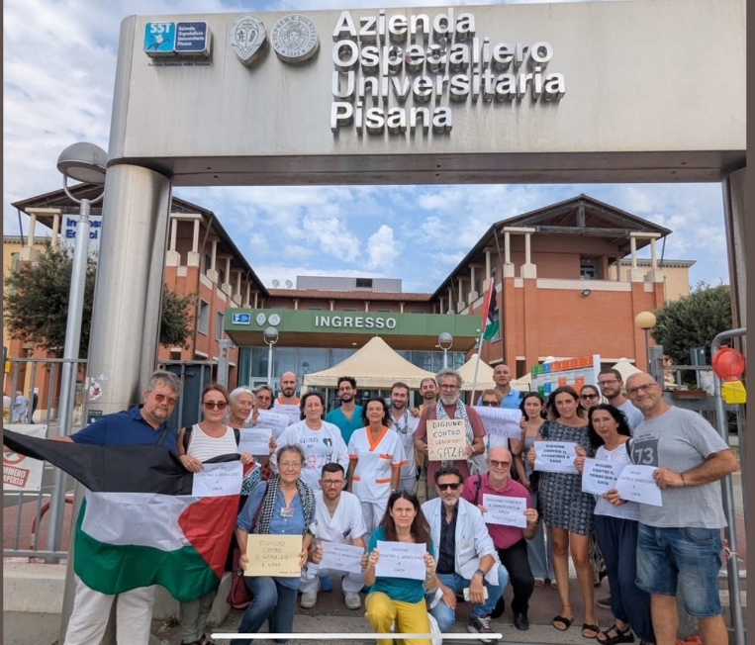
Connective actions within arenas

Slide 15
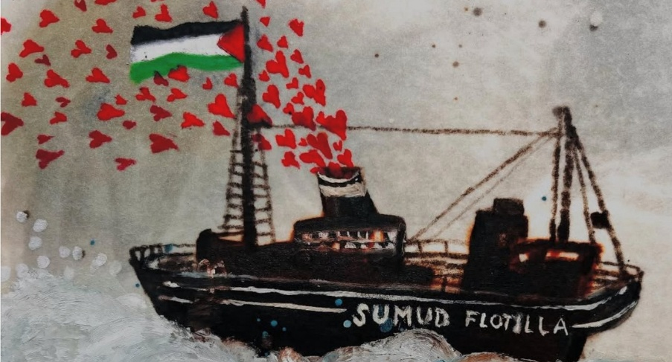

Bridging repertoire
Testimony through a global crew
Broad involvement in the preparation and through the ground crew
The routes: connecting territories on the ways

Slide 16
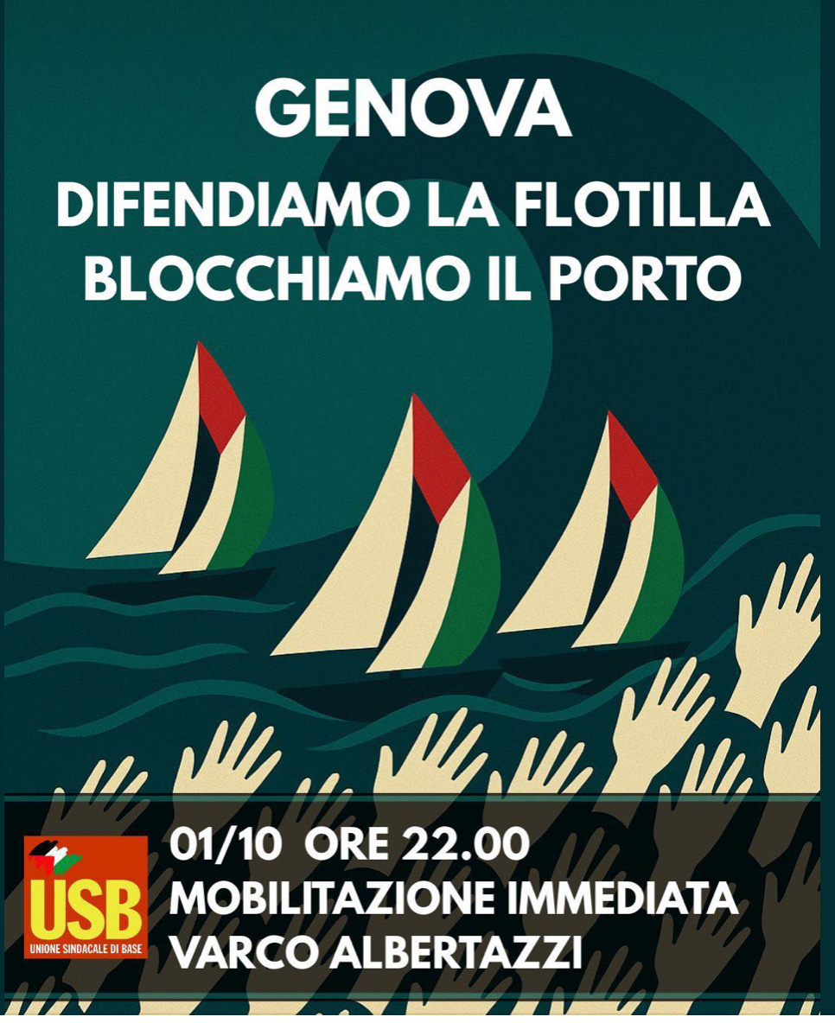
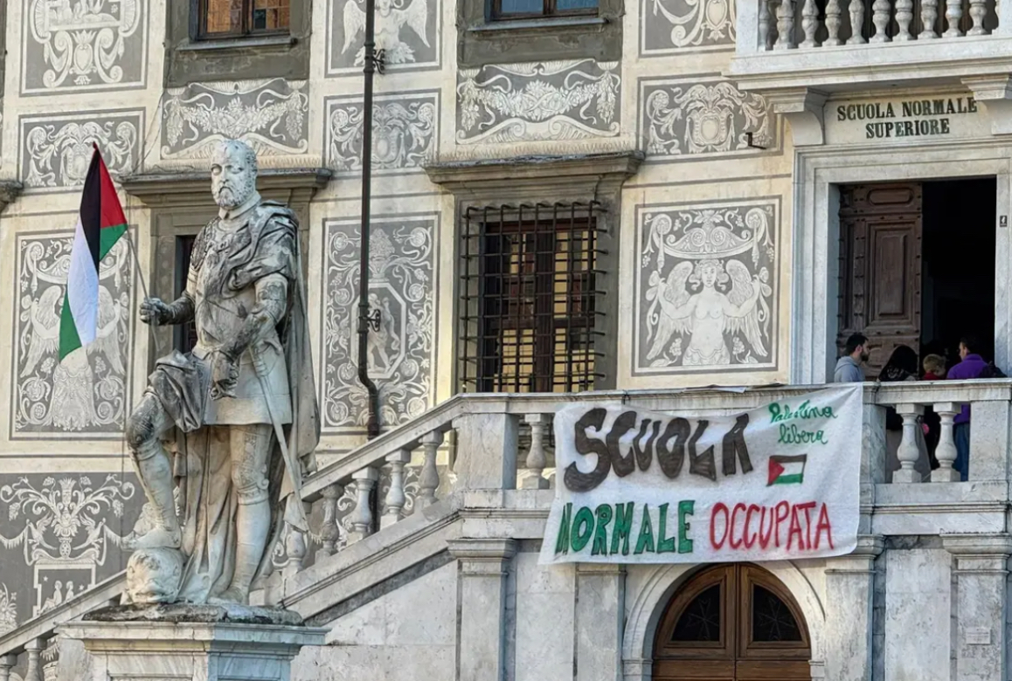
blocking

Slide 17

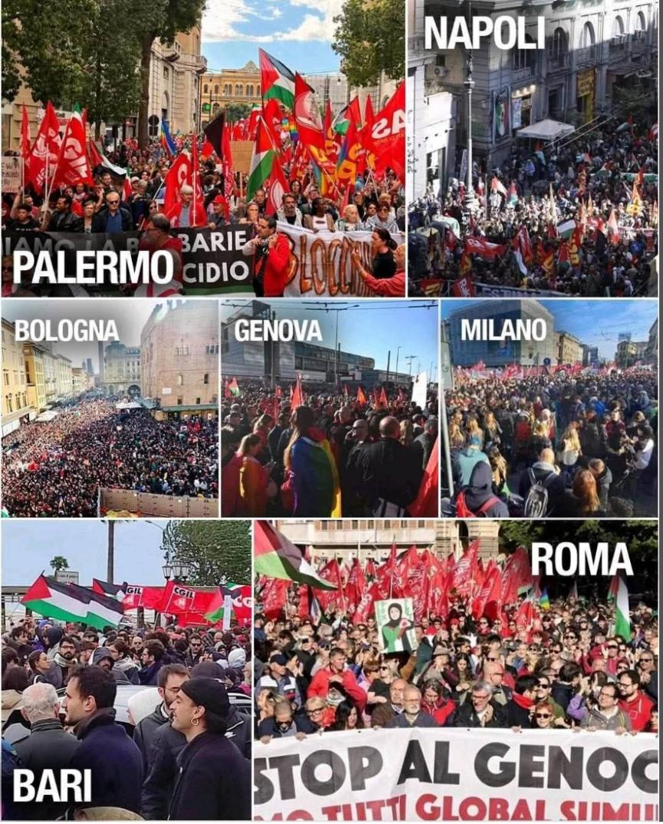

Striking

Slide 18
Organizational convergences
Loose networks of cooperation between SMOs, CSOs, Unions, ethnic communities through:
Alliances in the streets
Expert based campaigns
Prefigurative spaces

Slide 19
networking in action
the horror of the images that we are getting made us mobilize. Even if it’s true that this genocide is, unfortunately, not the only one happening today .. . this one is the most televised, so the amount of information is huge. That has been key to mobilizing people and public opinion ... the Palestinian cause is a progressive cause. This has helped us to situate better the debate around movements for housing, health, education for everyone, self-determination for everyone. This international polarizing moment has helped us to situate the debate. (Interview #ES1, RESCOP)

Slide 20
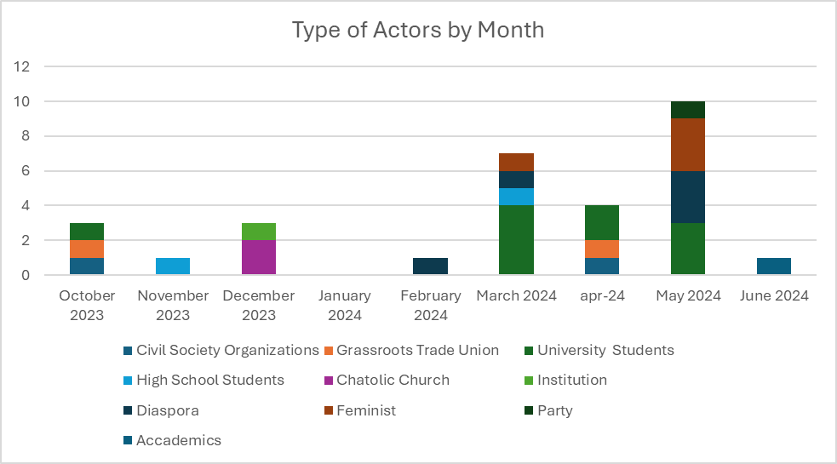

Slide 21
Frame bridging
Peace and genocide:
Patriarchy (the women in Gaza)
Environmental destruction (ecocide)
Education (scolasticide)
Labour (Health; ports…)
Press….

Slide 22
Time intensification as game changers/the frame
The Palestinian issue perfectly embodies, …, issues deeply connected to race and the challenges faced by second generation immigrants. … the enormous risk of creating a deep division in Europe between racialized people and white Europeans. […] The bodies of racialized people, people who are not white, seem to matter less. This issue is not only happening in Gaza with an ongoing genocide, but it’s also evident here in Italy. (Interview #IT10)

Slide 23
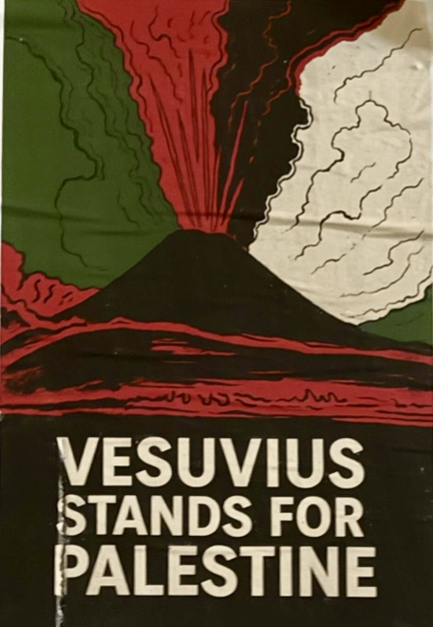
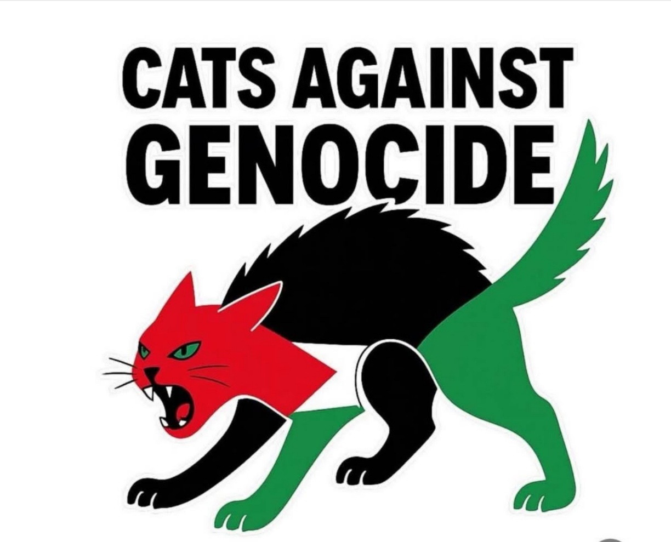
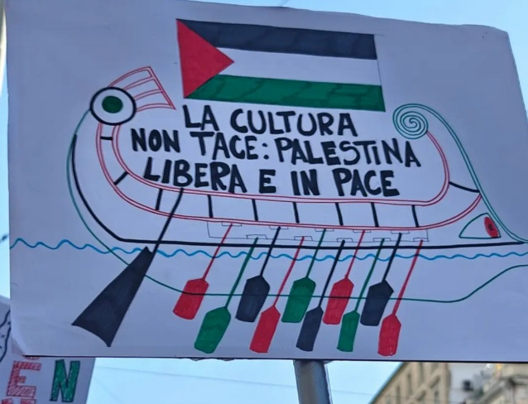
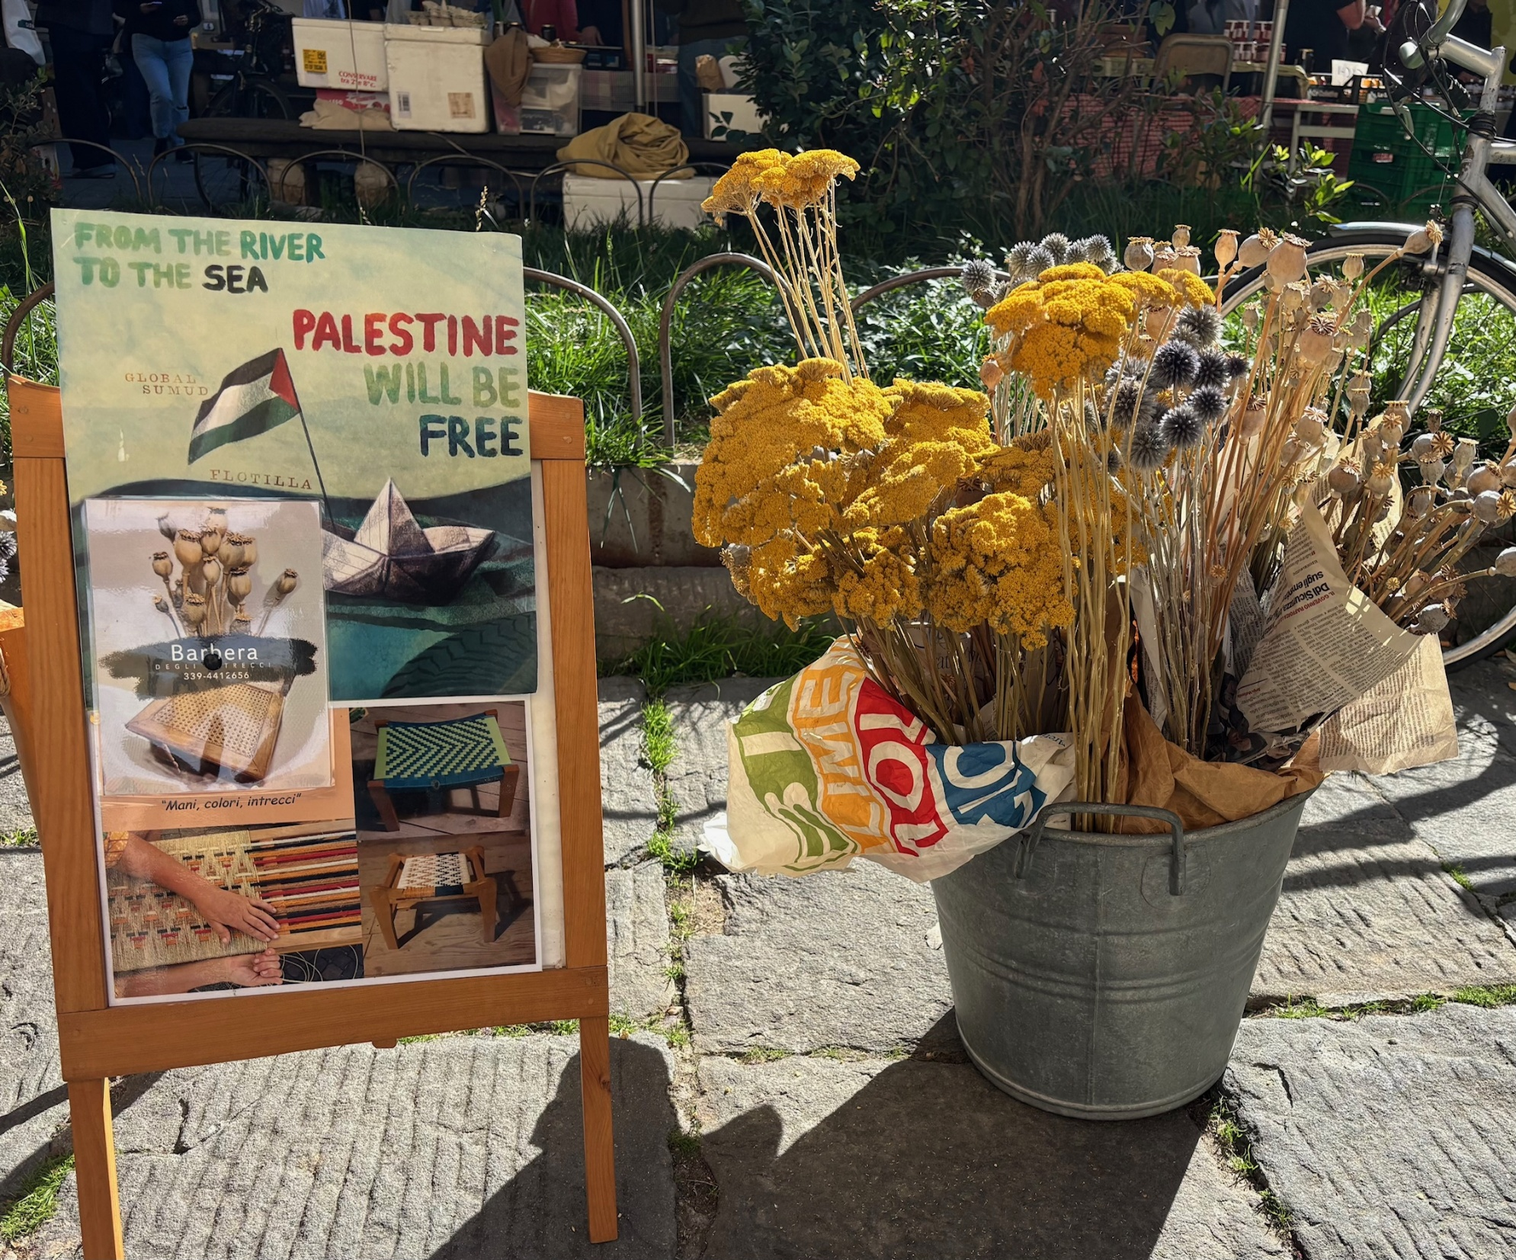
Each and everyone against the genocide

Slide 24
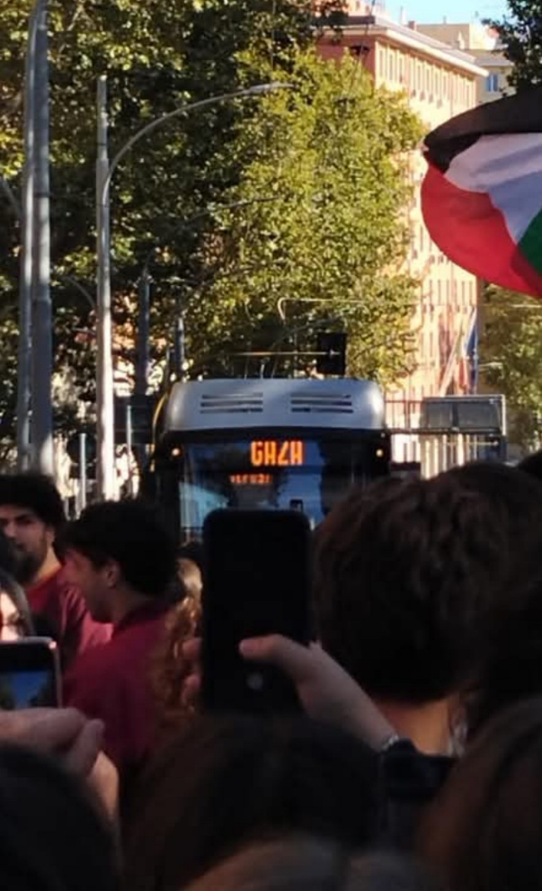
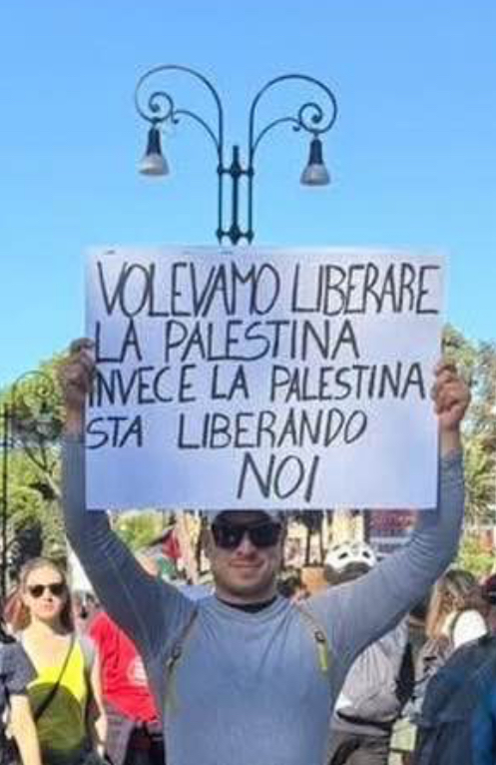
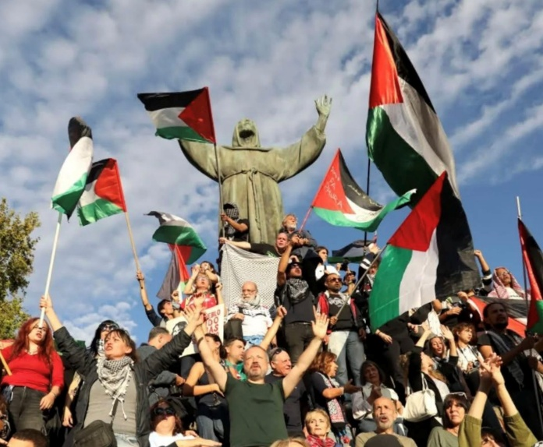
Palestine is here

Slide 25
Time intensification
Mechanisms/processes | fluidization of structures | densification of relations
Relational | Rupture | Emergence
Cognitive | Search for clue | Expansion of possibilities
Affective | Surprise | Empowerment

