Slide 1
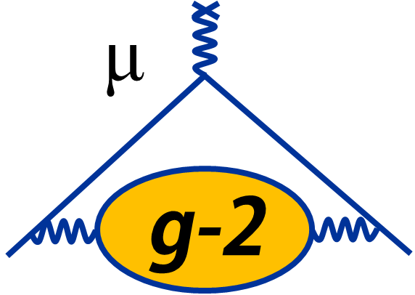
Final Results from the Fermilab Muon g-2 Experiment
Breese Quinn, University of Mississippi
14th International Workshop on e⁺e⁻ collisions from Phi to Psi
June 8, 2026

Slide 2
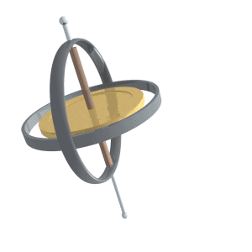
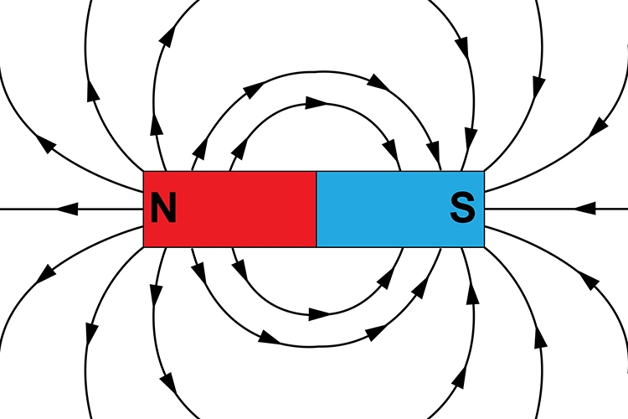
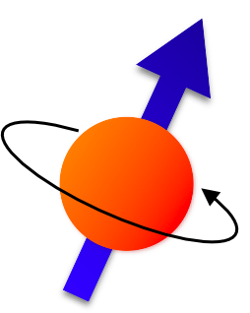
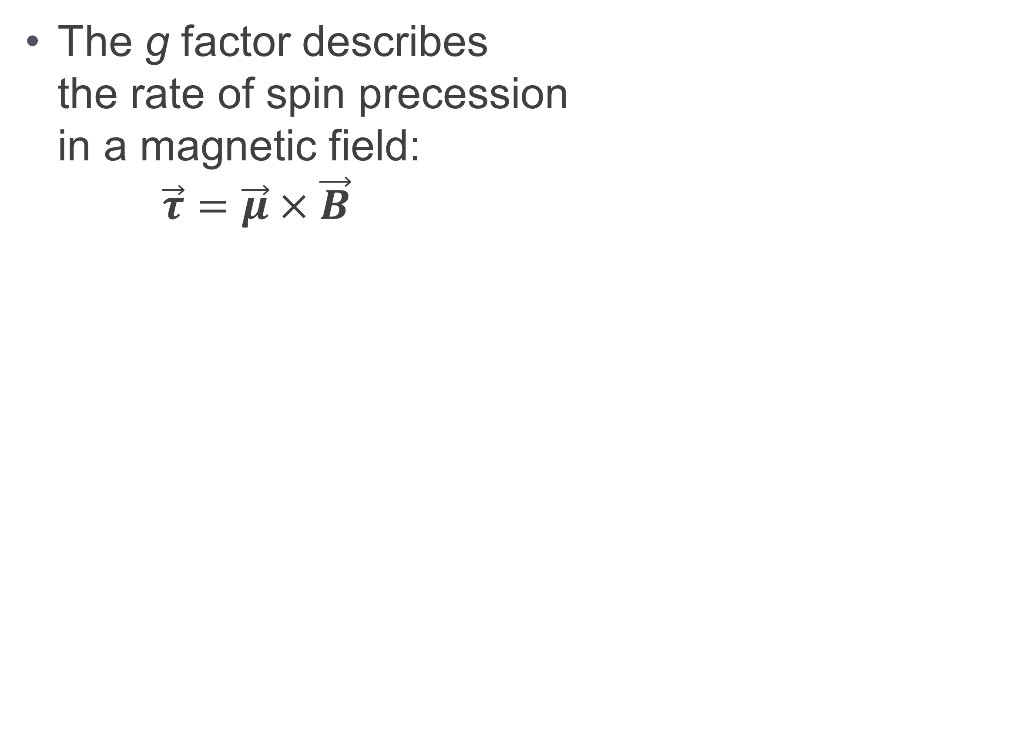

Magnetic Moment
A particle with charge and spin generates a magnetic moment:
The g factor describes the rate of spin precession in a magnetic field: $\vec{τ}=\vec{μ}×\vec{B}$
B
$$\vec{μ}=g\frac{e}{2m}\vec{S}$$
+

Slide 3
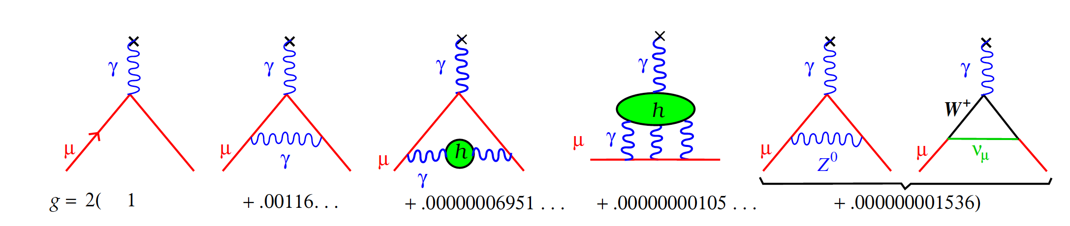
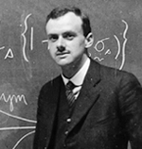
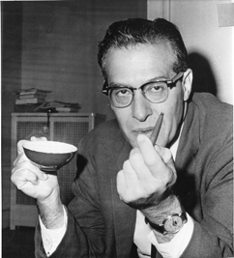
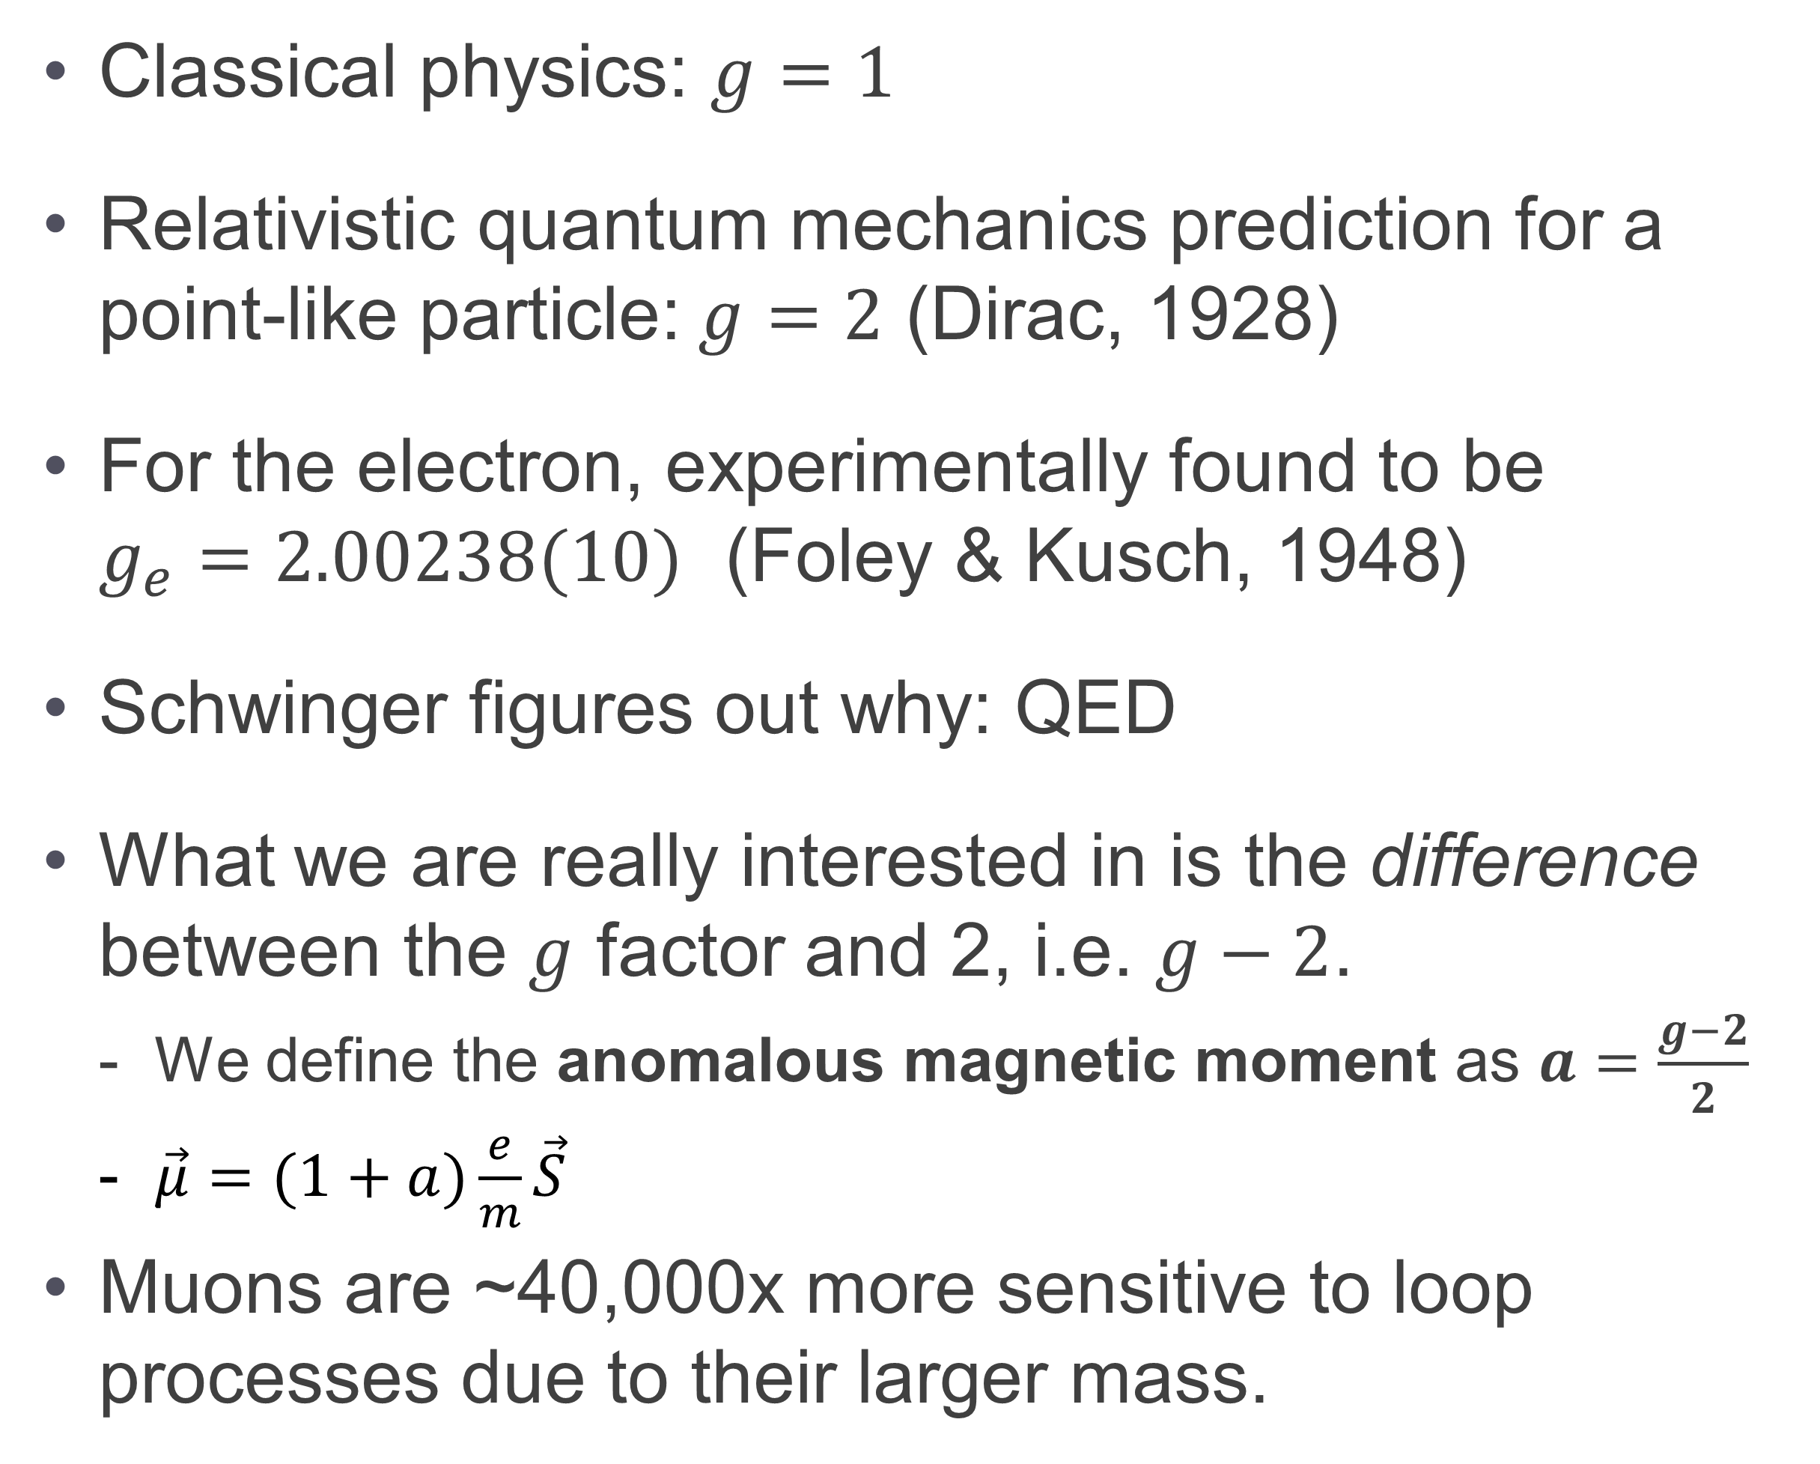
Magnetic Moment
Classical physics: $g=1$
Relativistic quantum mechanics prediction for a point-like particle:$g=2$ (Dirac, 1928)
For the electron, experimentally found to be $g_{e}=2.00238(10)$ (Foley & Kusch, 1948)
Schwinger figures out why: QED
What we are really interested in is the difference between the $g$ factor and 2, i.e. $g−2$.
  We define the anomalous magnetic moment as $a=\frac{g−2}{2}$
  $\vec{μ}=(1+a)\frac{e}{m}\vec{S}$
Muons are ~40,000x more sensitive to loop processes due to their larger mass.
A particle with charge and spin generates a magnetic moment:
$$\vec{μ}=g\frac{e}{2m}\vec{S}$$
)

Slide 4
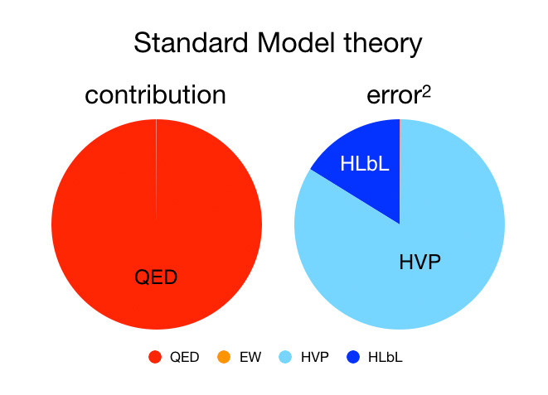
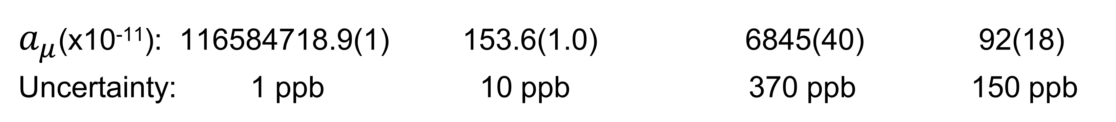
SM Calculation of a_{μ} (Muon g-2 Theory Initiative WP20) Phys. Rept. 887 (2020) 1-166
New
Physics?
SUSY
DM
???
QED EW Hadronic VP Hadronic LbL
$a_{μ}$(x10⁻¹¹): 116584718.9(1) 153.6(1.0) 6845(40) 92(18)
Uncertainty: 1 ppb 10 ppb 370 ppb 150 ppb

Slide 5
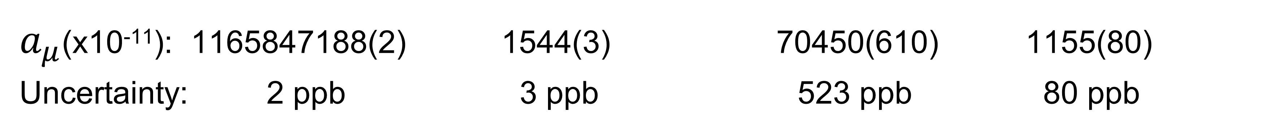
SM Calculation of a_{μ} (Muon g-2 Theory Initiative WP25) Physics Reports 1143 (2025) 1-158
QED EW Hadronic VP Hadronic LbL
$a_{μ}$(x10⁻¹¹): 1165847188(2) 1544(3) 70450(610) 1155(80)
Uncertainty: 2 ppb 3 ppb 523 ppb 80 ppb

Slide 6
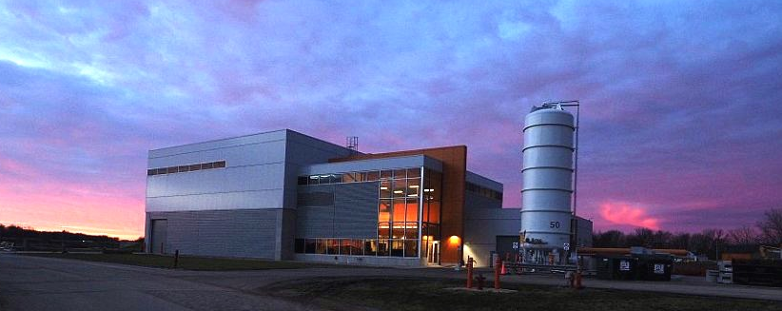
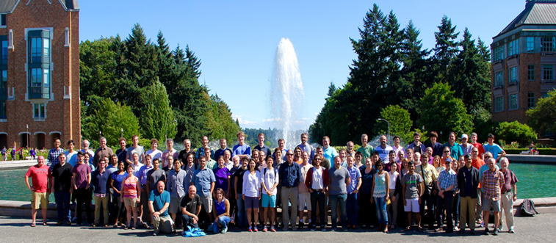
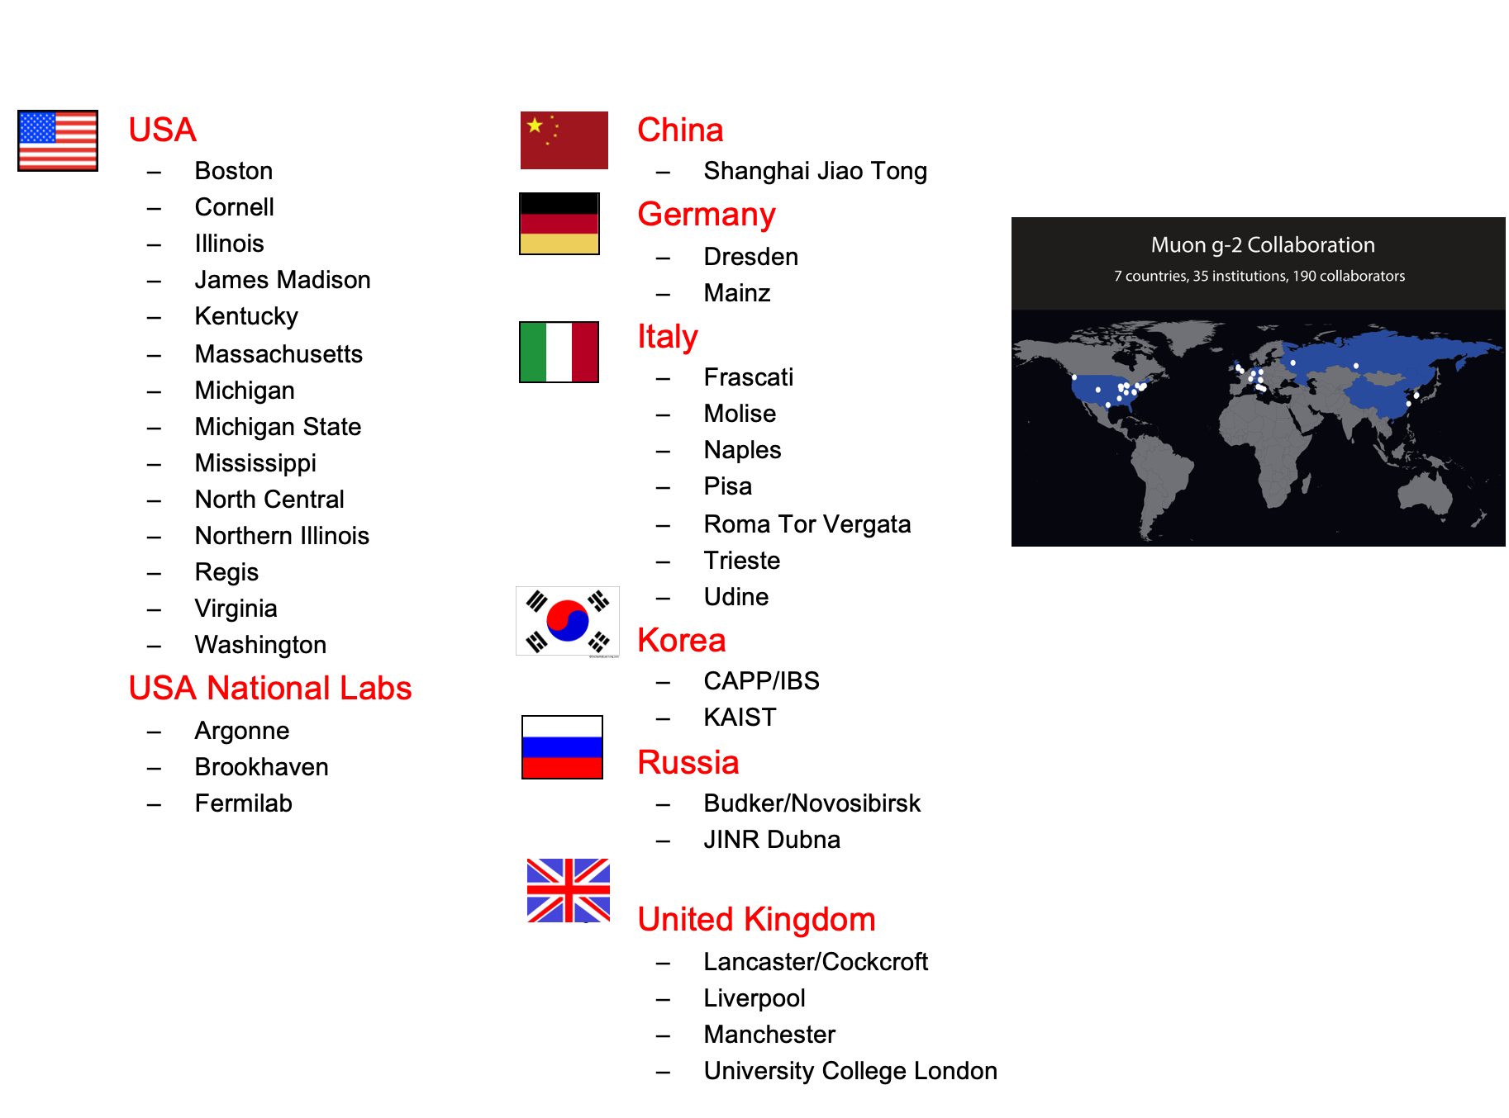
Fermilab Muon g-2 Experiment (E989)
Rebuild the BNL experiment at Fermilab, but “Better, Stronger, Faster than before”
Start with the original core foundation
  Reuse the BNL storage ring – move it to FNAL
Power with Fermilab’s more intense, cleaner beams
4x reduction in uncertainty (540 ppb→140 ppb)
  21x more muons (stat.unc. 460 ppb→100 ppb)
  Improvements/upgrades (syst.unc. 280 ppb→100 ppb)
Muon g-2 Collaboration
  >200 collaborators, 35 institutes, 7 nations
  Particle, Nuclear, Atomic, Optical, Accelerator, Theory
  Experienced BNL E821 veterans, and lots of new young (and some old…) talent

Slide 7
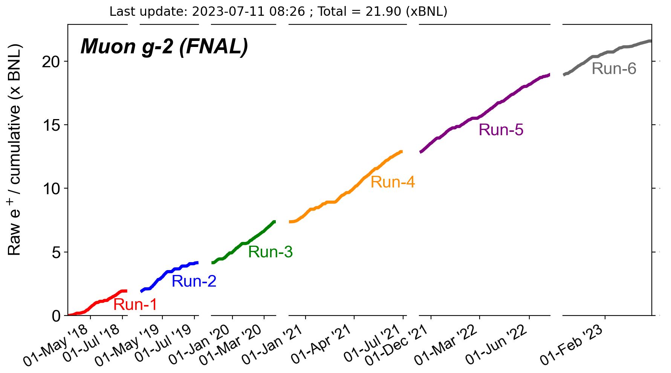
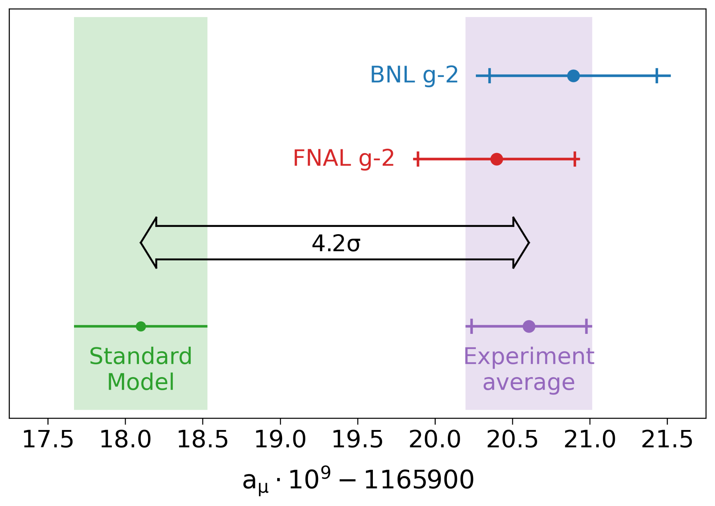
Fermilab Muon g-2 Experiment (E989)
Data Collection 2018 – 2023
Apr. 2021:
  Run-1 Result (2018 data)
    Consistent with BNL, 15% smaller uncertainty
    Uncertainty comparable to WP2020 SM
PROPOSAL
GOAL

Slide 8
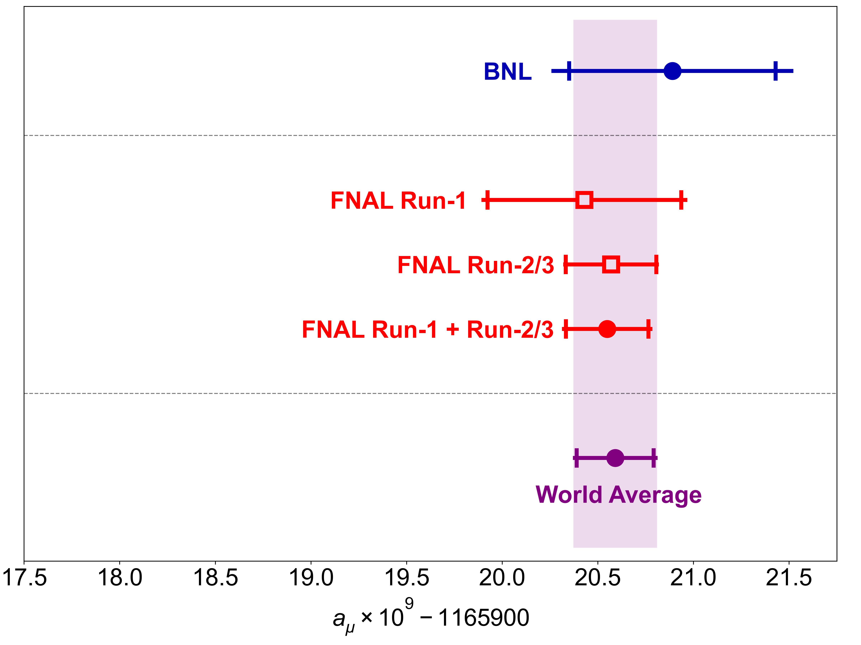
Fermilab Muon g-2 Experiment (E989)
Data Collection 2018 – 2023
Aug. 2023:
  Run-2/3 Result (2019-20 data)
    Factor of 2 uncertainty reduction
    Less than half the Run 1 uncertainty
PROPOSAL
GOAL
203 ppb
190 ppb

Slide 9
Fermilab Muon g-2 Experiment (E989)
Data Collection 2018 – 2023
Apr 2025:
  FINAL Run-4/5/6 Result (2021-23 data)
  Reached our proposal goal for statistics
  (~21x BNL, ~4x Run-1/2/3)
PROPOSAL
GOAL

Slide 10
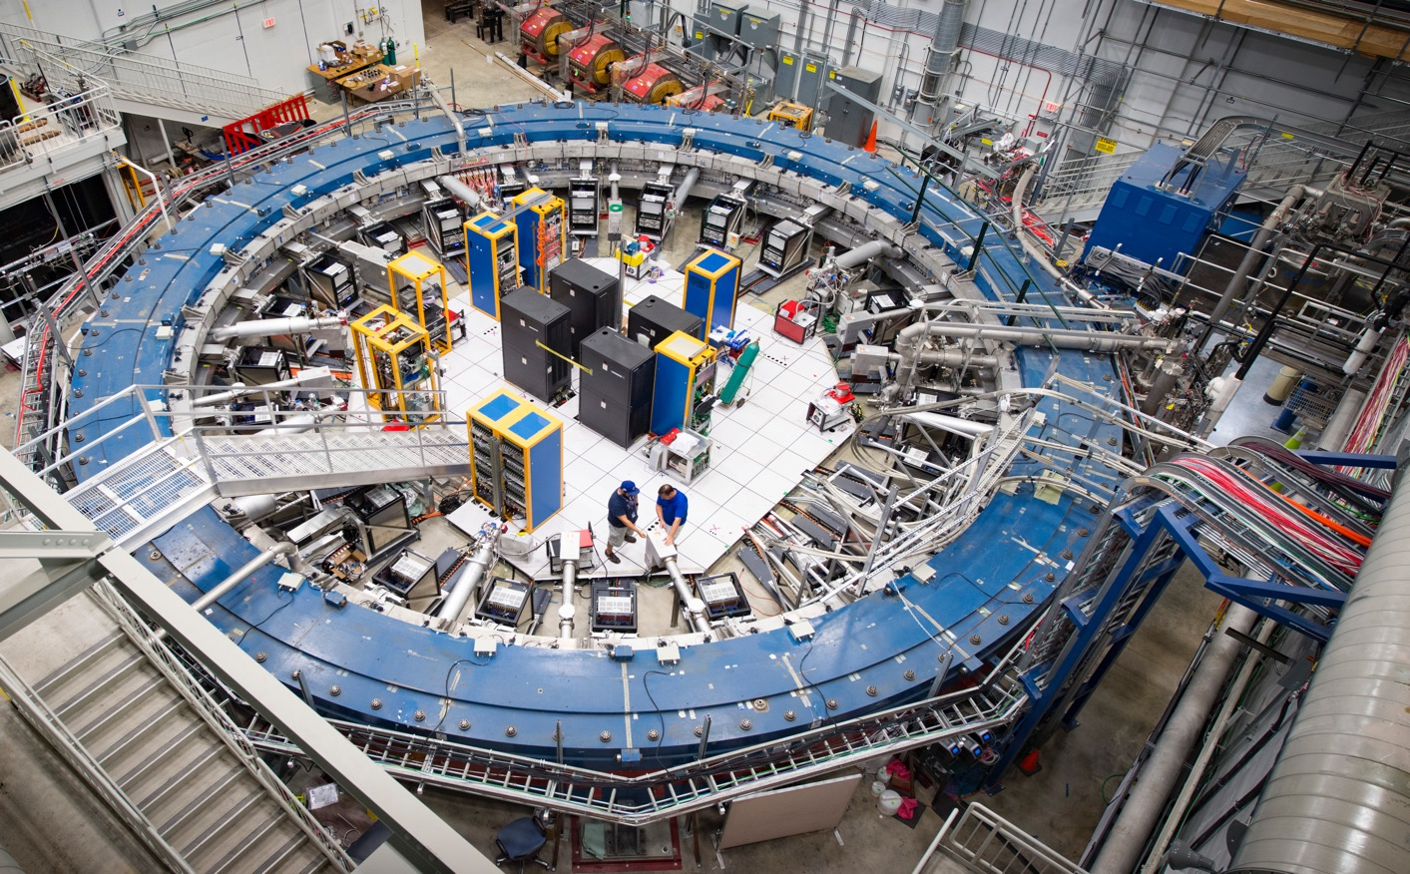
The Main Idea
Store muons in the ring
The spins precess like a top about the magnetic field as they circulate around the ring
So how are we able to observe this and measure a_{μ}?

Slide 11
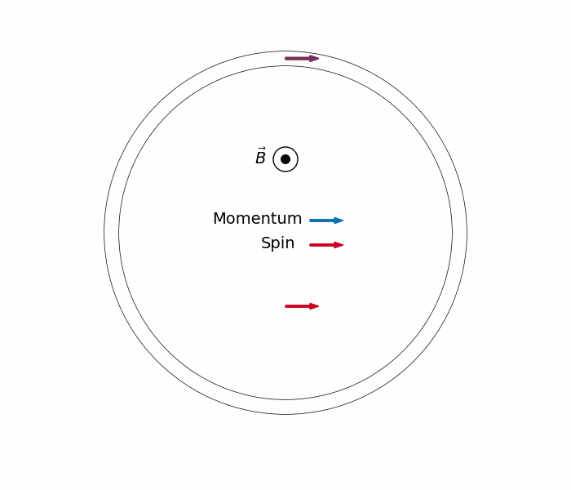
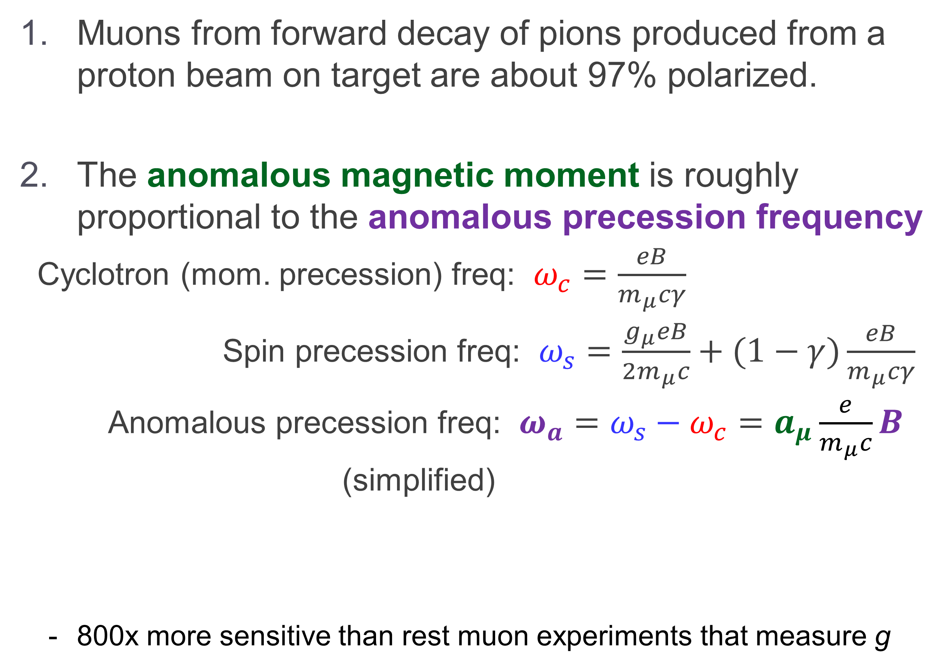
The Key Principles of Storage Ring Muon g-2
Muons from forward decay of pions produced from a proton beam on target are about 97% polarized.
The anomalous magnetic moment is roughly proportional to the anomalous precession frequency
Cyclotron (mom. precession) freq: $ω_{c}=\frac{eB}{m_{μ}cγ}$
Spin precession freq: $ω_{s}=\frac{g_{μ}eB}{2m_{μ}c}+(1−γ)\frac{eB}{m_{μ}cγ}$
Anomalous precession freq: $ω_{a}=ω_{s}−ω_{c}=a_{μ}\frac{e}{m_{μ}c}B$ (simplified)
  800x more sensitive than rest muon experiments that measure g
p
π⁺
μ⁺
ν
π⁺
μ⁺
To get this
Measure these

Slide 12
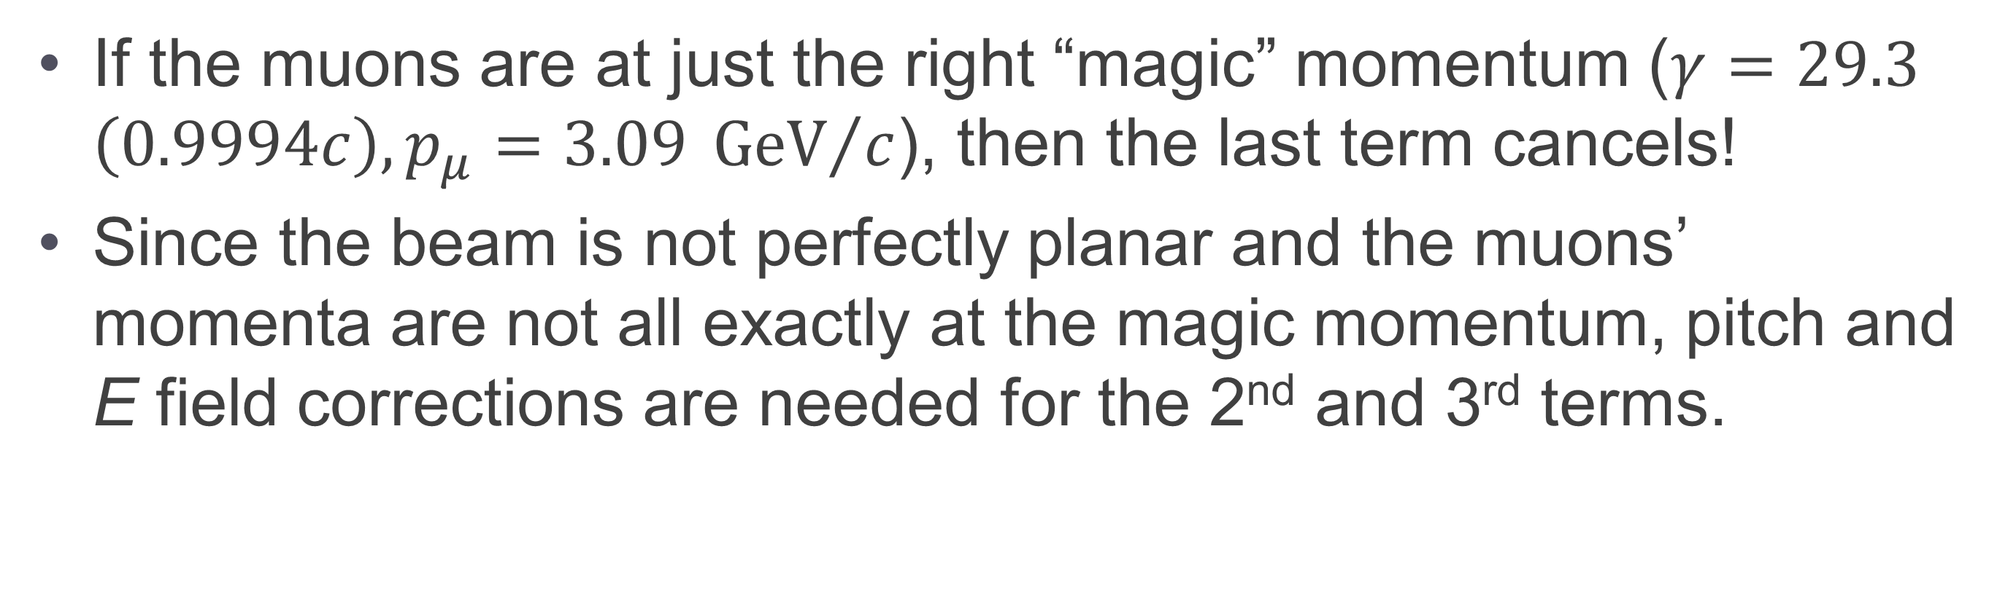
The Key Principles of Storage Ring Muon g-2
There is some vertical beam motion, so need to use electric quadrupole fields to contain the beam vertically (the B field holds them in horizontally). But these facts complicate the expression for the anomalous precession frequency:
$${\vec{ω}}_{a}={\vec{ω}}_{s}−{\vec{ω}}_{c}=−\frac{e}{mc}\left[a_{μ}\vec{B} −a_{μ}\left(\frac{γ}{γ+1}\right)\left(\vec{β}⋅\vec{B}\right)\vec{β}−\left(a_{μ}−\frac{1}{γ^{2}−1}\right)\left(\vec{β}×\vec{E}\right)\right]$$
If the muons are at just the right “magic” momentum ($γ=29.3$ $\left(0.9994c\right), p_{μ}=3.09 {GeV}/c$), then the last term cancels!
Since the beam is not perfectly planar and the muons’ momenta are not all exactly at the magic momentum, pitch and E field corrections are needed for the 2nd and 3rd terms.

Slide 13




The Key Principles of Storage Ring Muon g-2
Muon decays are self-analyzing: due to parity violation, the highest energy decay positrons are preferentially emitted in the direction of the muon spin.
$μ^{+}→e^{+}ν_{e}{\overline{ν}}_{μ}$
$${\overline{ν}}_{μ}$$
μ⁺
$$e^{+}$$
$$ν_{e}$$
Weak decay Michel spectrum

Slide 14
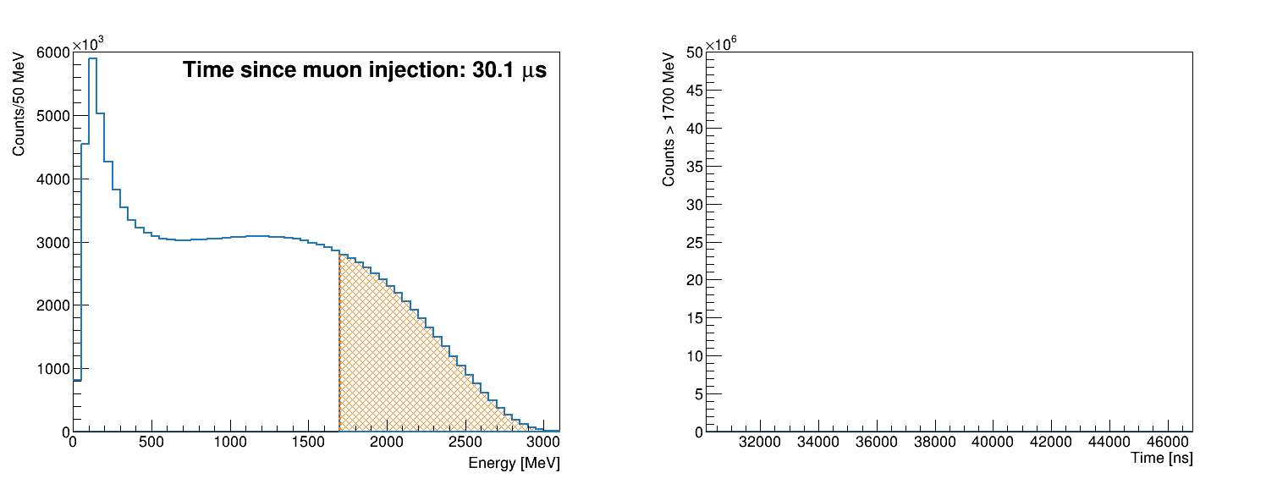
The Key Principles of Storage Ring Muon g-2
Muon decays are self-analyzing: due to parity violation, the highest energy decay positrons are preferentially emitted in the direction of the muon spin.
$μ^{+}→e^{+}ν_{e}{\overline{ν}}_{μ}$
$${\overline{ν}}_{μ}$$
μ⁺
$$e^{+}$$
$$ν_{e}$$
Real data from Run-3
Energy spectrum
Time spectrum
Spin
Momentum
Threshold Energy

Slide 15
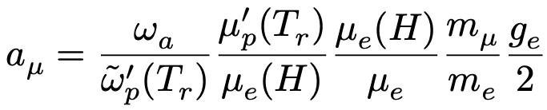

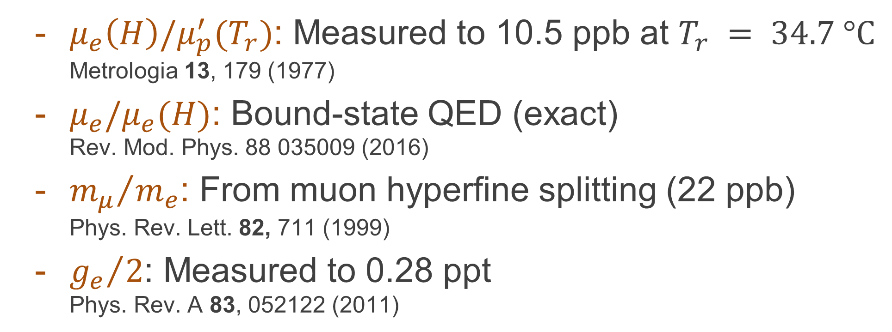

Measuring a_{μ}: Only measure frequencies!
Remember: $ω_{a}=a_{μ}\frac{e}{m_{μ}c}B$
  $ω_{a}$: we measure from the rate of high energy decay positrons
  $B$: we measure in terms of the proton Larmor precession frequency, $2ℏω_{p^{′}}=2μ_{p^{′}}B$
Us
Others
  $ω_{a}$: anomalous precession frequency
  ${\tilde{ω}}_{p}^{′}\left(T_{r}\right)$: proton Larmor precession frequency in water sample mapping the field and weighted by the muon distribution Metroligia 13, 179 (1977); 51, 54 (2014); 20, 81 (1984)
  $μ_{e}\left(H\right)/μ_{p}^{′}(T_{r})$: Measured to 10.5 ppb at $T_{r} = 34.7 °C$
  Metrologia 13, 179 (1977)
  $μ_{e}/μ_{e}(H)$: Bound-state QED (exact)
  Rev. Mod. Phys. 88 035009 (2016)
  ${m_{μ}}/{m_{e}}$: From muon hyperfine splitting (22 ppb)
  Phys. Rev. Lett. 82, 711 (1999)
  ${g_{e}}/2$: Measured to 0.28 ppt
  Phys. Rev. A 83, 052122 (2011)

Slide 16
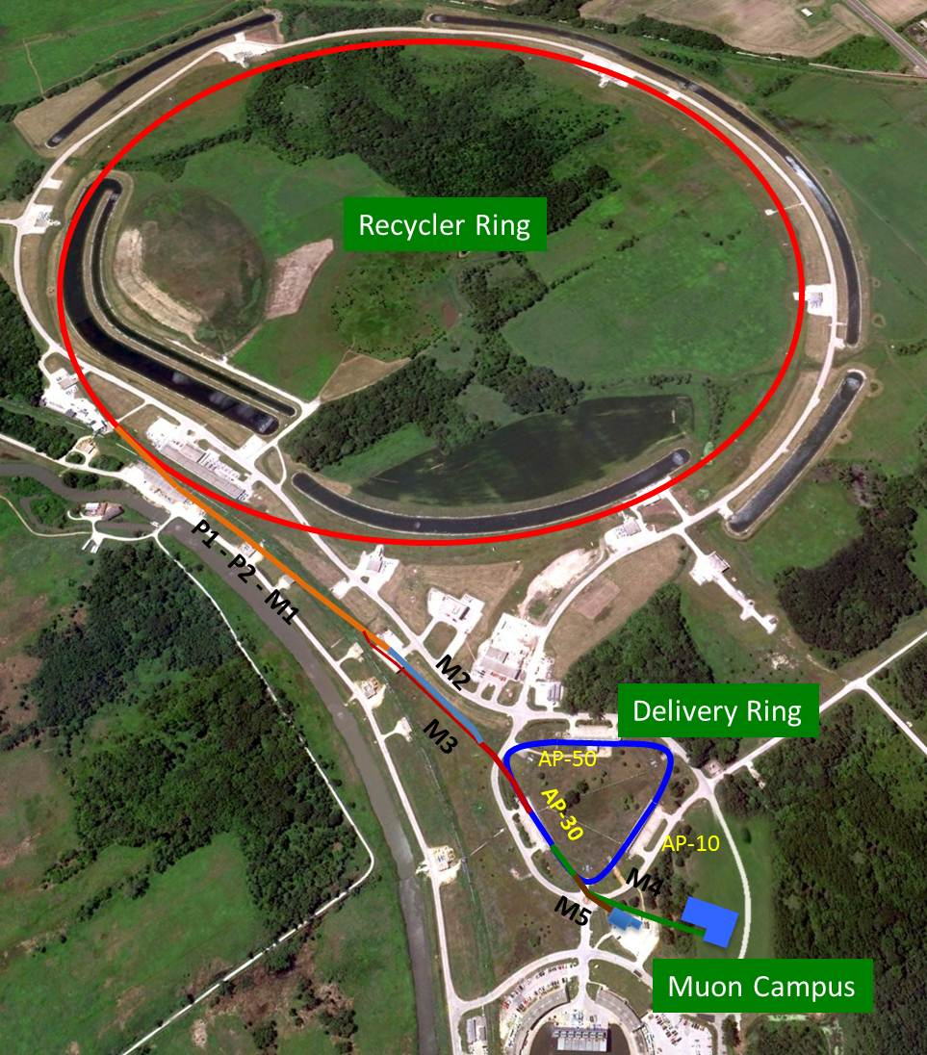
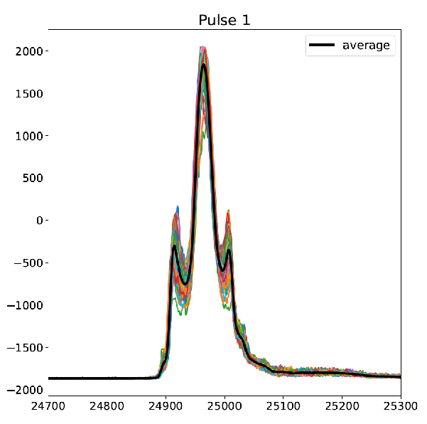
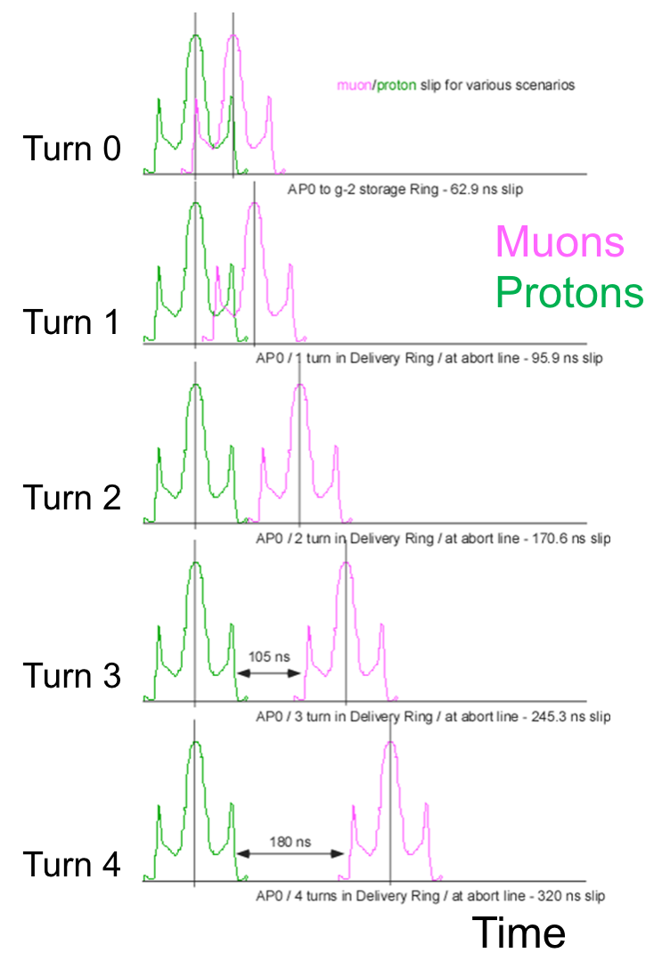
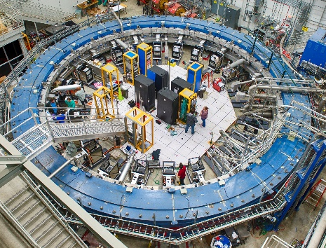


Polarized Muon Beam
Brynn MacCoy
8 GeV protons
Divided into 4 bunches
intensity
Extract single bunches to strike iron target producing pions
150 ns
The pions traverse a transfer line where 80% decay π ◊ μν. Magnetically select 3.09 GeV muons
Entry
Turn 1
Turn 2
Turn 3
Turn 4
$$μ^{+}$$
$$p$$
Send muons into a small Delivery Ring to remove contamination (pions decay, protons separated and kicked out
And only muons enter storage ring

Slide 17
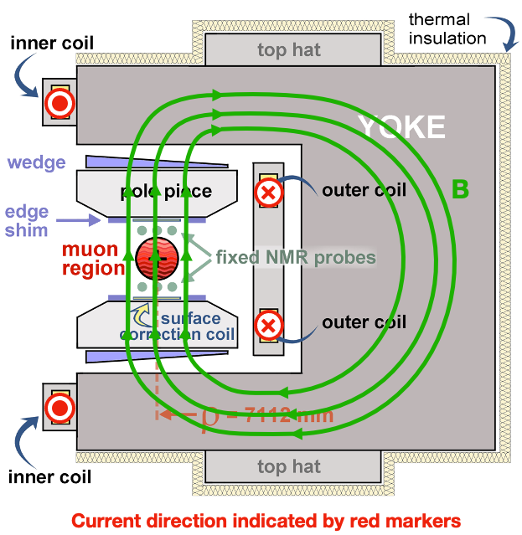
Magnetic Field
1.45 T Superferric Magnet
14 m diameter
12 iron yokes excited by superconducting
coils
Iron top hats (24), poles (72), wedges (864), foil laminations (8000), edge shims and surface coils for field shaping

Slide 18
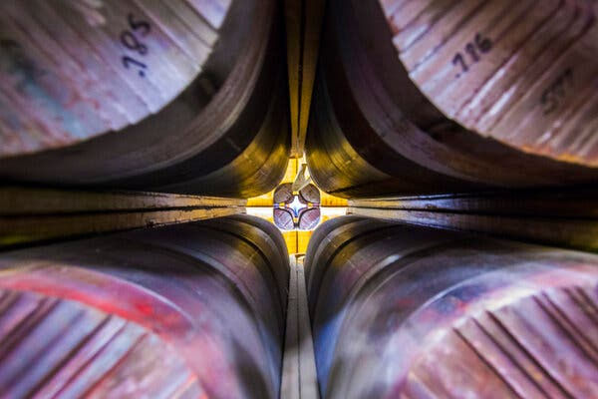
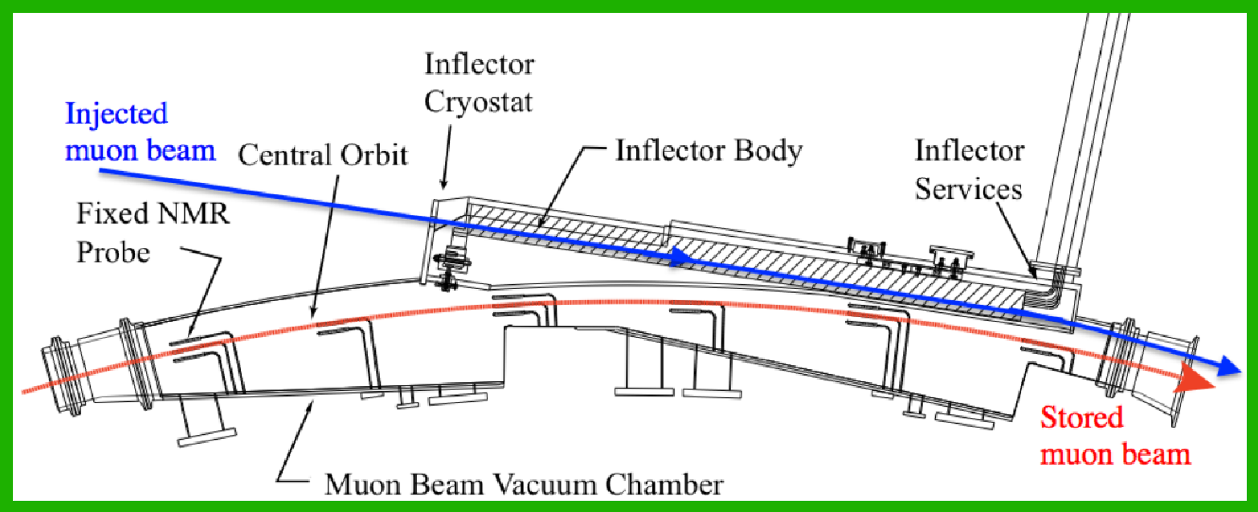


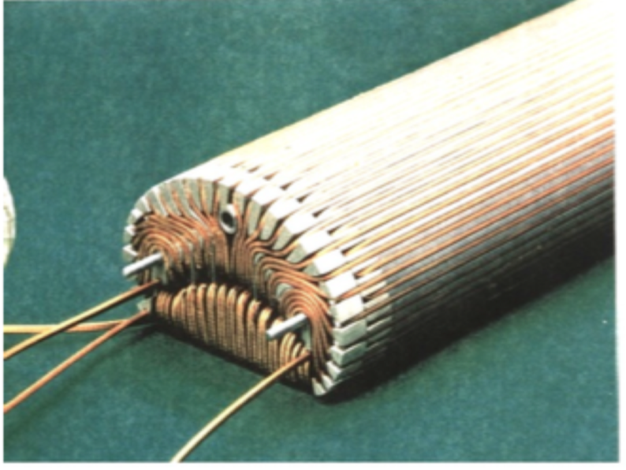
Beam Injection
Inflector Magnet
Provides field free region to deliver beam to edge of storage region
Stops strong deflection of the beam
Injected beam center 77mm off from storage region center

Slide 19
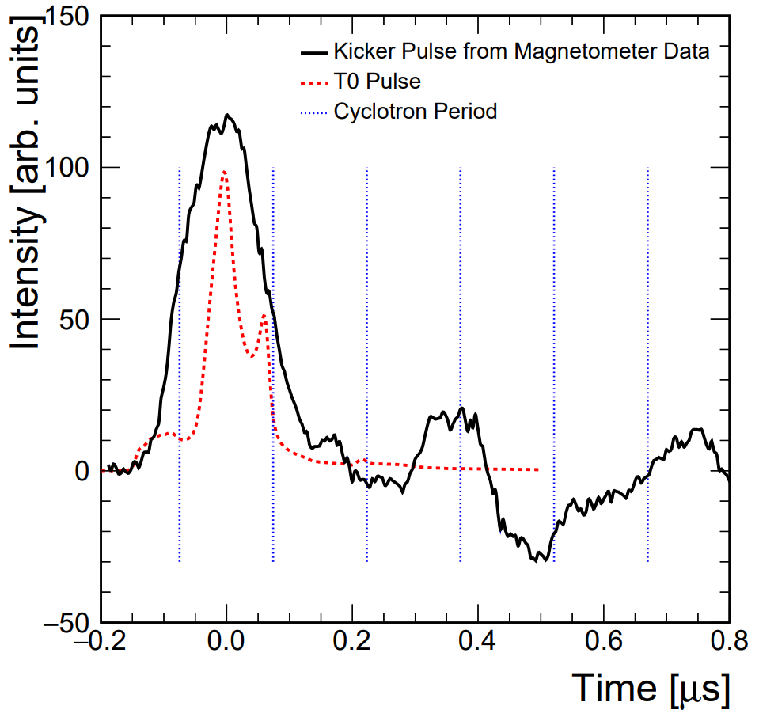

Kick Beam Onto Stable Orbit
μ⁺
Kicker
3 Pulsed Kicker Magnets
Provide 10.8 mrad “kick” to direct muons into ideal orbit (< 149 ns)

Slide 20
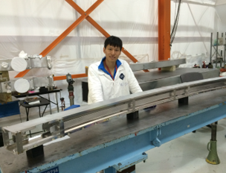
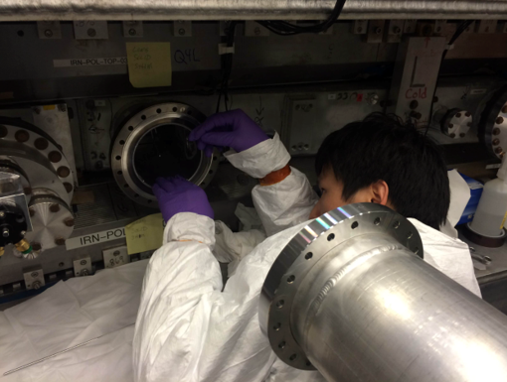
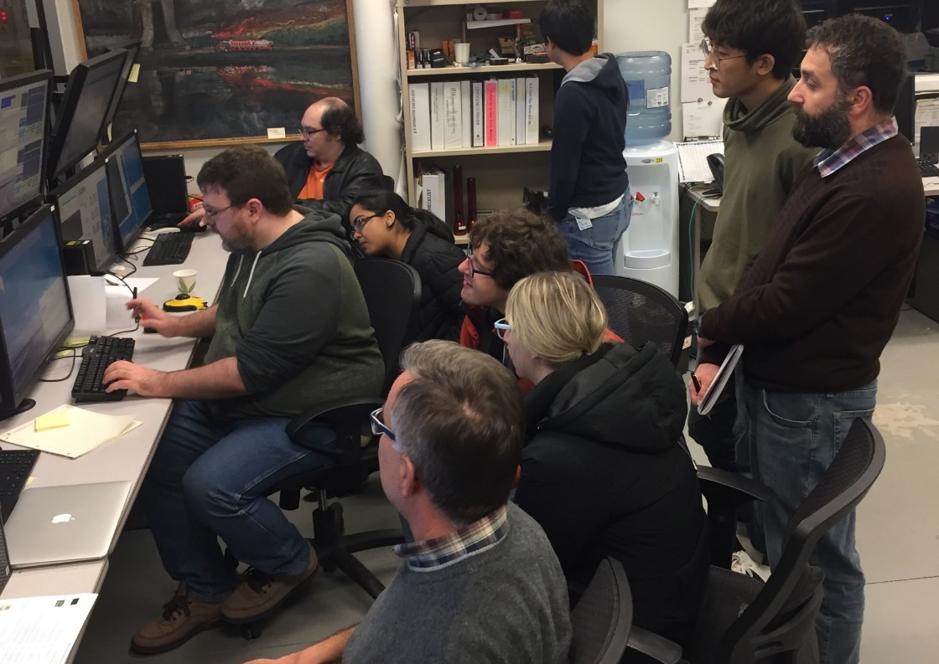
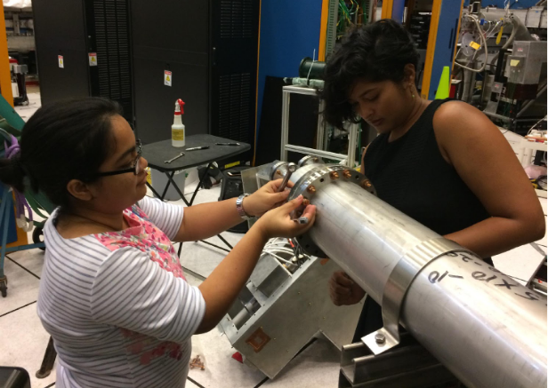
Vertical Focusing with Quadrupoles
+
-
-
4 Electrostatic Quadrupole (ESQ)
Provide weak vertical focusing of the beam
4 sections cover 43% of ring circumference
+
Wanwei W. aligning and installing ESQs
Jason C. teaching us to use them
Meghna B. performing upgrades

Slide 21
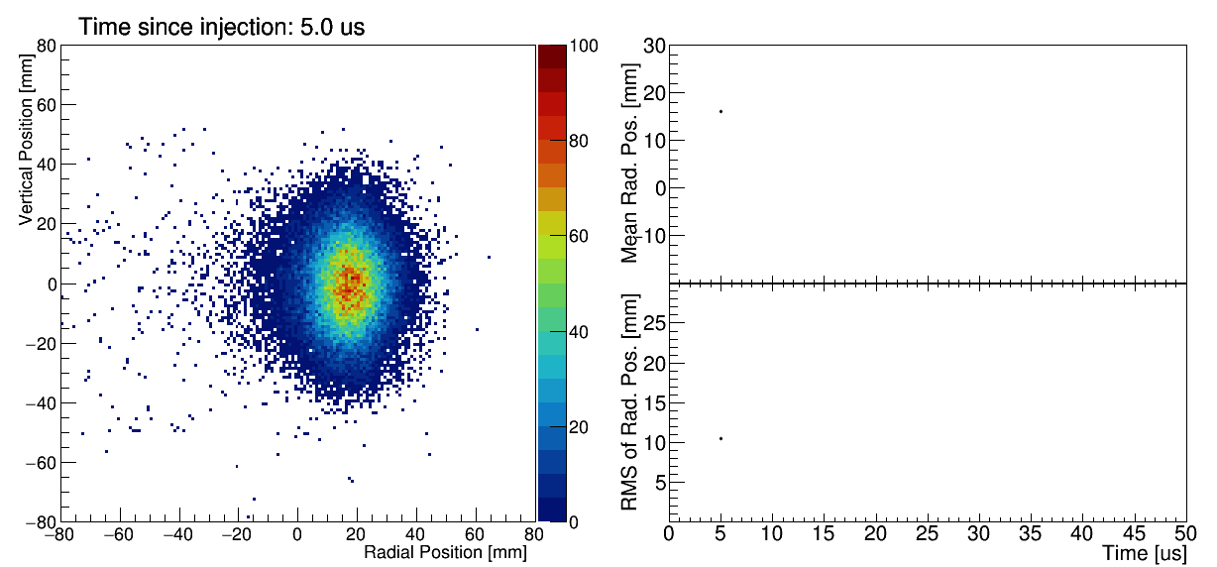
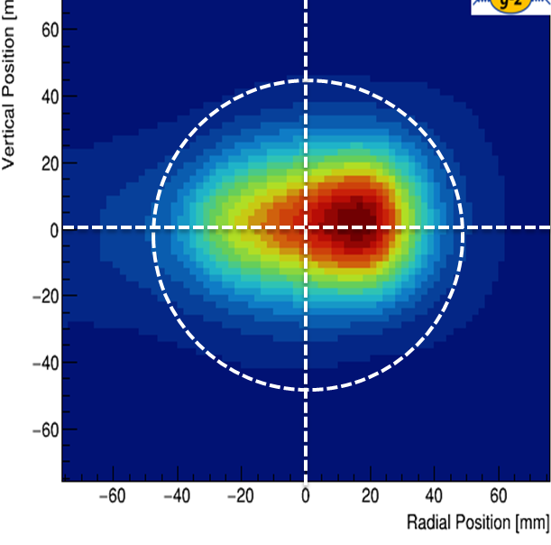
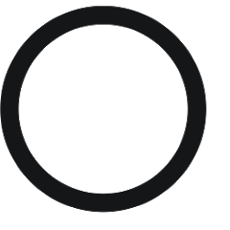
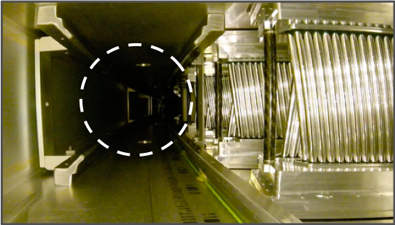
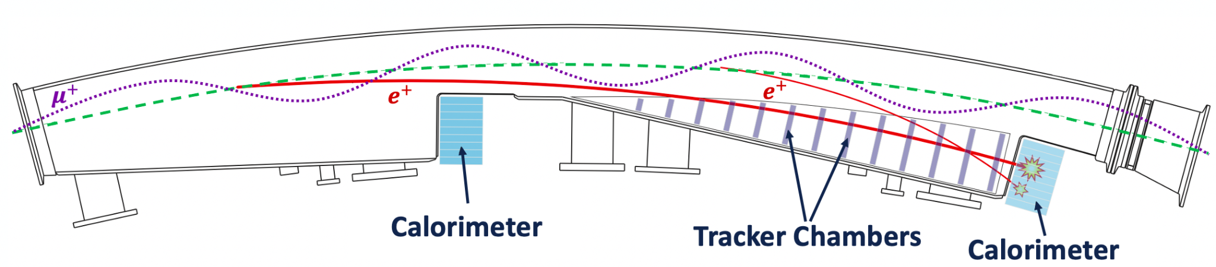
Beam Positions with Trackers
2 Straw Tracker Stations
8 modules/station, 128 straws/module
Reconstruct muon decay positions from e⁺ hits to obtain spatial beam profile

Slide 22



Measure Positrons with Calorimeters
. . .
24 Electromagnetic Calorimeters
9x6 arrays of PbF₂ crystals
Fast SiPM readout
Measure arrival time & energy of the decay e⁺
. . .
Calorimeters
Spin
Momentum
Software threshold

Slide 23



Measuring a_{μ}
Us
Others
Wiggle Plot (calorimeters)
$$a_{μ}∝$$
⊗
Transverse Field Map
(NMR)
Transverse Muon Distribution
(trackers)

Slide 24


Measuring a_{μ}
Realistic beam motion
Time-changing
spin phase
$$a_{μ}∝\frac{ω_{a}}{{\tilde{ω}}_{p}^{′} \left(T_{r}\right)}=\frac{f_{clock} ω_{a}^{meas} \left(1+C_{e}+C_{p}+C_{ml}+C_{pa}+C_{dd}\right)}{f_{calib} \left\langle ω_{p}^{′}\left(x, y, φ\right)×M\left(x, y, φ\right) \right\rangle \left(1+B_{k}+B_{q}\right)}$$
$ω_{a}^{m}$: Measured precession frequency
$\left\langle ω_{p}(\vec{r})×M(\vec{r})\right\rangle$: Muon-weighted magnetic field, ${\tilde{ω}}_{p}$
Now need corrections and calibrations
$f_{clock}$: $ω_{a}$clock blinding
$C$ terms: Beam dynamics corrections to $ω_{a}$
$f_{calib}$: Absolute magnetic field calibration for $ω_{p}$
$B$ terms: Transient magnetic field corrections to $ω_{p}$

Slide 25





Fitting for $ω_{a}$
$$a_{μ}∝\frac{f_{clock} ω_{a}^{meas} \left(1+C_{e}+C_{p}+C_{ml}+C_{pa}\right)}{f_{calib} \left\langle ω_{p}^{′}\left(x, y, φ\right)×M\left(x, y, φ\right) \right\rangle \left(1+B_{k}+B_{q}\right)}$$
Wiggle plot is fit to exponential decay and anomalous precession oscillation
Try simple 5-parameter fit: $N\left(t\right)=N_{0}e^{−t/τ_{μ}} \left[1+Acos\left(ω_{a}t+φ_{0}\right)\right]$
5-parameter simple model is missing several effects
  Radial and vertical beam motions (e.g. Coherent Betatron Oscillations, or CBO)
  Early-to-late slow effects (e.g. Pileup, Muon Losses, Differential Decay)
$$ω_{a}/2π$$
$χ^{2}$/ndf = 4007/4097
5-parameter fit
Full fit

Slide 26


Fitting for $ω_{a}$
$$a_{μ}∝\frac{f_{clock} ω_{a}^{meas} \left(1+C_{e}+C_{p}+C_{ml}+C_{pa}\right)}{f_{calib} \left\langle ω_{p}^{′}\left(x, y, φ\right)×M\left(x, y, φ\right) \right\rangle \left(1+B_{k}+B_{q}\right)}$$
Wiggle plot is fit to exponential decay and anomalous precession oscillation
Try simple 5-parameter fit: $N\left(t\right)=N_{0}e^{−t/τ_{μ}} \left[1+Acos\left(ω_{a}t+φ_{0}\right)\right]$
Full Fit Model
  Accounting fully for all the beam oscillations shifts ω_{a} by 𝒪 1 ppm
  Final fit function has >30 fit parameters
  5 different analysis teams, 8 methods, 20 different analyses
$$ω_{a}/2π$$
$χ^{2}$/ndf = 4007/4097
5-parameter fit
Full fit

Slide 27



Run 2/3 Uncertainties

Slide 28


RF Modulation of Electrostatic Quadrupole Fields
Driving term for harmonic oscillator, applied at CBO frequency and out of phase with it
Example of Run 4/5/6 improvements
Phase space without RF

Slide 29

RF Modulation of Electrostatic Quadrupole Fields
Driving term for harmonic oscillator, applied at CBO frequency and out of phase with it
Example of Run 4/5/6 improvements
Phase space with RF
Reduces coherence, dampens oscillation of mean position

Slide 30


RF Modulation of Electrostatic Quadrupole Fields
No Additional RF
With additional RF
Significant reduction in oscillation amplitude
10x reduction in horizontal CBO amplitude
5x reduction in vertical CBO amplitude
4x reduction in muon loss rate
Better centered muon distribution

Slide 31


Run 4/5/6 Uncertainties
TDR goal of 100 ppb systematic reached
No dominant source of systematic
Further improving would require reduction in many categories

Slide 32

Run 4/5/6 Uncertainties
$$\frac{ω_{a}}{{\tilde{ω}}_{p}^{′}}$$ | Stat. Uncertainty (ppb) | Syst. Uncertainty (ppb) | Total Uncertainty (ppb)
Run-1 | 434 | 159* | 462
Run-2/3 | 201 | 78* | 216
Run-4/5/6 | 114 | 76 | 137
Run-1-6 | 98 | 78 | 125
*corrected based on new systematics analyses since original publication
TDR goal: 140ppb

Slide 33


FINAL FNAL a_{μ} Results
Run-2/3 (2023) halved the Run-1 (2021) uncertainty
Run-4/5/6 (2025) data reduced uncertainty by another factor of 1.8
New world average reduces BNL E821 uncertainty by a factor of 4.4, exceeding design goal
$a_{μ}\left(FNAL\right)=116 592 0705 \left(148\right) × {10}^{−12} (127 ppb)$
$a_{μ}\left(EXP\right) =116 592 0715 \left(145\right) × {10}^{−12} \left(124 ppb\right)$

Slide 34

Consistency Checks
Independent analyses with different methods agree
  T method: accept pulses with energy > 1.7 GeV
  A method: weight pulses by asymmetry A(E); statistically optimal
  R method: cancel out slow variations with ratio technique
  S method: slices by coherent betatron oscillation phase (new!)
  Q method: total energy vs. time

Slide 35

Consistency Checks
Statistical consistency of all analysis datasets
  ($p=58\%$)
BNL
1999-2001
FNAL
2021
FNAL
2023
FNAL
2025

Slide 36


Consistency Checks
Datasets were taken at slightly different field settings allowing a fundamental cross check
  e.g. $ω_{a}∝{B(ω}_{p}^{′})$; ($p=51\%$)
  Also checked a_{μ} vs temperature, day/night, etc.

Slide 37

Conclusion?
2026 Breakthrough Prize in Fundamental Physics
  The Muon g-2 Collaborations at CERN, Brookhaven National Laboratory, and Fermilab
  For multi-decade, groundbreaking contributions to the measurement of the muon's anomalous magnetic moment, pushing the boundaries of experimental precision and igniting a new era in the quest for physics beyond the Standard Model.
Publication | Laboratory | Uncertainty
1961 | CERN | 0.4%
1968 |  | 0.02%
1979 |  | 7 ppm
2006 | Brookhaven National Laboratory | 540 ppb
2021 2023 2025 | Fermi National Accelerator Laboratory | 127 ppb

Slide 38



Outlook: Experimental Progress for a_{μ}
Muon g-2/EDM Experiment @ J-PARC
  Independent low energy approach, novel techniques
  Goal < 400 ppb uncertainty
Proposed MUonE @ CERN
  Alternative approach to measure $a_{μ}^{HVP,LO}$ with $e−μ$ scattering
New $σ\left(e^{+}e^{−}→π^{+}π^{−}\right)$ analyses to resolve the tensions among the data-driven HVP evaluations

Slide 39





Outlook: More BSM Physics from FNAL Muon g-2
Muon Electric Dipole Moment (EDM) search
  Muon EDM in the SM beyond experimental reach (< ${10}^{−20} e⋅cm$)
  A large muon EDM would tilt the muon spin precession plane
  Current limit by the BNL g-2 experiment: $1.8 ×{10}^{−19}e⋅cm$
  Projected limit with FNAL experiment: $≤3 ×{10}^{−20} e⋅cm$
CPT and Lorentz Invariance Violation
  Sidereal/annual motion modulates $ω_{a}$
  Current limit (BNL): $1.4 × {10}^{−24} GeV$
  Projected limit: $𝒪\left({10}^{−25}\right) GeV$
Ultralight Dark Matter
  $ω_{a}$ modulated at the DM Compton frequency

Slide 40











Acknowledgements
Department of Energy (USA),
National Science Foundation (USA),
Istituto Nazionale di Fisica Nucleare (Italy),
Science and Technology Facilities Council (UK),
Royal Society (UK),
Leverhulme Trust (UK),
European Union's Horizon 2020,
Strong 2020 (EU),
German Research Foundation (DFG),
National Natural Science Foundation of China,
MSIP, NRF and IBS-R017-D1 (Republic of Korea)
Thanks also to all engineers, techs and support staffs at all our collaborating institutions for their work which made g-2 successful!!

Slide 41

Thank You!
May 2019 – Elba, Italy

