Slide 1
statistics for data science
F. Morandin – University of Parma
frmor.net

Slide 2
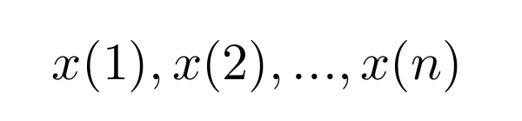
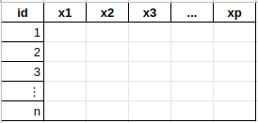
statistics 101
population
whole production lot
uniform subset of larger lot
homo sapiens
smaller community or genetic group
distribution of some quantity in a given experimental setting
modeled as distribution of some random variable (no concept of size, or infinite size)
sample
finite and small subset of the population
modeled as i.i.d. random variables

Slide 3
statistical tests
you look for something exciting in the data
H₀: boring, expected, old physics, no-nobel theory
(you must have a theory/model to predict things here)
H₁: anything different

Slide 4
statistical tests
you have to model H₀ and compute expected distribution of
if you find something that is [a [little] bit] too strange, then you got something new
you must fix beforehand what you call strange
the p-value is the probability of so much strangeness under your H₀ model
sample
statistics
estimators

Slide 5

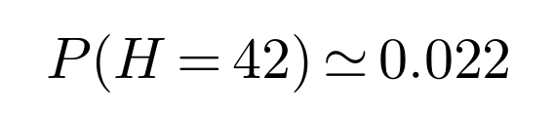
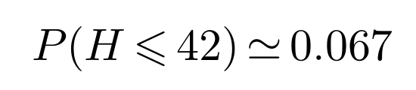
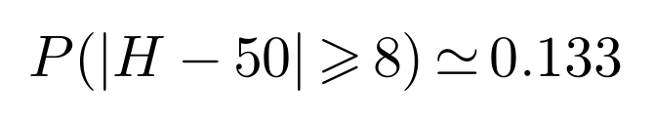
the deadly sin of choosing H₁ late
toss a coin 100 times
you get 42 heads
«Wow! Look at the probability of this: 2.2%!»
«The coin must be rigged!»
you can always redo the experiment if you believe in Douglas Adams...

Slide 6
fine tuning your test
operating charasteristic curve (OCC) is a neglected but useful tool
tests about parameters have it
fair coin toss (100 times)
probability to accept H₀
as a function of the parameter

Slide 7


fine tuning your test
OCC is a measure of the performances of a test
before the experiment
does not depend on data
no p-value here
how to read it?
$$α$$
$$β$$

Slide 8
fine tuning your test
too many false positives?
change k, there is a trade-off
purple [43,57]
green [40,60]
yellow [37,63]
red [31,69]

Slide 9
fine tuning your test
ok, so fix the false positives!
change n and k, cost increases
green [50±10] over 100 tosses
blue [125±16] over 250 tosses
purple [500±31] over 1000 tosses

Slide 10
fine tuning your test
what about unilateral tests?
here H₁: P(heads)<0.5
of course OCC is monotone
let’s compare plots

Slide 11
fine tuning your test
same n and same α
unilateral is more powerful
more specialized H₁
again, choose wisely

Slide 12

fine tuning your test
how to choose the test/curve?
recipe by-the-book is given:
and
when looking for n, fix two points
target/aql/p0/μ0
α
n
$$(x,y)$$

Slide 13
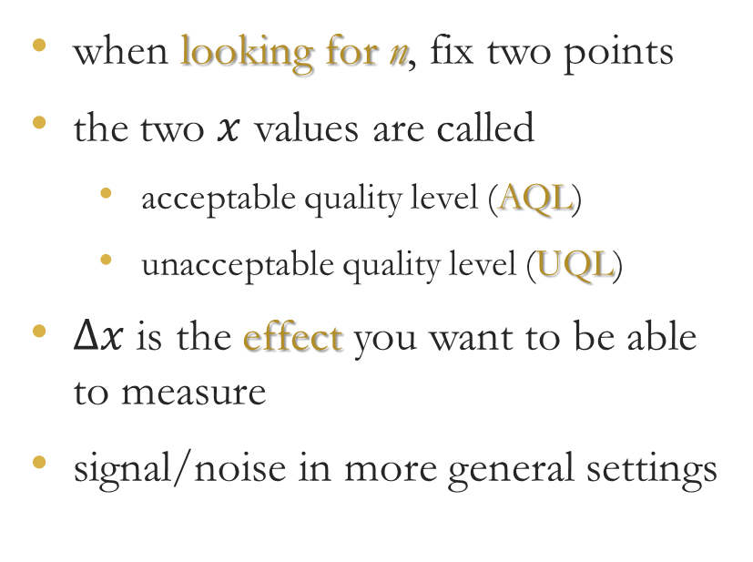
fine tuning your test
when looking for n, fix two points
the two $x$ values are called
  acceptable quality level (AQL)
  unacceptable quality level (UQL)
$Δx$ is the effect you want to be able to measure
signal/noise in more general settings

Slide 14
families of tests
parametric, Gaussian
  few parameters: simple regression, t-test, tests on μ, σ, ...
  many parameters: ANOVA, general regression
parametric, non-Gaussian
non-parametric
  sign test, Wilcoxon
  chi-squared, contingency tables, Fisher-Irwin
  Anderson-Darling, Shapiro-Wilk, ...
Bayesian

Slide 15
parametric or not
compare:
t-test vs Wilcoxon test
one way ANOVA vs contingency tables
they do similar things in similar settings
the ones on the left are parametric tests and require normal data
the ones on the right are non-parametric and have no requirement

Slide 16
parametric or not
the cost of more generality is [much] less statistical power
use parametric tests when possible
non-parametric when data are not Gaussian
how do you know?
there are other tests, of course!

Slide 17
test for normality paradox
H₀: Gaussian distribution H₁: anything else
stringency of this test depends on n (recall OCC)
stringency on H₀ that is really needed depends on the other test
(and usually decreases with n because of central limit theorem!)
it is better to plot the distribution and use your eyes

Slide 18
test for normality (or plot)
what part/feature of the data should be Gaussian?
typically, not the data itself
if there are two groups or conditions
we expect bimodal distribution
for regression/ANOVA, check residuals
must fit the model before checking

Slide 19
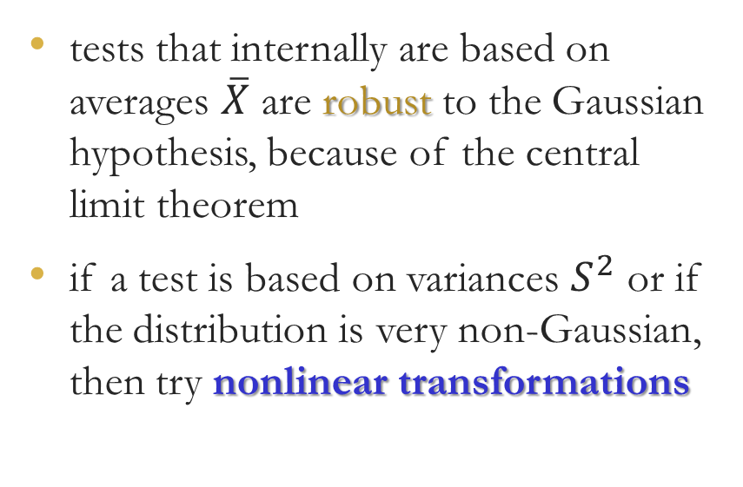
not normal data
tests that internally are based on averages $\overline{X}$ are robust to the Gaussian hypothesis, because of the central limit theorem
if a test is based on variances $S^{2}$ or if the distribution is very non-Gaussian, then try nonlinear transformations

Slide 20
not normal data
when data spans different orders of magnitude, it may be log-normal
in general, concave transformations correct right-skewedness
log sqrt
are your friends

Slide 21
not normal data
right-skewed data are common
these are gamma-distributed
log is a bit too much
but sqrt is quite fine
then you can use the normality hypothesis

Slide 22

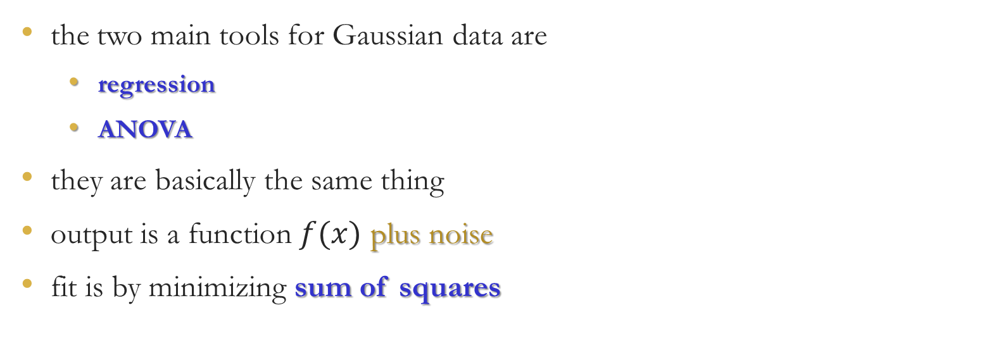
normal data
the two main tools for Gaussian data are
  regression
  ANOVA
they are basically the same thing
output is a function $f(x)$ plus noise
fit is by minimizing sum of squares
$$x_{1}$$
𝑥_1
$$x_{2}$$
𝑥_2
$$x_{p}$$
𝑥_𝑝
...
process
$$Y\sim 𝒩\left(μ=f\left(x\right),σ^{2}\right)$$

Slide 23
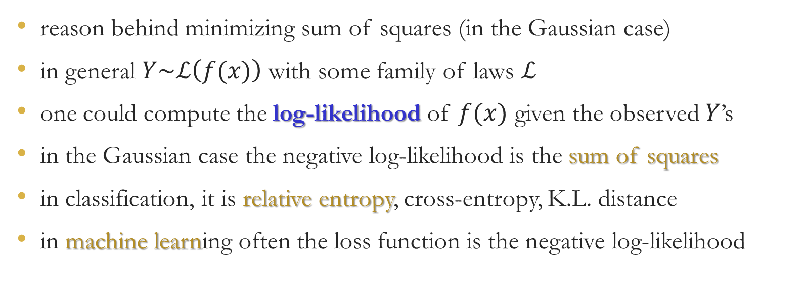
sum of squares
reason behind minimizing sum of squares (in the Gaussian case)
in general $Y\sim ℒ\left(f(x)\right)$ with some family of laws $ℒ$
one could compute the log-likelihood of $f(x)$ given the observed $Y$’s
in the Gaussian case the negative log-likelihood is the sum of squares
in classification, it is relative entropy, cross-entropy, K.L. distance
in machine learning often the loss function is the negative log-likelihood

Slide 24
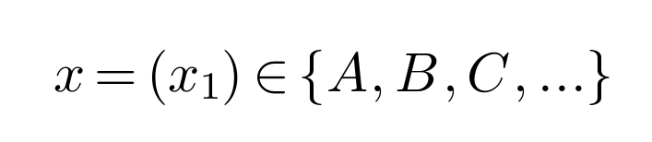
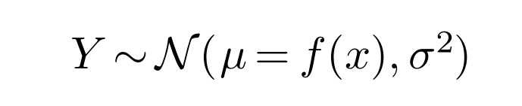
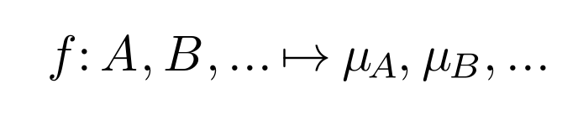
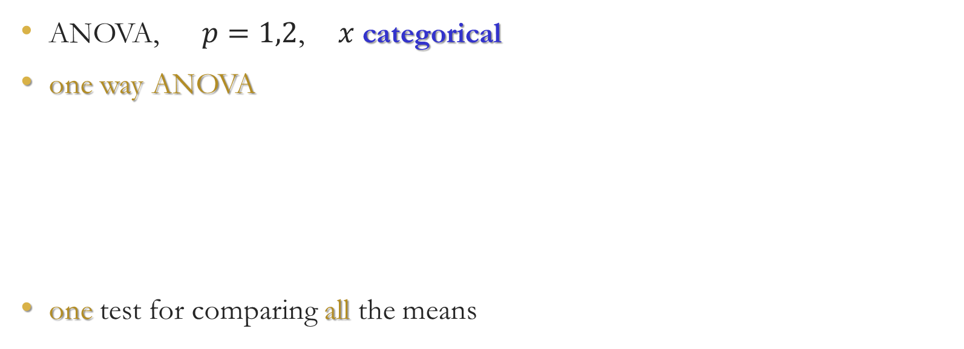
analysis of variance
ANOVA, $p=1,2$, $x$ categorical
one way ANOVA
one test for comparing all the means

Slide 25

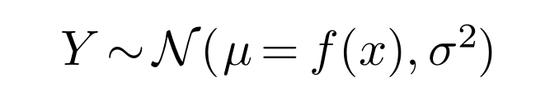

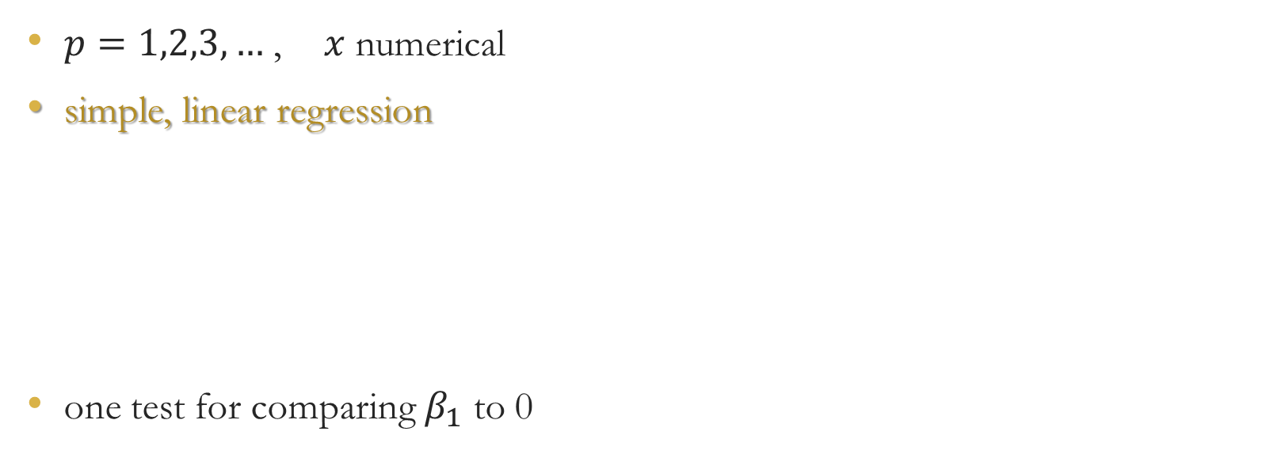
regression
$p=1,2,3,…$, $x$ numerical
simple, linear regression
one test for comparing $β_{1}$ to 0

Slide 26
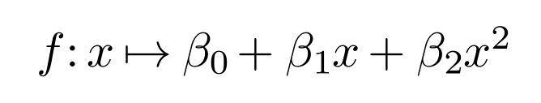
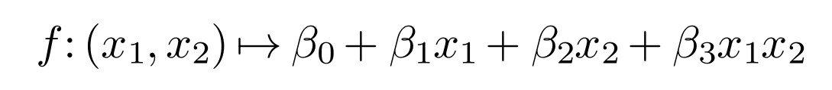

regression is flexible
$p=1,2,3,…$
no costraints in experimental design
allows for polynomial dependence
allows for simple interactions
can also deal with categorical data

Slide 27
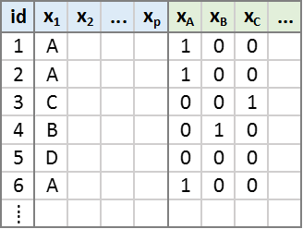
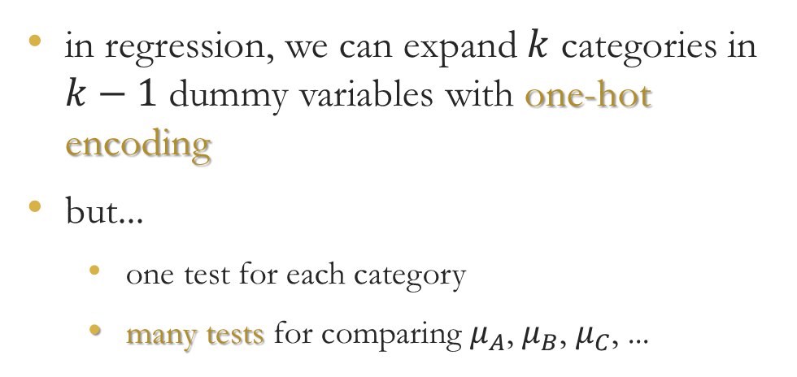
categorical data
in regression, we can expand $k$ categories in $k−1$ dummy variables with one-hot encoding
but...
  one test for each category
  many tests for comparing $μ_{A}$, $μ_{B}$, $μ_{C}$, ...
ANOVA is best for categorical data because of multiple tests

Slide 28
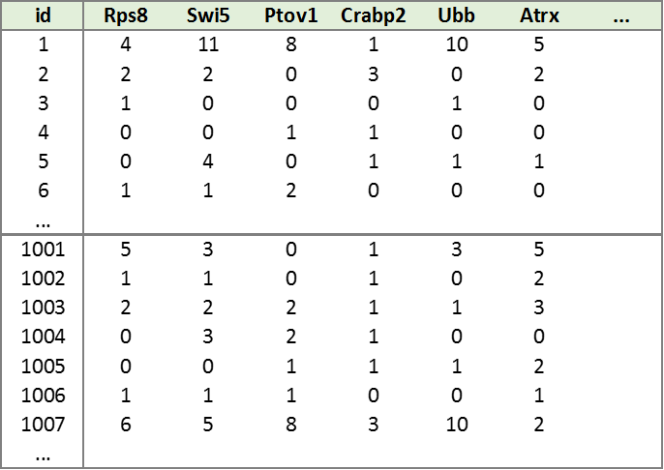
many tests issue
we want to identify genes specifically expressed in some group of cells
we collect a sample of cells inside and outside this group
for each gene we can test if it is differentially expressed in the two groups
genes are 15 thousands

Slide 29
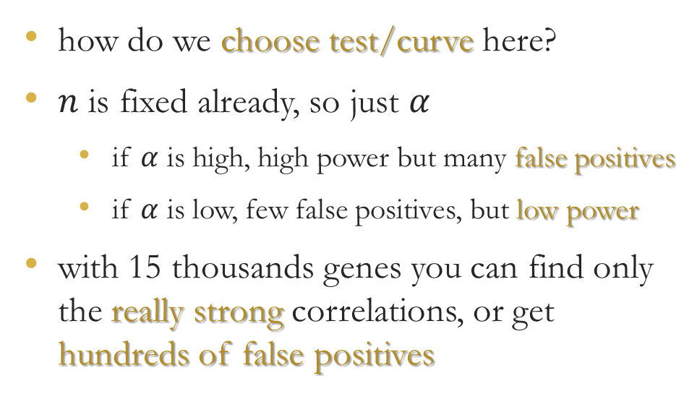
many tests issue
how do we choose test/curve here?
$n$ is fixed already, so just $α$
  if $α$ is high, high power but many false positives
  if $α$ is low, few false positives, but low power
with 15 thousands genes you can find only the really strong correlations, or get hundreds of false positives

Slide 30

curse of dimensionality
the worst thing is when $p$ is large
  multiple tests issue
  clustering with uniform distances
  dubious factor analysis
  noisy selection of variables
  overfitting/overlearning

Slide 31

curse of dimensionality
problems also when $n$ is large
  heavy tails, rare events, outliers
  tests sometimes too powerful
  data visualization, overplotting
  data management
  data cleaning

Slide 32
modern view on p-value
recent upheaval against the misuse of tests in science
  American Statistical Association, June 2016
  American Statistical Association, March 2019
  Nature, 854 signatures, March 2019
«Call for the entire concept of statistical significance to be abandoned.»

Slide 33
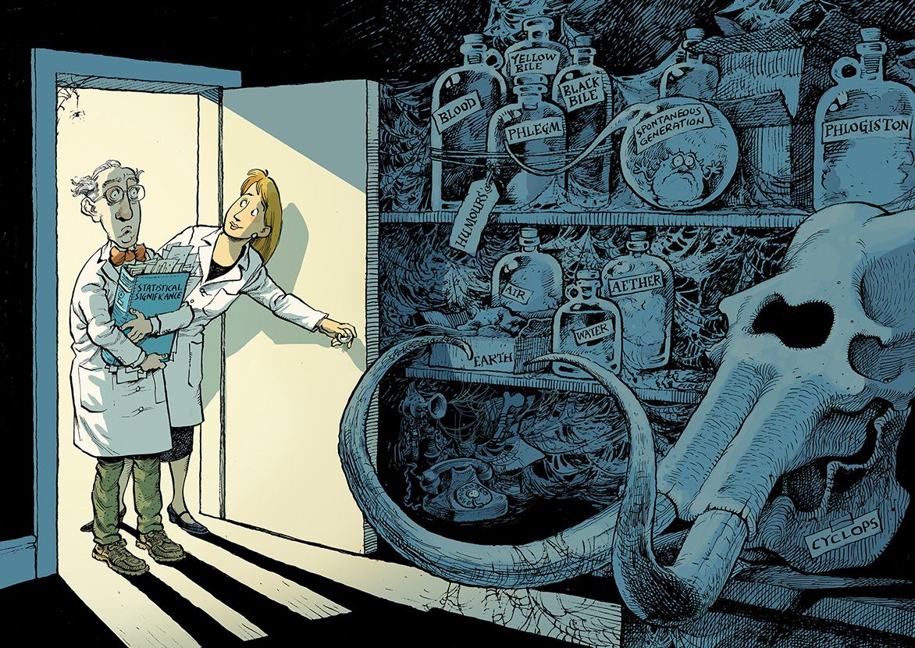

Slide 34
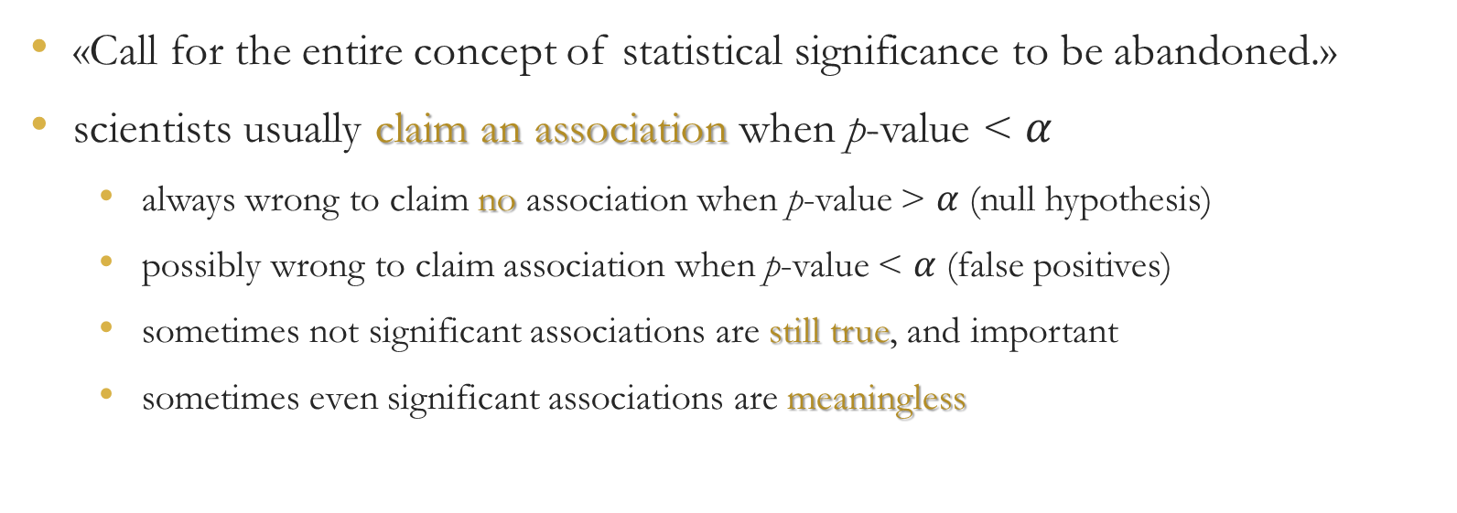
modern view on p-value
«Call for the entire concept of statistical significance to be abandoned.»
scientists usually claim an association when p-value < $α$
  always wrong to claim no association when p-value > $α$ (null hypothesis)
  possibly wrong to claim association when p-value < $α$ (false positives)
  sometimes not significant associations are still true, and important
  sometimes even significant associations are meaningless

Slide 35
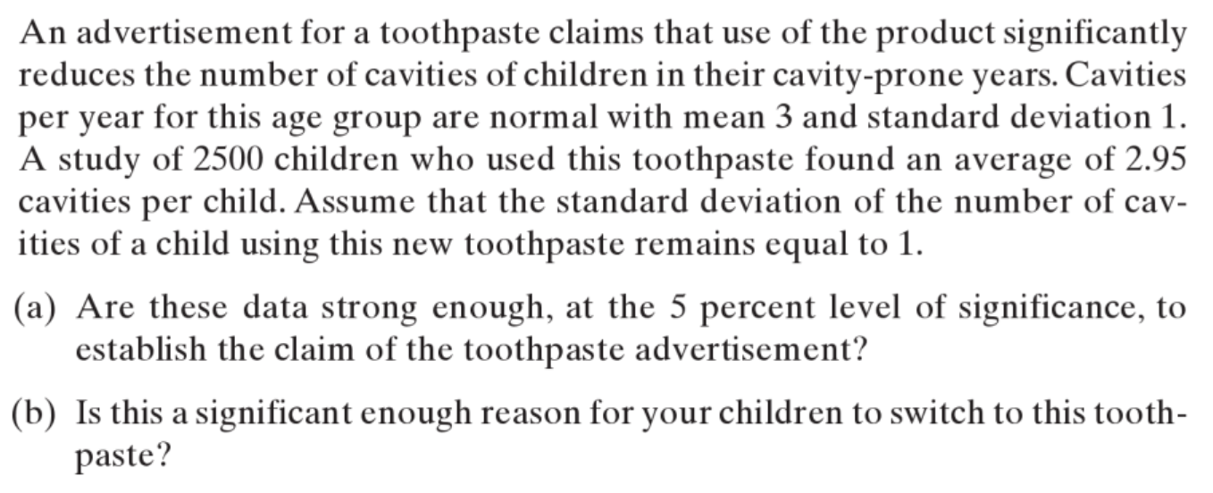
illuminating example
Ross, Introductory Statistics, 2005

Slide 36
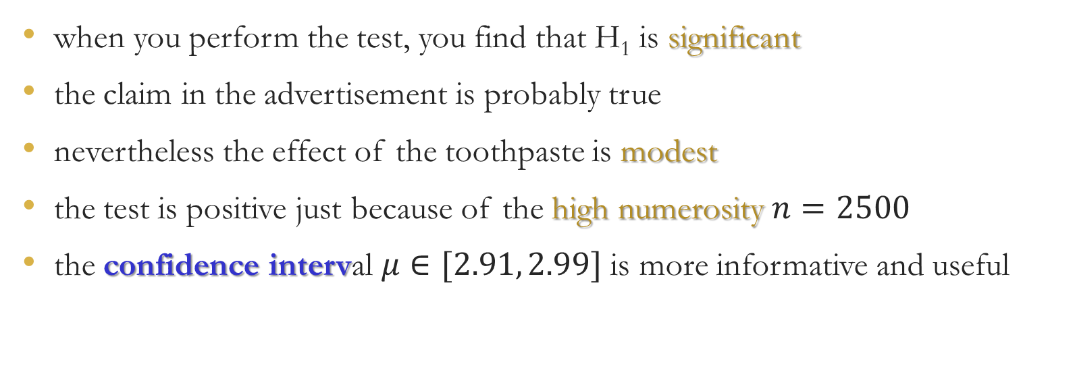
illuminating example
when you perform the test, you find that H₁ is significant
the claim in the advertisement is probably true
nevertheless the effect of the toothpaste is modest
the test is positive just because of the high numerosity $n=2500$
the confidence interval $μ∈[2.91, 2.99]$ is more informative and useful

Slide 37
confidence intervals strike back
modern view on statistics for science recommends to use
  pointwise estimators
  confidence intervals
confidence intervals are the set of values that a test would find compatible with data
as such, in many cases they are more difficult to obtain than p-value

Slide 38
thank you for your attention

