Slide 1

School on Scientific Data Analysis,
25-28 November 2019
Scuola Normale Superiore
Data Analysis in Next Generation Sequencing
Paolo Aretini
Senior Researcher
Fondazione Pisana per la Scienza

Slide 2
Outline
Introduction
Bioinformatics in NGS data analysis
  Basics: terminology, data formats, etc.
  Data Analysis Pipeline
  Sequence Quality Control and preprocessing
  Sequence mapping
  DNA-Seq data analysis
  Post-alignment processing
  Variant Calling
  Variant Annotation, Filtration, Prioritization
  NGS and rare diseases
Summary
Notes:
Today I will talk about the basic principles of data analysis for Next Generation Sequencing. Trying to highlight the advantages of these revolutionary nucleic acid sequencing techniques. I will talk about the steps common to all applications, focusing in the second part on NGS applications that directly involve DNA analysis.
In the third part I will address the clinical applications of DNA-seq analysis, in particular highlighting the merits of these technologies in the diagnosis of rare genetic diseases.

Slide 3
INTRODUCTION
Next generation sequencing (NGS) is the set of nucleic acid sequencing technologies that have in common the ability to sequencing, in parallel, millions of DNA fragments.
These technologies have marked a revolutionary turning point in the possibility of characterizing large genomes compared to the first generation DNA sequencing method (Sanger sequencing), because of the potential to produce, in a single analysis session, a quantity of genetic information millions of times larger.
Notes:
NGS techniques are able of sequencing millions of DNA fragments in a short time.
These techniques represented a turning point compared to traditional sequencing techniques that could process only a few thousand DNA fragments.

Slide 4
INTRODUCTION
The Sanger method was used as part of the "Human Genome Project" for the complete sequencing of the first human genome; this objective was achieved in 2003, after 13 years of work and at an estimated cost of 2.7 billion dollars.
Today sequencing the genome costs 14 thousand times less, now it can be done with about 1000 dollars in a few days. This latest result highlights the rapid evolution in the field of next generation sequencing technologies.
Notes:
Sequencing the human genome using traditional methods took 13 years and $2.7 billion.
Now you can achieve the same result in a few days at a cost of less than $ 1000.

Slide 5
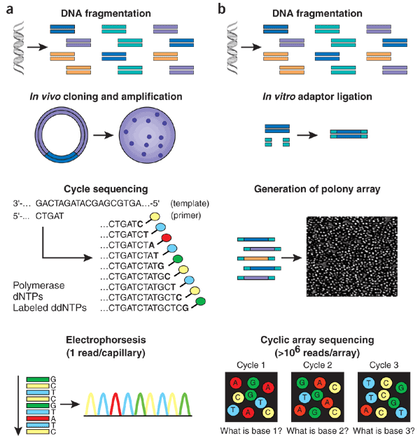
INTRODUCTION
Sanger sequencing
- Robust
- Manual analysis possible
- One region in one patient
NGS
- Multiple regions and patients
- Sensitive
- Need of intensive computational analysis
Notes:
The Sanger sequencing, while being robust and reliable, allows sequencing in a more or less limited genomic region of a patient. Data can be analyzed manually.
The NGS sequences more or less large regions of many patients together, but data analysis requires intensive computational analysis.

Slide 6
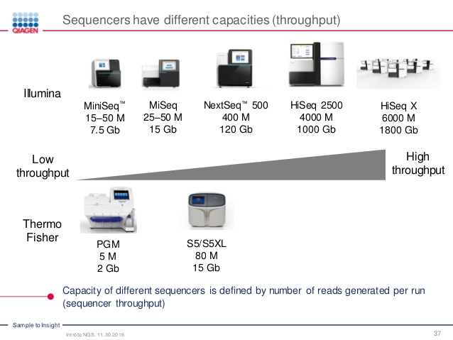
INTRODUCTION
On the market there are two producers of sequencing machine, Illumina and Thermofisher.
llumina produces sequencers able of generating a greater amount of data (6 billion reads)
Notes:
We can say that basically on the market there are two competitors, Illumina and Thermofisher.
However, Illumina produces sequencers capable of generating a greater amount of data (6 billion reads).

Slide 7
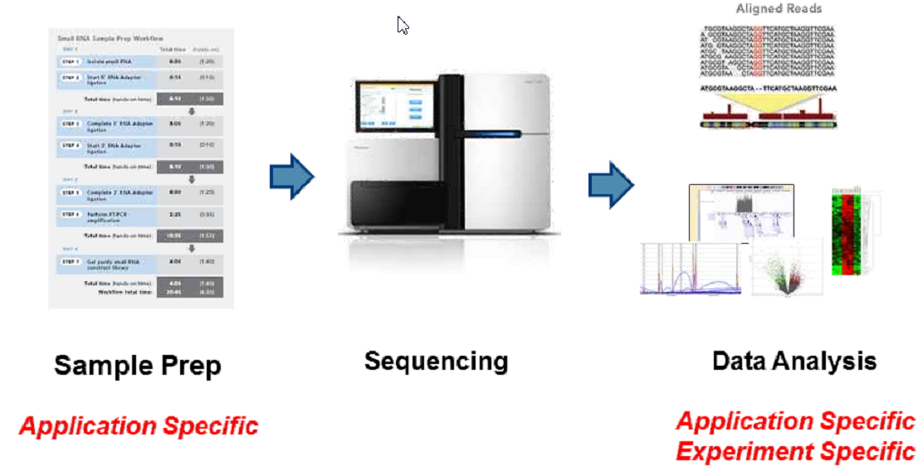
INTRODUCTION
Basic NGS Workflow
While the sequencing run is the same for each type of investigation, the sample preparation and data analysis are application specific.
Notes:
The basic procedures involve sample preparation, running on the instrument and data analysis.
While the sequencing run is the same for each type of investigation, the sample preparation and data analysis are application specific.

Slide 8
INTRODUCTION
NGS technologies are used for many applications:
genetic variant discovery by Whole Genome Sequencing (WGS) or Whole Exome Sequencing (WES, genome encoding regions);
transcriptome profiling of cells, tissues or organisms;
many more applications (alternative splicing, identification of epigenetic markers; ChIP-Seq).
Notes:
NGS technologies are used for many applications such as the discovery of genetic variants by investigating the entire genome or part of it; investigating the transcriptomic profile of cells, tissues or entire organisms.

Slide 9
INTRODUCTION
Bioinformatics Challenges in NGS Data Analysis
The application of NGS techniques required additional Information Technology resources.
“Big Data”
  It’s not possible to do ‘business as usual’ with familiar tools
  Manage, analyze, store and transfer huge files needed
Need for powerful computers and expertise
  Informatics groups must manage compute clusters
  Algorithms and software are required and often time they are open source Unix/Linux based.
  Collaboration of IT experts, bioinformaticians and biologists
Notes:
The application of NGS techniques required additional IT resources.
The enormous amount of data generated by the new sequencers requires computational and data storage power never used in the field of molecular biology.
In this new field of action, close cooperation between IT experts, bioinformaticians and biologists is required.

Slide 10
Outline
Introduction
Bioinformatics in NGS data analysis
  Basics: terminology, data formats, general workflow etc
  Data Analysis Pipeline
  Sequence QC and preprocessing
  Sequence mapping
  DNA-Seq data analysis
  Post-alignment processing
  Variant Calling
  Variant Annotation, Filtration, Prioritization
  NGS and rare diseases
Summary
Notes:
Let's start by clarifying some basic concepts that we need to understand the various phases of the analysis of NGS data.

Slide 11
Terminology
What is bioinformatics?
Broad term:
From AI to biostatistics
Here:
Computational analysis of NGS data
Giving clinical significance to hundreds of genetic alterations
Notes:
Let's define the term bioinformatics. In the broadest sense, it could be defined as a transition from Artificial Intelligence to Biostatistics.
But during today's lesson it will mainly mean computational analysis of NGS data and in particular giving a clinical sense to the results that come out of a sequencer.

Slide 12
Terminology
Genetic variant: An alteration in the most common DNA nucleotide sequence. The term variant can be used to describe an alteration that may be benign, pathogenic, or of unknown significance.
Single-nucleotide variant: a single-nucleotide variant (SNV) is a variation in a single nucleotide without any limitations of frequency and may arise in germline or somatic cells.
Indels: insertion–deletion mutations (indels) refer to insertion and/or deletion of nucleotides into genomic DNA. Indels are important in clinical next-generation sequencing (NGS), as they are implicated as the driving mechanism underlying many constitutional and oncologic diseases.
Whole genome sequencing: (also known as WGS) is the process of determining the complete DNA sequence of an organism's genome at a single time.
Exome sequencing: also known as whole exome sequencing (WES), is a genomic technique for sequencing all of the protein-coding region of genes in a genome (known as the exome)
Notes:
Here are some useful terms to understand the following concepts.
Genetic variants are alterations of the DNA sequence. It is a term that has taken the place of genetic mutation.
Single nucleotide variation (SNV) is an alteration in a single nucleotide of the DNA sequence. INDELS, on the other hand, are variations that involve the loss or acquisition of one or hundreds of nucleotides of DNA. These genetic variants are often the most deleterious, because they produce nonfunctional proteins.
Whole genome sequencing (also known as WGS) is the process of determining the complete DNA sequence of an organism's genome at a single time.
Exome sequencing, also known as whole exome sequencing (WES), is a genomic technique for sequencing all of the protein-coding region of genes in a genome (known as the exome)

Slide 13
Terminology
Paired-End Sequencing: Both end of the DNA fragment is sequenced, allowing highly precise alignment.
Quality Score: Each called base comes with a quality score which measures the probability of base call error.
Mapping: Align reads to reference genome to identify their origin.
Duplicate reads: Reads that are identical. Can be identified after mapping.
Notes:
In this slide I would like to highlight two important terms:
Paired End Sequencing: Sequencing both DNA ends allows for more precise mapping and ultimately more accurate results.
Quality Score: the attribution of the quality score to the single bases that is generated by the same sequencing machines allows to evaluate the quality of the data and improve the subsequent analysis steps.

Slide 14
List of file formats in NGS data analysis
FASTA – The FASTA file format, for sequence data. Sometimes also given as FNA or FAA (Fasta Nucleic Acid or Fasta Amino Acid).
FASTQ – The FASTQ file format, for sequence data with quality. Raw data from sequencer.
SAM – Sequence Alignment/Map format, in which the results of the 1000 Genomes Project will be released.
BAM – Binary compressed SAM format.
VCF – Variant Call Format, a standard created by the 1000 Genomes Project that lists the genetic variants generated by an NGS run.
Notes:
The fasta format is the one most used to store sequence data. It is a text file.
The fastq format represents the raw data that originates from the sequence tools is a text file with the indication of the quality of the reads. The Sam format is used to store mapping data.
The variant Call format (VCF) is a file containing the list of genetic alterations obtained from an NGS run.

Slide 15
Outline
Introduction
Bioinformatics in NGS data analysis
  Basics: terminology, data formats, general workflow etc
  Data Analysis Pipeline
  Sequence QC and preprocessing
  Sequence mapping
  DNA-Seq data analysis
  Post-alignment processing
  Variant Calling
  Variant Annotation, Filtration, Prioritization
  NGS and rare diseases
Summary
Notes:
Let's address the theme of what are the most common pipelines and workflows used for the analysis of NGS data.

Slide 16
NGS Analysis Pipelines
There are different pipelines for different applications. Many steps are common both for pipelines involving RNA analysis and for pipelines involving DNA Analysis
The quality control and mapping steps are fundamental in almost all data analysis procedures.
Quality Evaluation
Quality Evaluation
Sequencing
Read alignment
Transcript compilation
Differential expression
RNA-seq reads (2 x 100 bp)
Mapping
(Star, Tophat2; Hisat2)
(genome)
Gene Expression
(Cufflinks; StringTie)
Differential Gene Expression
(Cuffdiff; DeSeq: EdgeR:
(A:B comparison)
Raw sequencing data
(.fastq files)
Reference genome
(.fa file)
Gene annotation
(.gtf file)
Vizualization
CummeRbund
Inputs
Notes:
There are different pipelines for different applications. However, many steps are common both for pipelines involving RNA analysis and for pipelines involving DNA Analysis.
The quality control and mapping steps are fundamental in almost all data analysis procedures.

Slide 17
NGS Analysis Pipelines
Post-alignment processing
Quality Evaluation
Quality Evaluation
Sequencing
Read alignment
Transcript compilation
Differential expression
DNA-seq reads (2 x 100-150 bp)
Mapping
(BWA, Bowtie2; Soap)
(genome)
Duplicate Removal; Base Recalibration
(GATK; Picard; Samtools))
Variant Calling
(GATK; Mutect; FreeBayes; Pisces))
Raw sequencing data
(.fastq files)
Reference genome
(.fa file)
Variant Annotation
(Annovar; VEP)
Filtration and Prioritization
(Population and Disease Database)
Inputs
In DNA-seq pipeline is very important the improvement of the mapping.
Notes:
Each pipeline starts from the evaluation of the quality of the fastq files and moves to the mapping against a reference genome.
Very important is the quality control step of the mapping and improvement of the mapping.

Slide 18
Outline
Introduction
Bioinformatics in NGS data analysis
  Basics: terminology, data formats, general workflow etc
  Data Analysis Pipeline
  Sequence QC and preprocessing
  Sequence mapping
  DNA-Seq data analysis
  Post-alignment processing
  Variant Calling
  Variant Annotation, Filtration, Prioritization
  NGS and rare diseases
Summary
Notes:
Let's talk about QC sequencing and preprocessing

Slide 19
FASTQ Files
The raw data from a sequencing machine are most widely provided as FASTQ files, which include sequence information, similar to FASTA files, but additionally contain further information, including sequence quality information.
A FASTQ file consists of blocks, corresponding to reads, and each block consists of four elements in four lines. The last line encodes the quality score for the sequence in line 2 in the form of ASCII characters. The byte representing quality runs (lowest quality; '!' in ASCII; highest quality; '~' in ASCII).
The PHRED score is the most used scoring system and represents the probability, on a logarithmic scale, that a base is misread.
Notes:
Quality control starts with the raw fastq files.
Fastq files are text files similar to fasta files with the addition of some information, among which, those related to the quality of the generated bases.
The last line encodes the quality score for the sequence in line 2 in the form of ASCII characters. The byte representing quality runs from 0x21 (lowest quality; exclamation point) to 0x7e (highest quality; tilde'). In this case the sequence is of bad quality.
The PHRED score is the most used scoring system and represents the probability, on a logarithmic scale, that a base is misread.

Slide 20
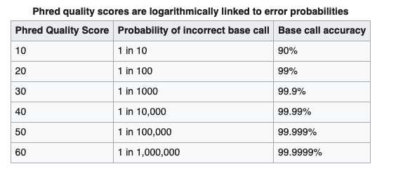
Quality Control: PHRED Score
The PHRED score is depicted in terms of probability of error and accuracy of base calls.
PHRED score above 30 means 99.9 % of accuracy
Notes:
This is a table that represents the PHRED score in terms of probability of error and accuracy of base calls. PHRED score above 30 means 99,9 % of accuracy

Slide 21
Quality Conytrol: Why?
On the basis of the information contained in the fastq files it is possible to carry out a quality control and possibly improve the raw data to avoid errors in the downstream analysis.
By performing QC at the beginning of the analysis, chances encountering any contamination, bias, error, and missing data are minimized.
Notes:
On the basis of the information contained in the fastq files it is possible to carry out a quality control and possibly improve the raw data to avoid errors in the downstream analysis.

Slide 22
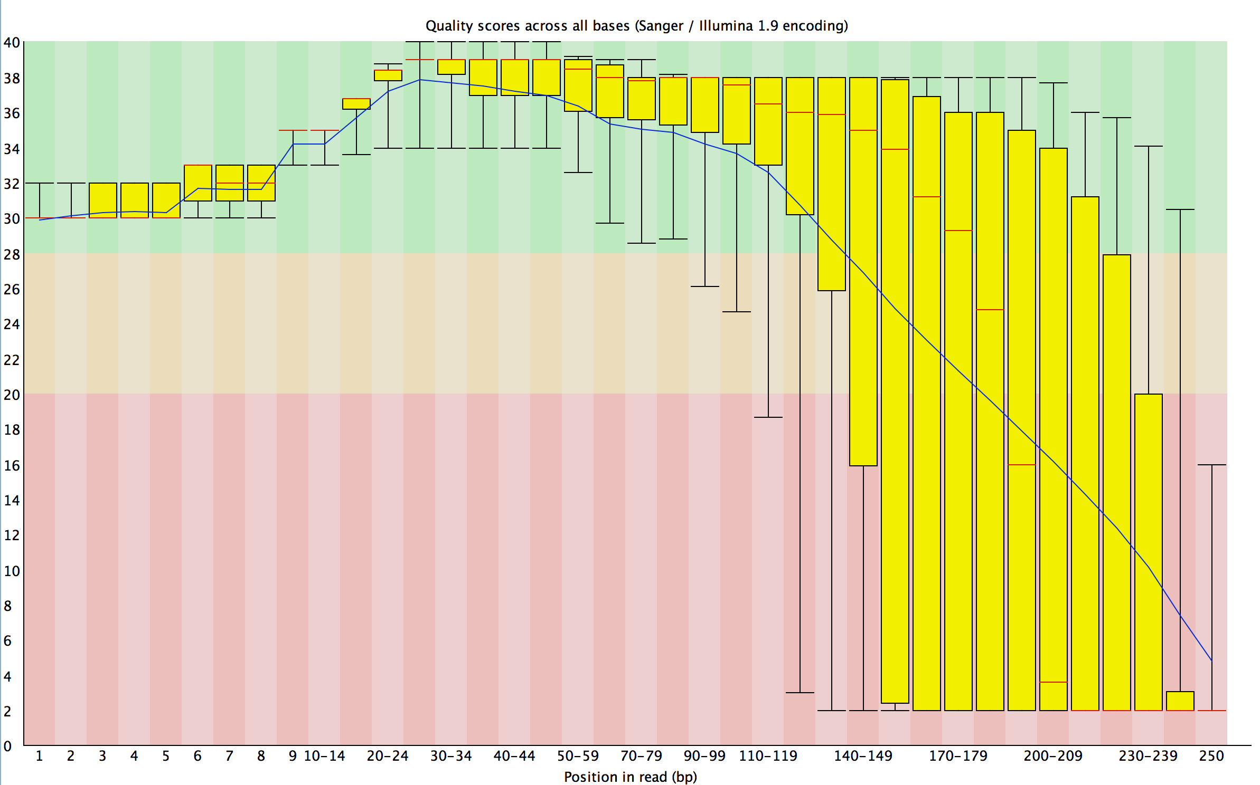
Quality Control: FASTQC
http://www.bioinformatics.babraham.ac.uk/projects/fastqc/
PHRED score
The FASTQC software allows the evaluation of the quality of the sequences. The PHRED score is shown in the ordinate.
Many of the sequences have a value of less than 20. This indicates a probability of error of 1%

Slide 23
FASTQ Files
Tools for FASTQ manipulation an QC improving
Notes:
There are many computer tools to evaluate and improve the quality of reads. They are useful to eliminate contaminations, low quality sequences or too short reads. All factors that can influence the final result of the analysis.

Slide 24
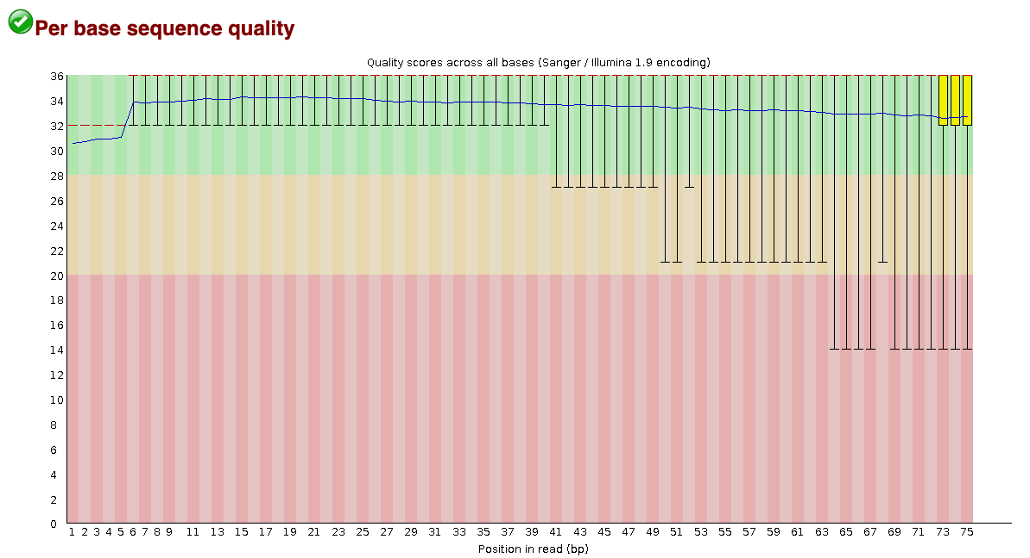
Quality Control: FASTQC
http://www.bioinformatics.babraham.ac.uk/projects/fastqc/
Good quality
PHRED score over 30
The improvement of the quality of the reads is realized through the elimination of the "bad" sequences.
Notes:
After the use of these tools it is often possible to obtain a improvement in the quality of reads, as in this case. The improvement of the quality of the reads is realized through the elimination of the "bad" sequences.

Slide 25
Outline
Introduction
Bioinformatics in NGS data analysis
  Basics: terminology, data formats, general workflow etc
  Data Analysis Pipeline
  Sequence QC and preprocessing
  Sequence mapping
  DNA-Seq data analysis
  Improving the quality and robustness of mapping
  Variant Calling
  Variant Annotation, Filtration, Prioritization
  NGS and rare diseases
Summary
Notes:
Now, sequence mapping.

Slide 26
Pipeline, Software and Algorhytms:
Mapping
Quality Evaluation
Quality Evaluation
Sequencing
Read alignment
Transcript compilation
Differential expression
DNA-seq reads (2 x 100-150 bp)
Mapping
(BWA, Bowtie2; Soap)
(genome)
Duplicate Removal; Base Recalibration
(GATK; Picard; Samtools))
Variant Calling
(GATK; Mutect; FreeBayes; Pisces))
Raw sequencing data
(.fastq files)
Reference genome
(.fa file)
Variant Annotation
(Annovar; VEP)
Filtration and Prioritization
(Population and Disease Database)
Inputs
Different mapping tools for different analysis pipelines: Exome and Genome sequencing, RNAseq (transcriptomics).
Notes:
Mapping requires a specific software and a reference genome. Here are some of the most commonly used tools.

Slide 27
Mapping
Mapping has fastq files as input and produces SAM files.
Factors influencing mapping:
Read length
Sequencing libraries: single-end and paired-end sequencing
Some pitfalls: sequencing errors, low quality reads, duplicated reads.
Notes:
Mapping has fastq files as input and produces sam files.
The factors that influence the mapping process are different:
the length of the reads (a too short sequence generates many hits in homologous regions)
single end and paired end sequencing: Single ends limit the field of application of sequencing;
Sequencing errors, low quality reads and duplicate reads can negatively affect the mapping process.

Slide 28
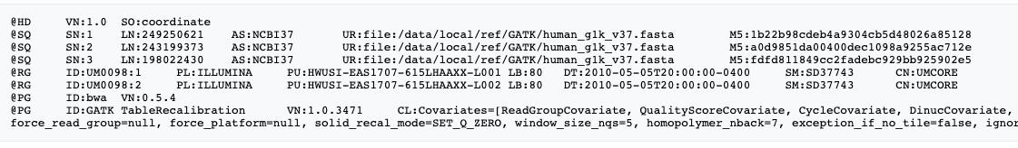
Mapping
SAM Format
The Sequence Alignment/Map (SAM) format is a generic alignment format for storing read alignments against reference sequences. It was firstly introduced by the 1000 Genomes Project Consortium to release the alignments performed.
The SAM format consists of one header section and one alignment section.
The header section contains information about the quality of the mapping, information about the instruments used and about the tools used.
Notes:
The SAM format is the format used to store mapped data.
It contains a section with a header and a section with aligned reads.
The header section contains information about the quality of the mapping, information about the instruments used and in which case it also contains information about the tools used.

Slide 29
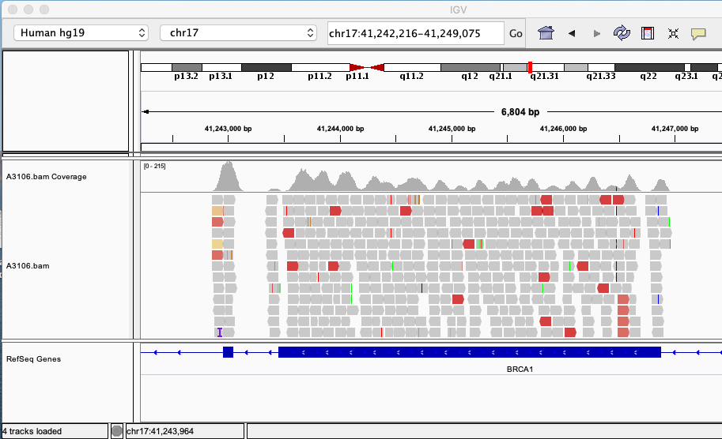
Mapping
BAM Format
To improve the performance, 1000 genomes project consortium designed a companion format Binary Alignment/Map (BAM), which is the binary representation of SAM and keeps exactly the same information as SAM.
BAM is compressed by the BGZF library, a generic library specifically developed to achieve fast random access in a zlib-compatible compressed file.
BAM files can be sorted by chromosomal coordinates. This procedure allows for indexing the BAM. Index sorted alignment enables to efficiently retrieve all reads aligning to a locus.
Notes:
BAM files contain the same information as SAM files, but they are compressed.
They can be sorted by chromosome coordinates and then indexed to find quickly and efficiently genomic regions.

Slide 30
Mapping
SAMtools software package
Samtools is a software that is used to manipulate SAM/BAM files and is one of the most used tools in the analysis of NGS data.
It is able to convert from other alignment formats, sort and merge alignments, remove PCR duplicates, call SNPs and short indel variants, and show alignments in a text-based viewer.
Notes:
Samtools is a software that is used to manipulate SAM/BAM files and is one of the most used tools in the analysis of NGS data.
It is capable of converting various formats of mapping, sort and merge files and so on.

Slide 31
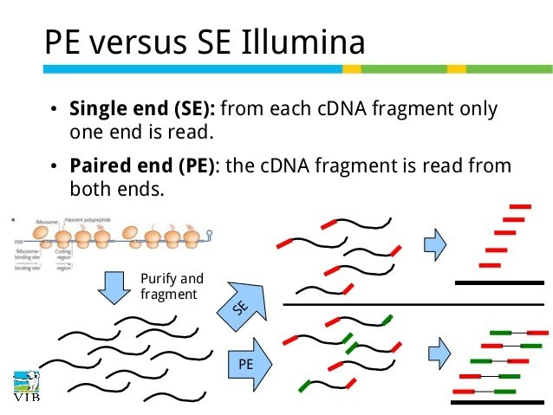
Mapping
Single-End vs Paired-End alignment
Paired-end sequencing:
Improves read alignment and therefore variant calling
Helps to detect structural variation
Can detect gene fusions and splice junctions. Useful for de novo assembly
In general for genomic variant analysis we need high quality reads, paired-end datasets work better, and no multiple hits must be allowed.
Notes:
A short slide to illustrate the advantages of paired end sequencing versus single end sequencing.
Single end means that from each fragment of DNA only one end is read. Paired end means that every DNA fragment is read by both ends.

Slide 32
Mapping
Before starting the mapping…get a reference genome!
A reference genome is a consensus sequence built up from high quality sequenced samples from different populations. It is the control reference sequence to compare our samples
Genome Reference Consortium (GRC) created to deliver assemblies:
http://www.ncbi.nlm.nih.gov/projects/genome/assembly/grc/
Current human assembly is GRCh38, released in the summer of 2014. Many genomic regions corrected and improved such as centromeres.
Notes:
Before proceeding to the alignment it is necessary to have a reference genome for any organism we want to analyze. For the human genome the latest version is the GRCh38 which was released by the Genome Reference Consortium in the summer of 2014.

Slide 33
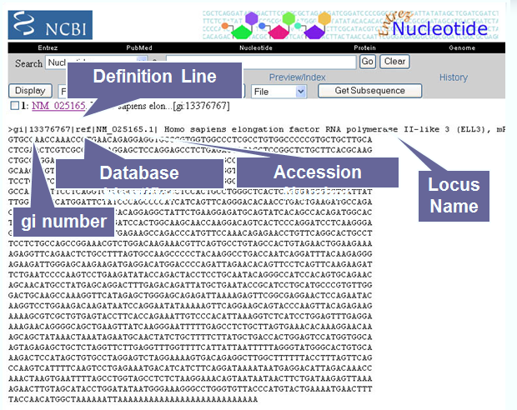
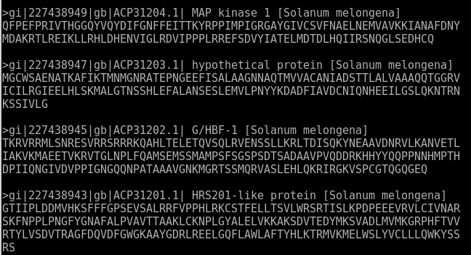
FASTA Files
The file that stores the data of the reference genomes is in the fasta format. It is a text format that has a first line of header, where there are data related to the IDs of the chromosomes
Notes:
The file that stores the data of the reference genomes is in the fasta format that we have already mentioned. It is a text format that has a first line of header, where there are data related to the IDs of the chromosomes

Slide 34
Sequence Mapping
Difficulties:
The high volume of data and the size of the reference genome constitute one of the major difficulties from the computational point of view, reflecting on the execution times.
The length of the reads and the ambiguity caused by repeats and sequence errors are reflected in the accuracy of the mapping.
Notes:
The high volume of data and the size of the reference genome constitute one of the major difficulties from the computational point of view, reflecting on the execution times.
The length of the reads and the ambiguity caused by repeats and sequence errors are reflected in the accuracy of the mapping.

Slide 35
How to choose an aligner?
There are many short read aligners and they vary a lot in performance (accuracy, memory usage, speed and flexibility etc).
Factors to consider : application, platform, read length, downstream analysis, etc.
Guaranteed high accuracy will take longer time.
Popular choices: Bowtie2, BWA, Tophat2, STAR.
Notes:
There are many tools to map reads. The choice of the aligner is made on the basis of precise criteria.

Slide 36
Mapping: RNA-seq
TopHat2, the (old) standard RNA-seq aligner:
It uses Bowtie2 to align reads, so it is not very sensitive, usually maps 75% of reads.
Not ready for long reads (>150bp), mapping decrease to below 50%. Poor performance, can take several hours to map.
Mapping fall down with mismatches, INDELS and longer reads.
STAR:
STAR developed for ENCODE project
High-performance, not very high sensitivity.
Notes:
TopHat, the (old) standard RNA-seq aligner:
It uses Bowtie2 to align reads, so it is not very sensitive, usually maps 75% of reads.
Not ready for long reads (>150bp), mapping decrease to below 50%. Poor performance, can take several hours to map.
Mapping fall down with mismatches, INDELS and longer reads.
STAR:
STAR developed for ENCODE project: https://code.google.com/p/rna-star/
High-performance, not very high sensitivity.

Slide 37
Mapping: DNA-seq
BWA:
It was one of the first NGS mappers and is the most widely used, provides very good results in common scenarios (genome and exome analysis).
It is multi-thread, but lacks some features such as support for RNA-seq or big INDELS (Insertions – Deletions). Not specially fast.
Bowtie2
Bowtie2 is claimed to be the fastest, but it missed many reads. It is a little bit less sensitivity than BWA.
Fail to correctly map many mismatches and INDELS. It is multi-thread, but lacks some biological features such as support for RNA or big INDELS.
Notes:
It was one of the first NGS mappers and is the most widely used, provides very good results in common scenarios (genome and exome analysis).
It is multi-thread, but lacks some features such as support for RNA-seq or big INDELS (Insertions – Deletions). Not specially fast.
Bowtie2
Bowtie2 is claimed to be the fastest, but it missed many reads. It is a little bit less sensitivity than BWA.
Fail to correctly map many mismatches and INDELS. It is multi-thread, but lacks some biological features such as support for RNA or big INDELS.

Slide 38
Outline
Introduction
Bioinformatics in NGS data analysis
  Basics: terminology, data formats, general workflow etc
  Data Analysis Pipeline
  Sequence QC and preprocessing
  Sequence mapping
  DNA-Seq data analysis
  Post-alignment processing
  Variant Calling
  Variant Annotation, Filtration, Prioritization
  NGS and rare diseases
Summary
Notes:
After mapping you can evaluate the quality of the files obtained and improve some parameters to get better downstream analysis.

Slide 39
Pipeline, Software and Algorhytms:
Post-alignment processing
Quality Evaluation
Quality Evaluation
Sequencing
Read alignment
Transcript compilation
Differential expression
DNA-seq reads (2 x 100-150 bp)
Mapping
(BWA, Bowtie2; Soap)
(genome)
Duplicate Removal; Base Recalibration
(GATK; Picard; Samtools))
Variant Calling
(GATK; Mutect; FreeBayes; Pisces))
Raw sequencing data
(.fastq files)
Reference genome
(.fa file)
Variant Annotation
(Annovar; VEP)
Filtration and Prioritization
(Population and Disease Database)
In this step tools like Genome Analysis Tool Kit (GATK) or Samtools are used to remove duplicate PCRs or to recalibrate the quality of the bases.
Inputs
Notes:
In this step tools are used to remove duplicate PCRs or to recalibrate the quality of the bases.

Slide 40
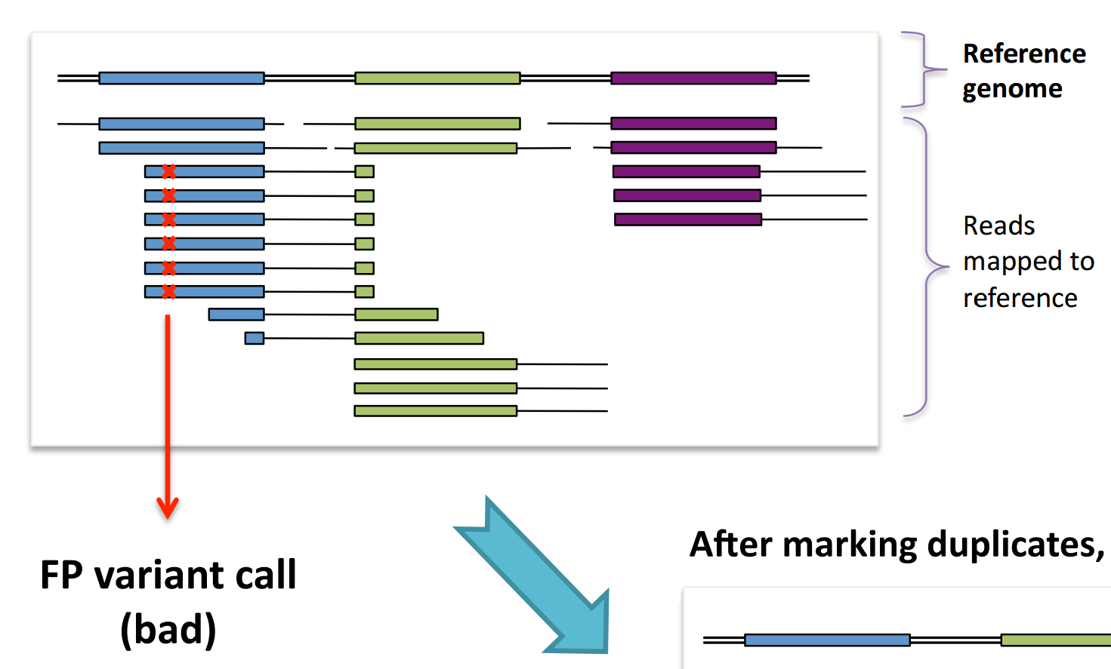
Duplicates Removal
Creating duplicate PCRs during sample preparation can lead to problems in the detection of genetic variants.
.
A sequencing error could be propagated by generating a genetic variant that is really a false positive.
We can remove the PCR duplcate by using bioinformatics tools (GATK, Picard, Samtools.
Notes:
Creating duplicate PCRs during sample preparation can lead to problems in the detection of genetic variants. A sequencing error could be propagated by generating a genetic variant that is really a false positive.

Slide 41
Base Quality Score Recalibration
Information on the quality score is provided directly by the NGS instrument. In some cases they are not very precise.
Base quality score recalibration (BQSR) is a machine learning approach that readjusts the base quality scores.
The most widely used tool for BQSR is provided by the Genome Analysis Toolkit (GATK).
After this step we can recover many unmapped reads.
Notes:
Information on the quality score is provided directly by the instrument. In some cases they are not very precise. The Base quality score recalibration step is able to estimate the score more correctly and provide a more robust one. The tool used in this step is the Genome Analysis Toolkit which includes multiple utilities to manipulate genomic data.

Slide 42
Outline
Introduction
Bioinformatics in NGS data analysis
  Basics: terminology, data formats, general workflow etc
  Data Analysis Pipeline
  Sequence QC and preprocessing
  Sequence mapping
  DNA-Seq data analysis
  Post-alignment processing
  Variant Calling
  Variant Annotation, Filtration, Prioritization
  NGS and rare diseases
Summary
Following data processing steps, the reads are ready for downstream analyses. In the case of DNA-seq analysis the following step is most frequently Variant Calling.
Notes:
Following data processing steps, the reads are ready for downstream analyses. In the case of DNA-seq analysis the following step is most frequently variant calling.

Slide 43
Variant Calling
Variant calling is the process of identifying differences between the sequencing reads and a reference genome.
Input file: BAM-file
Output file: Variant Caller Format - file (VCF)
Notes:
Variant calling is the process of identifying differences between the sequencing reads, resulting from NGS experiments, and a reference genome.

Slide 44
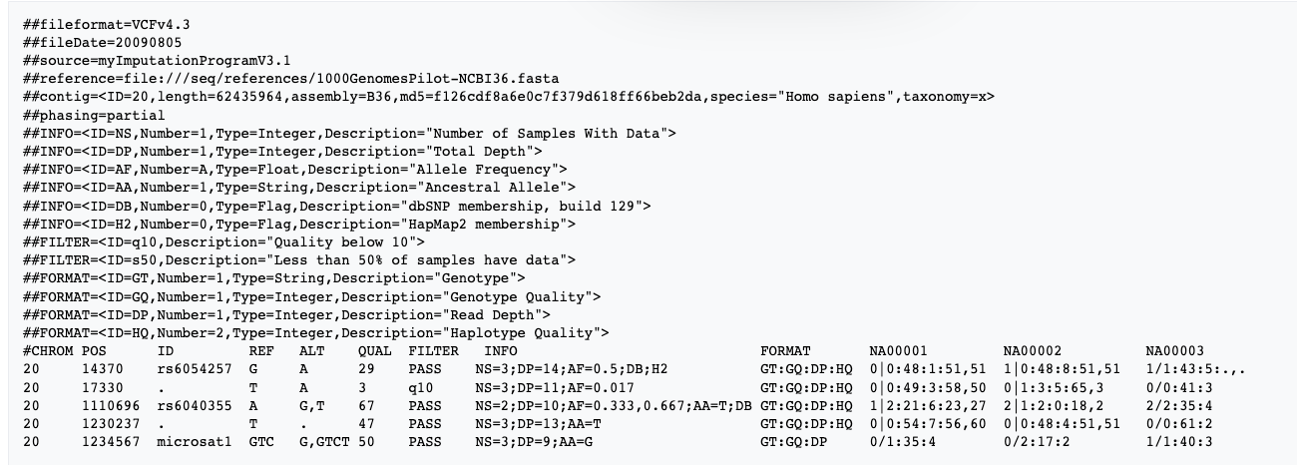
Variant Calling: VCF file
Variant Caller Format file (VCF) is a very raw output of the variant calling process. It contains the chromosomal coordinates of the mutations, useful information to extrapolate the type of mutation, the name of the sample etc.
No gene information inside
Notes:
It's a very raw output of the variant calling process. It contains the chromosomal coordinates of the mutations, useful information to extrapolate the type of mutation, the name of the sample and so on.

Slide 45
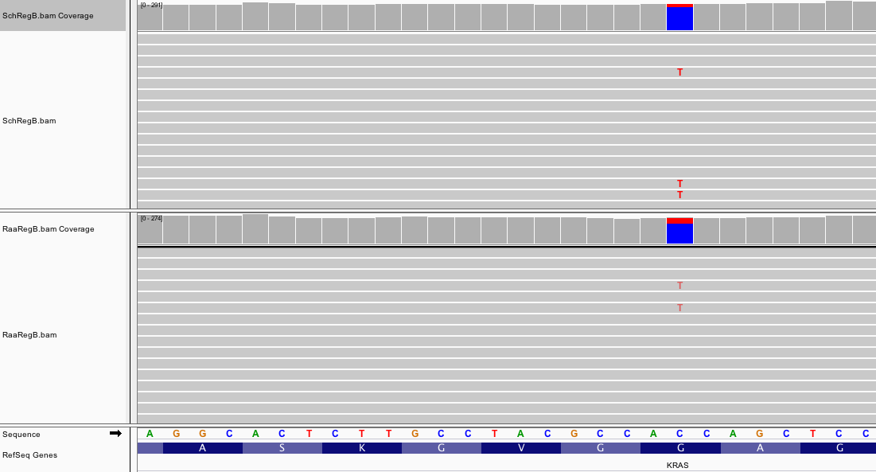
Variant Calling: VCF file
12%
Another very important information in the VCF files is the one related to the Variant Allele Frequency (VAF).
This value indicates how many reads support the presence of genetic variation.
21%
Notes:
Another very important information in the VCF files is the one related to the Variant allele frequency. This value indicates how many reads support the presence of genetic variation. In one case 12%, in the other 21%. These are values related to tumor tissue samples. In the case of normal tissues this parameter reaches a value of about 50%.

Slide 46
Variant Calling
The most widely used state-of-the-art variant callers include, GATK-HaplotypeCaller, SOAPsnp, SAMTools, bcftools, Strelka, FreeBayes, Platypus, and DeepVariant.
A combination of different variant callers outperforms any single method
Notes:
Also in this case there are several useful tools for calling variants. General purpose tools.
In any case, the combination of different tools on the same sample improves the accuracy of the call of the mutations

Slide 47
Somatic calling – some tools
To detect mutations in cancer samples there are specific tools: MuTect2, VarScan2, SomaticSniper.
Almost all of them require the presence of normal tissue data matched with tumor tissue from the same individual to highlight the presence of genetic alterations present only in the tumor sample.
The only tool able to operate with only the presence of tumor data is Pisces (from Illumina), which infers somatic mutations on the basis of the low Variant Allele Frequency.
Notes:
To detect mutations in cancer samples there are specific tools that are listed below. Almost all of them require the presence of normal tissue data from the same individual to highlight the presence of genetic alterations present only in the tumor sample. The only one able to operate with only the presence of tumor data is Pisces, which discovers somatic mutations on the basis of the low variant allele frequency.

Slide 48
Outline
Introduction
Bioinformatics in NGS data analysis
  Basics: terminology, data formats, general workflow etc
  Data Analysis Pipeline
  Sequence QC and preprocessing
  Sequence mapping
  DNA-Seq data analysis
  Post-alignment processing
  Variant Calling
  Variant Annotation, Filtration, Prioritization
  NGS and rare diseases
Summary
Notes:
Next step: Variant annotation, filtration and prioritization

Slide 49
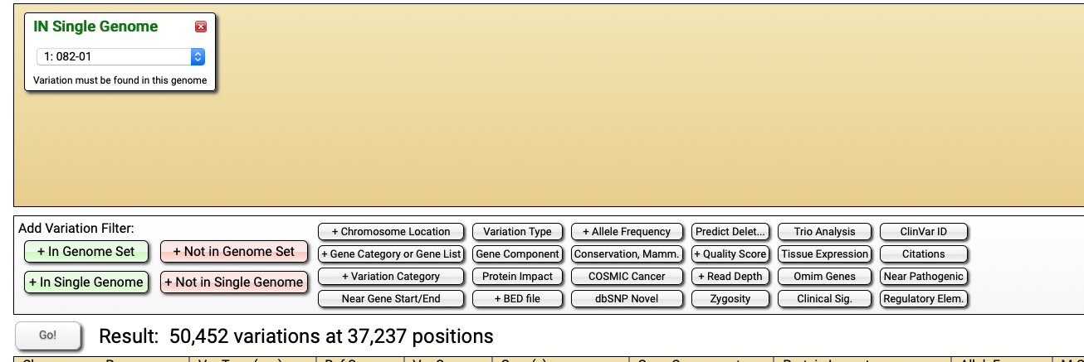
Variant Annotation, Filtration, Prioritization
Next-generation sequencing generates thousands of sequence variants that must be filtered and prioritized for clinical interpretation
Notes:
The large number of genetic variants that are usually found when using instruments such as WGS or WES (3M or 30K), requires a process of filtering variants, eliminating those less significant from a clinical point of view.
This process includes annotation of the variants (mainly attribute the variant to a specific gene or transcript), application of filters on the frequency of population and searches on databases. The aim is to enrich our list of rare variants in the population. This is because the rarer the genetic variant is, the more likely it is to be directly linked to a disease.

Slide 50
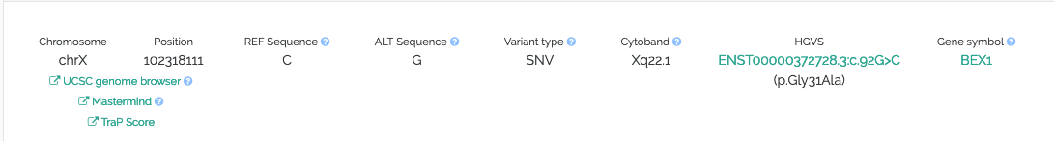
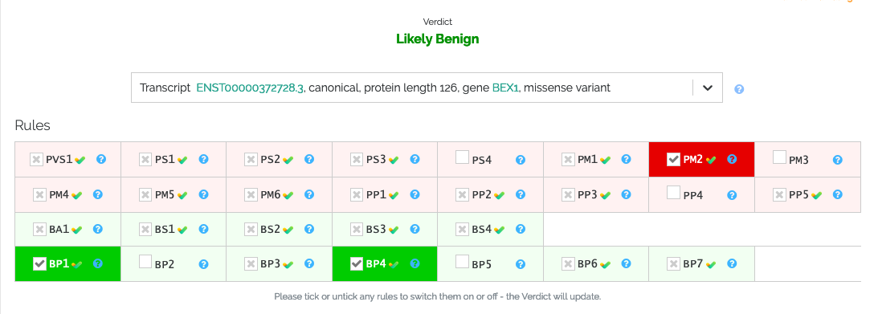
Variant Annotation, Filtration, Prioritization
This process may differ slightly among individual laboratories, but it generally includes annotation of variants (mainly to attribute the variant to a specific gene or transcript), application of population frequency filters and database searches to enrich for rare variants and eliminate common variants, and prediction of functional effect.
Notes:
The large number of genetic variants that are usually found when using instruments such as WGS or WES (3M or 30K), requires a process of filtering variants, eliminating those less significant from a clinical point of view.
This process includes annotation of the variants (mainly attribute the variant to a specific gene or transcript), application of filters on the frequency of population and searches on databases. The aim is to enrich our list of rare variants in the population. This is because the rarer the genetic variant is, the more likely it is to be directly linked to a disease.

Slide 51
VARIANT ANNOTATION
Variant annotation is a critical step in the genomic analysis workflow.
The aim of all functional annotation tools is to annotate information of the variant effects/consequences, including:
Listing which genes/transcripts are affected.
Determination of the consequence on protein sequence.
Correlation of the variant with known genomic annotations (e.g., coding sequence, intronic sequence, noncoding RNA, regulatory regions, etc.).
matching known variants found in variant databases (dbSNP , 1000 Genomes Project, ExAc, gnomAD, COSMIC, ClinVar)
Notes:
The annotation and filtering step is a critical step. The aim is to have as much information as possible to suggest effects and the consequences of genetic variants. In detail you can see here the various information we can get after the annotation.

Slide 52
VARIANT ANNOTATION
Once the analysis-ready VCF is produced, the genomic variants can then be annotated using a variety of tools and a variety of transcript sets.
Both the choice of annotation software and transcript set (e.g., RefSeq transcript set, Ensembl transcript set) have been shown to be important for variant annotation.
The most widely used functional annotation tools include:
AnnoVar, SnpEff, Variant Effect Predictor (VEP), GEMINI , VarAFT VAAST, TransVar, MAGI, SNPnexus, and VarMatch.
Notes:
There are many tools to annotate vcf and we can use different sets of transcripts. Both the choice of the tools and the choice of the transcript is important the annotation of the variants

Slide 53
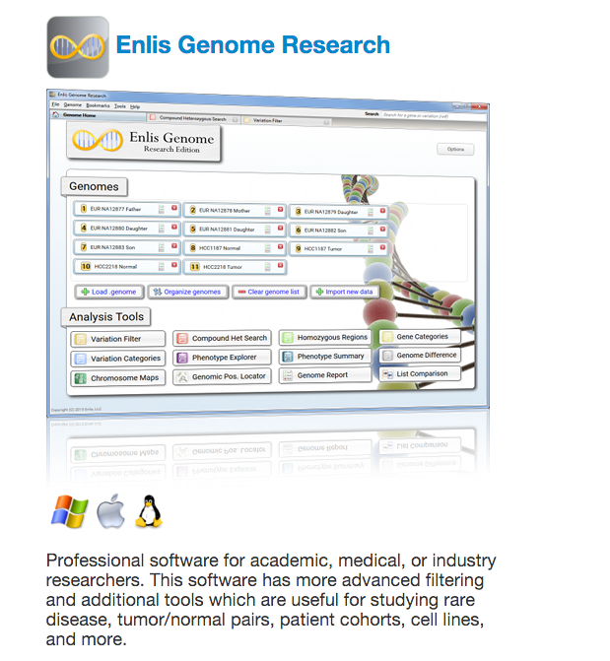
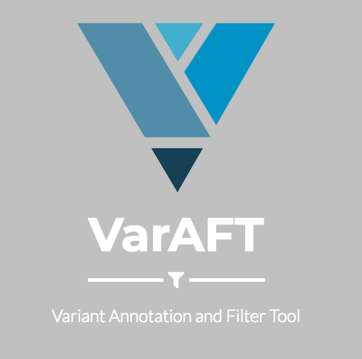
VARIANT ANNOTATION
Many annotation tools utilize the predictions of SNV/indel pathogenecity prediction methods, to name a few, SIFT, PolyPhen-2, LRT, MutationTaster, MutationAssessor, FATHMM, GERP++, PhyloP, SiPhy , PANTHER-PSEP [43], CONDEL, CADD, CHASM, CanDrA, and VEST.
Notes:
The annotation tools use the in silico prediction of the pathogenicity of genetic alterations such as...
Databases, in silico predictions and filtering tools are often implemented in commercial or open source software.

Slide 54
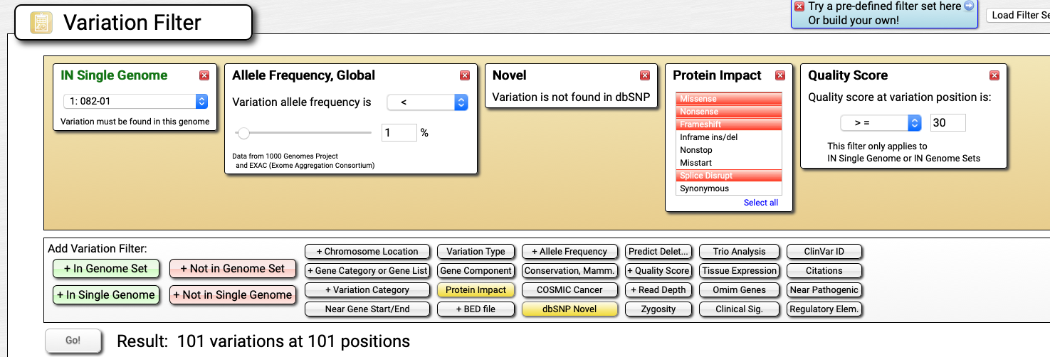
VARIANT FILTRATION
After the annotation we can proceed with the filtering of the variants.
Technical Filtration
Technical quality of variants
- VAF cutoff
- Read depth cutoff
- Variant quality score cutoff
Biological Filtration
Remove known germline variants in population
Remove non-coding and synonymous variants
Notes:
After the annotation we can proceed with the filtering of the variants. A first filtration is the technical one and it concerns the data quality, coverage and variant allele frequency.

Slide 55

VARIANT PRIORITIZATION
The most difficult aspect is to give biological and clinical meaning to the impressive number of genetic variants detected through WES/WGS.
Notes:
The most difficult aspect is to give biological and clinical meaning to the impressive number of genetic variants generated by the NGS techniques

Slide 56
VARIANT PRIORITIZATION
Methods required for the interpretation of genomic variants:
variant-dependent annotation such as population allele frequency (e.g., in 1000 Genomes, ExAc, gnomAD);
the predicted effect on protein and evolutionary conservation;
disease-dependent inquiries such as mode of inheritance;
co-segregation of variant with disease within families;
prior association of the variant/gene with disease, investigation of clinical actionability;
pathway-based analysis;
Notes:
Strategies and methods for achieving results need to be combined. In any case, they use the annotation information

Slide 57
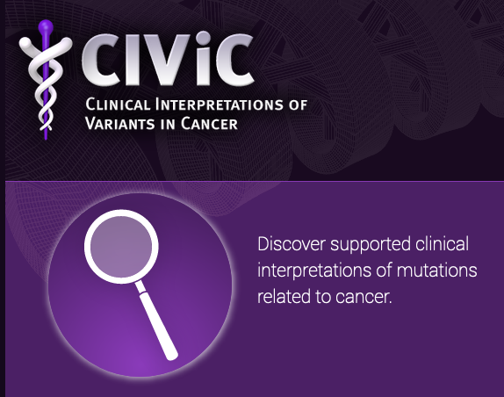

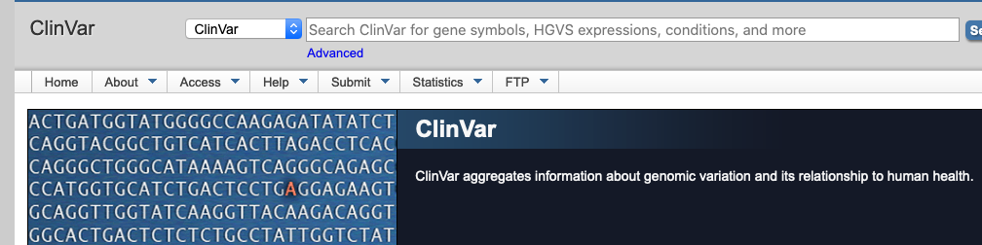
VARIANT PRIORITIZATION
Mutational databases are an indispensable resource to give meaning to genetic data. We can verify if, for example, a mutation has already been found and associated with a disease.
Databases such as ClinVar, HGV databases, COSMIC, and CIViC can aid interpretations of clinical significance of germline and somatic variants for reported conditions.
Notes:
Mutational databases are an indispensable resource to give meaning to genetic data. We can verify if, for example, a mutation has already been found and associated with a disease. There are databases of germ mutations responsible for genetic diseases such as ClinVar or databases of mutations found in tumors such as Cosmic etc.

Slide 58
VARIANT PRIORITIZATION
Some software helps to speeds up the process of interpreting variants.
Ingenuity Variant Analysis, BaseSpace Variant Interpreter, VariantStudio, Varaft and Phenoxome
Notes:
Some software helps to make processes fully automatic and speeds up the process of interpreting variants. We are using Varaft, an open source software updated and up to date.

Slide 59
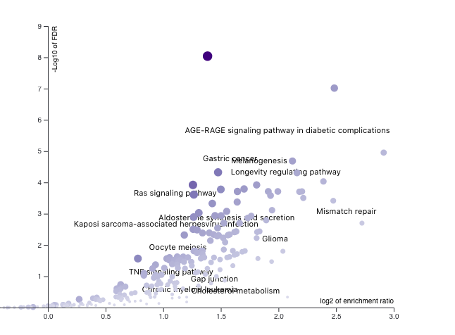
VARIANT PRIORITIZATION
Pathway analysis is another powerful tool to give biological and clinical significance to genetic variants.
It is a method that interacting with public databases is able to group extended lists of genes into smaller sets of linked genes.
Moreover, thanks to the pathway analysis it is possible to clarify the role of several variants and their interaction in the onset of a disease.
Notes:
Pathway analysis is another powerful tool to give biological and clinical significance to genetic variants. It is a method that interacting with public databases is able to group extended lists of genes into smaller sets of linked genes. Moreover, thanks to the pathway analysis it is possible to clarify the role of several variants and their interaction in the onset of a disease.

Slide 60

VARIANT PRIORITIZATION
Countless tools for pathway analysis exist. Some of the widely used pathway analysis tools are GSEA, DAVID, IPA PathVisio.
Additionally, many different pathway resources exist, the most popular of which are Kyoto Encyclopedia of Genes and Genomes (KEGG), Reactome, WikiPathways, MSigDb, STRINGDB, Pathway Commons, Ingenuity Knowledge Base, and Pathway Studio.
WEB-based Gene SeT AnaLysis Toolkit (WEBGESTALT) brings together methods and databases to perform a very comprehensive analysis.
Notes:
There are countless tools that can perform this type of analysis. Almost all of them are connected to databases that group genes into functional groups.
WEB-based Gene SeT AnaLysis Toolkit (WEBGESTALT) brings together methods and databases to perform a very comprehensive analysis.

Slide 61
VARIANT PRIORITIZATION
Many times, however, it is necessary to validate «in vitro» the results in silico, in order to arrive at definitive conclusions about the pathogenicity of genetic alterations. Especially if you want to inform a patient of the course of the disease.
Functional validation can be performed using different model systems (e.g., patient cells, model cell lines, model organisms, induced pluripotent stem cells) and performing the suitable type of assay (e.g., genetic rescue, overexpression, biomarker analysis).
Notes:
Many times, however, it is necessary to validate the results in silico in order to arrive at definitive conclusions about the pathogenicity of genetic alterations. Especially if you want to inform the patient of the course of the disease.
Functional validations can be performed using different model systems.

Slide 62
Outline
Introduction
Bioinformatics in NGS data analysis
  Basics: terminology, data formats, general workflow etc
  Data Analysis Pipeline
  Sequence QC and preprocessing
  Sequence mapping
  DNA-Seq data analysis
  Post-alignment processing
  Variant Calling
  Variant Annotation, Filtration, Prioritization
  NGS and rare diseases
Summary
Notes:
Let's now see an interesting application of NGS methods aimed at genetic analysis. Rare diseases.

Slide 63
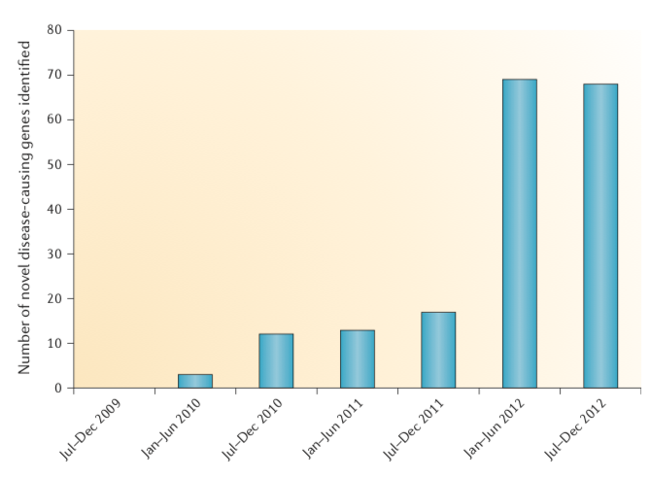
NGS and rare diseases
The number of rare diseases varies between 6000 and 7000 according to recent estimates (OMIM and Orphanet)
Many of these diseases are difficult to diagnose with traditional methods.
Genetic diagnosis of these diseases has been significantly increased in recent years thanks to NGS techniques.
Notes:
The number of rare diseases varies between 6000 and 7000 according to recent estimates. Many of these diseases are difficult to diagnose with traditional methods. Genetic diagnosis of these diseases has been significantly increased in recent years thanks to NGS techniques.

Slide 64
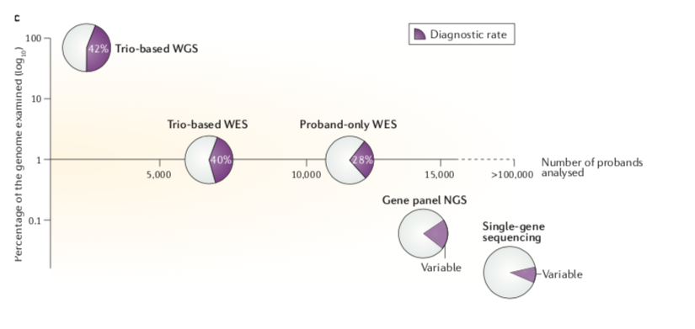
NGS and rare diseases
WGS and WES are powerful approaches for detecting genetic variation.
However, because of the extent and inherent complexity (as well as the greater cost) of WGS, WES is currently the more popular platform for the discovery of rare-disease-causing genes.
A clinical next-generation sequencing test can be designed to target a panel of selected genes. Gene panels target curated sets of genes associated with specific clinical phenotypes.
Notes:
WES is certainly the most widely used approach for the diagnosis of rare genetic disorders. This is because it is definitely a reliable method and really less expensive than the WGS.
Another approach is to select a panel of selected genes allegedly involved in the disease to be studied. As you can see from the graph, however, the percentage of cases detected is much lower than 40% obtained with WES or WGS.

Slide 65
NGS and rare diseases
Identifying inherited mutations
Knowledge of the disease history of the various family members is always of great help in the diagnosis of genetic diseases
When there is familial recurrence of a defined rare phenotype or parental consanguinity, the likelihood that a rare disease is monogenic is high.
Notes:
Knowledge of the disease history of the various family members is always of great help in the diagnosis of genetic diseases

Slide 66
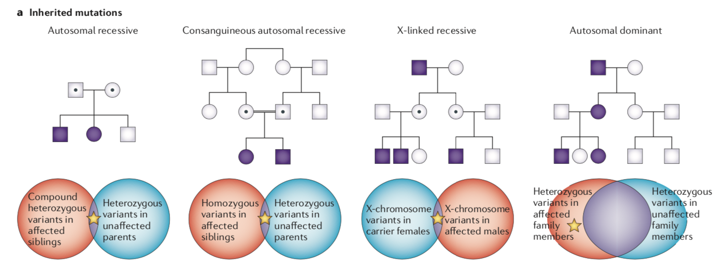
NGS and rare diseases
Identifying inherited mutations
The mode of inheritance influences the selection and number of individuals to sequence, as well as the analytical approach used.
Notes:
Here are represented the various types of hereditary transmission of the disease.
Autosomal recessive, autosomal recessive consanguineous (or of isolated populations), X-linked recessive and autosomal dominant. Without going into detail, it should be remembered that the mode of inheritance influences the selection and number of individuals to sequence, as well as the analytical approach used

Slide 67
NGS and rare diseases
Autosomal recessive disease: a case of Leigh Syndrome
We have supported a unit of Medical Genetics to correctly frame a case of Leigh Syndrome, a neurodegenerative disease that leads to death in the early years of life.
The disease is generally caused by mutations in mitochondrial genes, although mutations also exist in nuclear genes. We decided to approach the case by analyzing the members of the family with the WES.
Notes:
Let us now describe a case of an autosomal recessive disease, i.e. a disease in which the gene must be altered in each of the two copies normally present.
We have supported a unit of medical genetics to correctly frame a case of Leigh Syndrome, a neurodegenerative disease that leads to death in the early years of life. The disease is generally caused by mutations in mitochondrial genes, although mutations also exist in nuclear genes. We decided to approach the case by analyzing the members of the family with the WES.

Slide 68
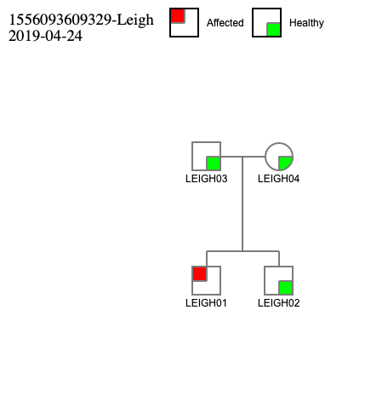
NGS and rare diseases
Homozygous variants: a case of Leigh Syndrome
The patient was a 19-year-old man who was diagnosed at 3 years of age with LS using clinical and neuroimaging data.
LS syndromes due to mtDNA mutations were excluded.
WES analysis was performed on the proband and the asymptomatic father’s and mother’s DNA.
Notes:
The case concerns a boy still alive at the age of 19.

Slide 69
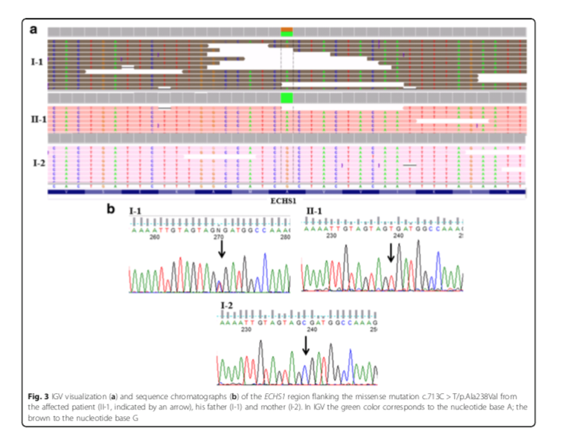
NGS and rare diseases
Homozygous variants: a case of Leigh Syndrome
To filter the hundreds of variants that remained even after the analysis of family segregation, we used a list of 30 genes that we have derived from the literature.
We found a variant in ECHS1 gene: the c.713C > T/ p.Ala238Val mutation was present in the proband in an apparent homozygous state, whereas the father only was found to be heterozygous. This mutation was predicted to be pathogenic by "in silico" models.
The mutation was absent in the mother.
Mutations in enoyl-CoA hydratase (ECHS1) has been previously associated with LS in several patients.
Notes:
To filter the hundreds of variants that remained even after the analysis of family segregation, we used a list of 30 genes that we have derived from the literature. We found a homozygous missense mutation in the ECHS1 gene already described as implicated in the LS. This mutation was predicted to be pathogenic by "in silico" models. The mutation was absent in the mother.

Slide 70
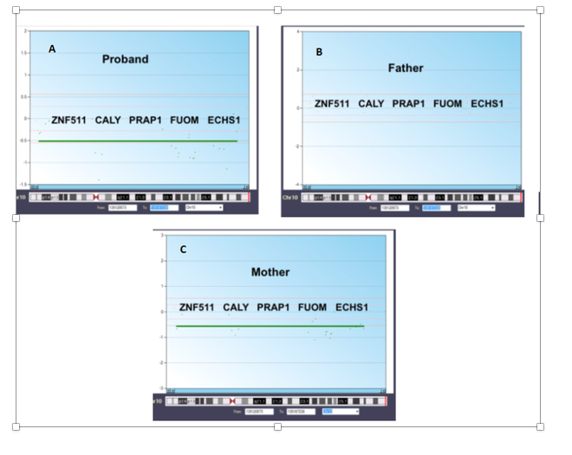
NGS and rare diseases
Homozygous variants: a case of Leigh Syndrome
Generally a homozygous mutation exists because both mother and father carry the same mutation. This made us suspect the presence of a deletion of one portion of chromosome where the ECHS1 gene is located.
We detected a deletion in an extended region of chromosome 10 (from 135,120,573 to 135,187,238) involving five genes: ZNF511, CALY, PRAP1, FUOM, and ECHS1. This deletion was present in the proband and in his mother but not in the father.
Notes:
Generally a homozygous mutation exists because both mother and father carry the same mutation. This made us suspect the presence of a deletion of one portion more than the chromosome where the ECHS1 gene is located. Using the data contained in the mapping files, we detected the presence of an extensive deletion of chromosome 10, shared with the affected boy.

Slide 71
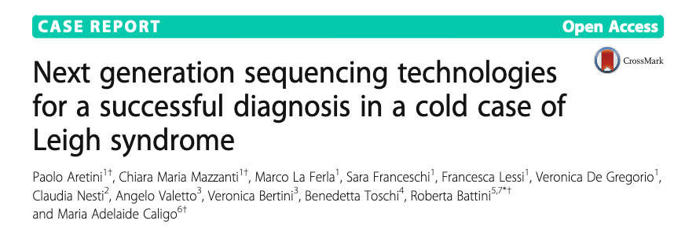
NGS and rare diseases
Homozygous variants: a case of Leigh Syndrome
We confirmed the clinical diagnosis hypothesized for 15 years by using whole exome sequencing (WES) analysis, which identified a missense mutation in ECHS1 and a deletion of the entire gene.
Notes:
Thanks to the analysis of the exome, we were able to solve a case that had remained undetected for many years.

Slide 72
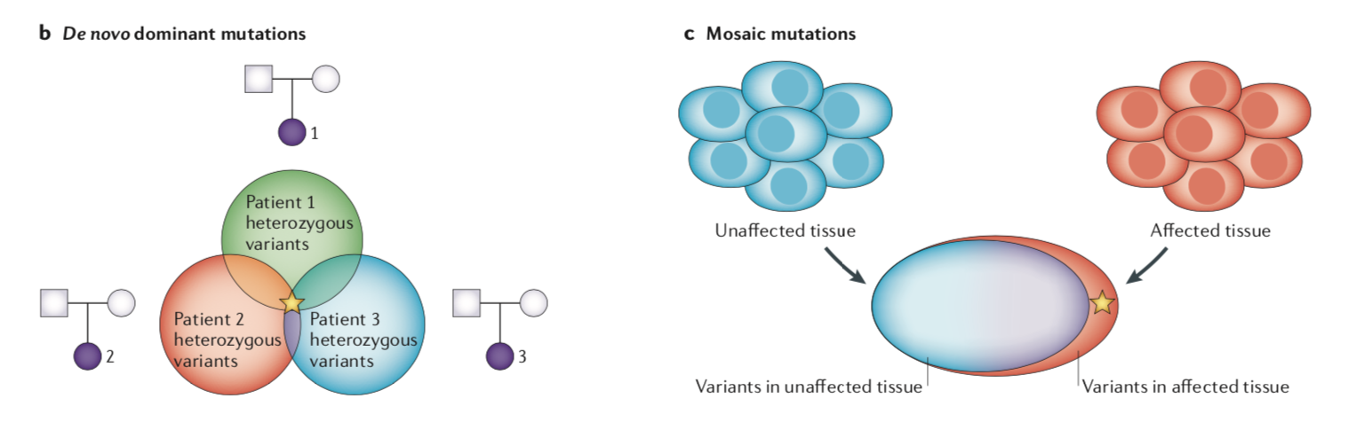
NGS and rare diseases
De Novo and Mosaic Mutations
Rare diseases are also due to "De Novo" mutations. They are mutations that are present in the affected subject and are not shared with the parents. They usually occur early during development.
In some cases the mutations are defined as "mosaic" because they affect only the affected tissue.
Notes:
Rare diseases are also due to "De Novo" mutations. They are mutations that are present in the affected subject and are not shared with the parents. They usually occur early during development. In some cases the mutations are defined as "mosaic" because they affect only the affected tissue.

Slide 73
NGS and rare diseases
Autosomal dominant disorders: de novo mutations
De novo mutations causing autosomal dominant disorders have proved to be much easier to identify, given that each individual carries very few variants that are not also found in their parents, resulting in a data set that is much less complex.
Notes:
The "de novo" mutations that cause rare diseases are easier to find because there are few variants that are not shared with parents.

Slide 74
NGS and rare diseases
Autosomal dominant disorders: de novo mutations
Prematurely deceased child with arthrogryposis (congenital joint contracture in two or more areas of the body.), hypotonia, urinary problems and neurodevlopmental delay. Initially diagnosed as suffering from Congenital Multiplex Arthrogryposis.
Negative to genetic investigation for known causative genes
Notes:
The other case I am presenting is that of an early deceased child with arthrogryposis, hypotonia, urinary problems and generalized delay. It was negative for genetic analysis for congenital multiple arthrogryposis.

Slide 75
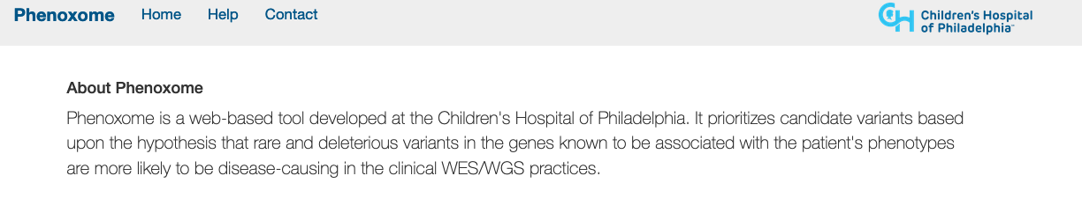
NGS and rare diseases
Autosomal dominant disorders: de novo mutations
After WES analysis, we analyzed the data using Phenoxome, a web tool, which annotates the genetic variants associating them to phenotypic manifestations of the disease.
Phenoxome adopt a robust phenotype-driven model to facilitate automated variant prioritization. Phenoxome dissects the phenotypic manifestation of a patient in concert with their genomic profile to filter and then prioritize variants that are likely to affect the function of the gene (potentially pathogenic variants).
Notes:
Again, we have used the WES. In addition, however, we have used Phenoxome, a tool that can select genes based on the affinity of symptoms of affected subjects, including only genetic variants that are probably pathogenic.

Slide 76
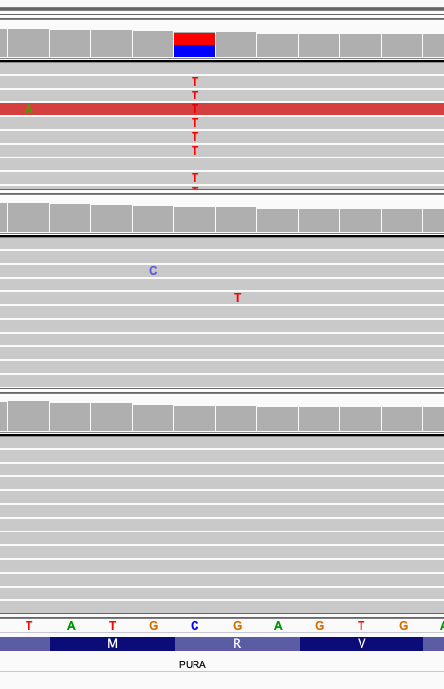
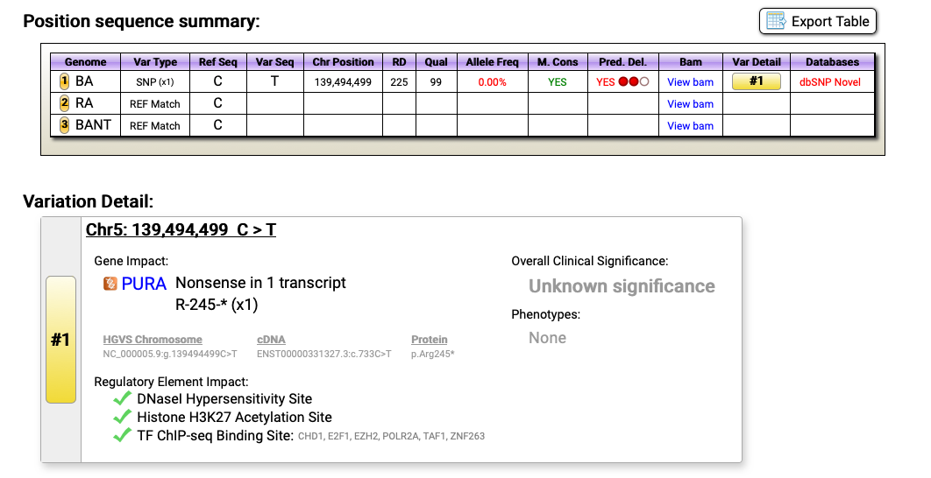
NGS and rare diseases
Autosomal dominant disorders: de novo mutations
Phenoxome returned a mutation of the PURA gene, as a likely mutation candidate to explain the patient's symptoms. This mutation is a nonsense mutation, which therefore leads to a premature end of the protein, dramatically altering its structure.
This mutation is present only in the affected subject
Notes:
The analysis resulted in a mutation in the PURA gene. The mutation is a nonsense mutation that prematurely truncates the protein and alters its function. This mutation was not present in the parents.

Slide 77
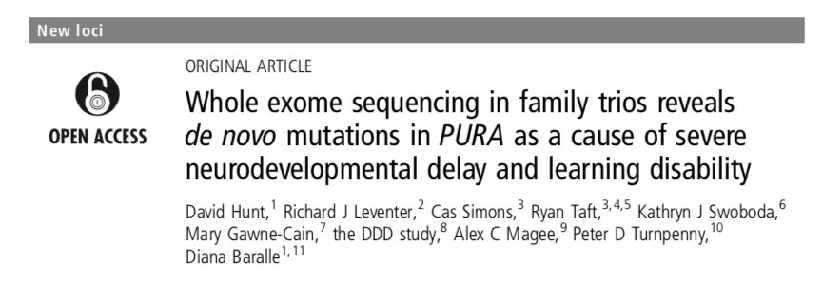
NGS and rare diseases
Autosomal dominant disorders: de novo mutations
PURA encodes Pur-α, a highly conserved multifunctional protein that has an important role in normal postnatal brain development in animal models.
Mutations in the PURA gene have recently been associated with the symptoms described in our patient.
Notes:
In fact, the protein encoded by the PURA gene has an important function in brain development. Mutations in the PURA gene have recently been associated with the symptoms described in our patient.

Slide 78
SUMMARY
The advancements in NGS and the development of bioinformatics methods and resources enabled the usage of WES/WGS to detect, interpret, and validate genomic variations in the clinical setting.
As we attempted to describe WES/WGS analysis is challenging, and there are a great number of tools for each step of variation discovery.
An optimal and coordinated combination of tools is required to identify the different types of genomic variants.
Patients with rare genetic diseases are among the first beneficiaries of the NGS revolution; their experience will inform personalized medicine in other areas over the next decade.
Notes:
The progress of NGS techniques and the development of bioinformatics has allowed to detect, interpret and validate the hundreds of variants that originate from genomic analysis. The discovery of genetic variants requires the use of numerous tools and often in combination with each other for optimal results.
Patients with rare diseases are among those who may benefit from the advent of these new techniques.

