Slide 1





Workshop on Radiative Corrections and Monte Carlo Simulations for $e^{+}e^{− }$collisions,
Scuola Normale Superiore Pisa,
May 7-9, 2025
Luminosity Measurement
at modern $e^{+}e^{− }$Colliders
Achim Denig
Institute for Nuclear Physics
Johannes Gutenberg University Mainz
FOR
5327

Slide 2
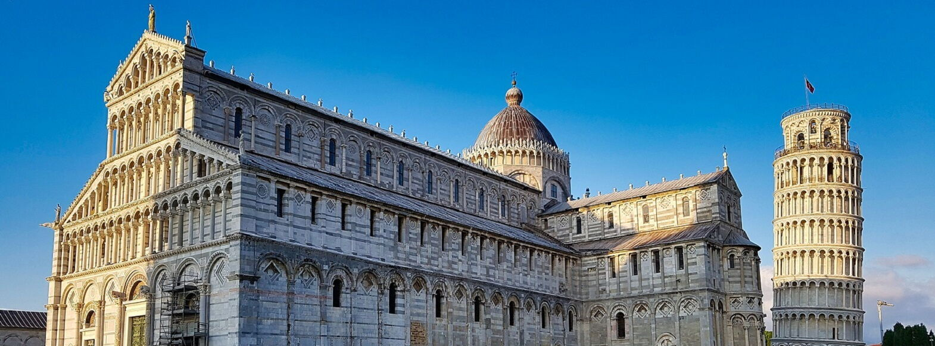
2
Normalization Techniques for absolute Cross Section
Measurements

Slide 3

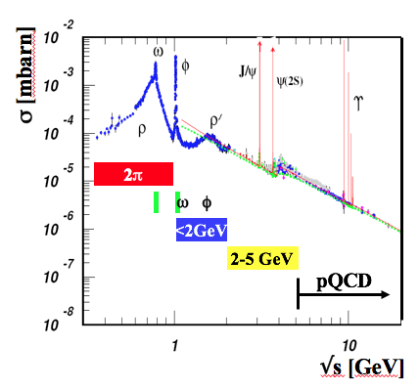
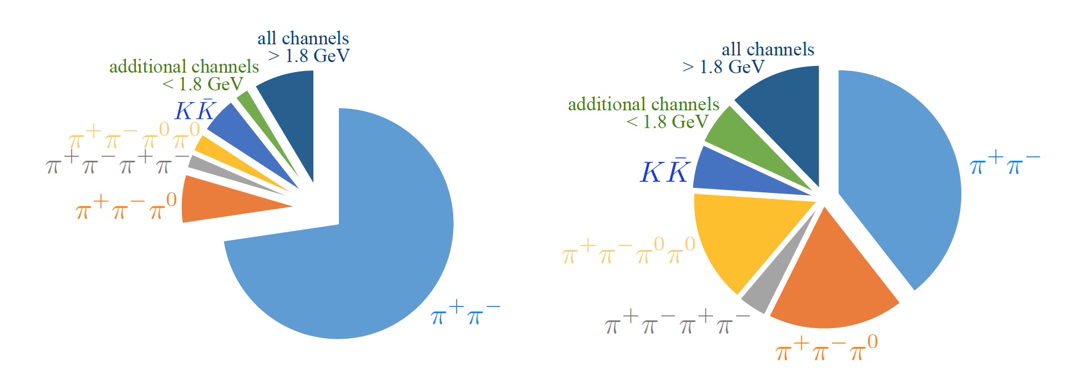
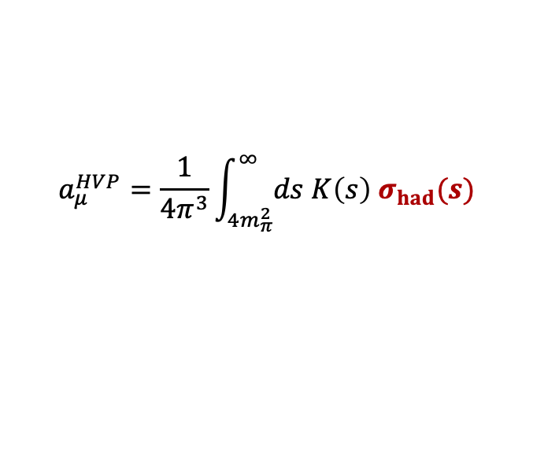
3
Hadronic Vacuum Polarization Contribution to (g-2)_{µ}
Anomalous magnetic moment of the muon (g-2)_{µ}
$$a_{μ}^{HVP}=\frac{1}{4π^{3}}\int_{4m_{π}^{2}}^{∞}{ds K\left(s\right) σ_{had}(s)}$$
Need for high-quality cross section measurements
Contributions to HVP integral
Contributions to HVP error

Slide 4
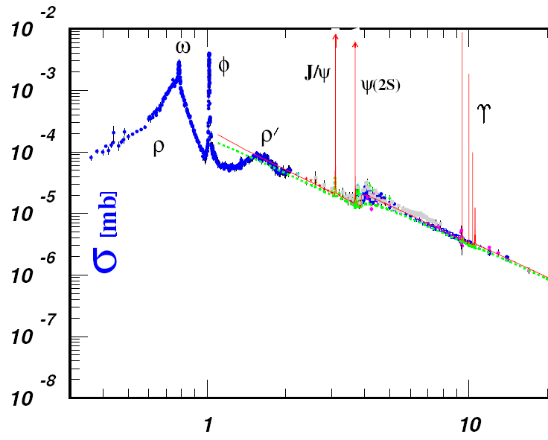
4
Measurements of σ_{had} – Energy Scan vs. Initial State Radiation
σ_{had} [mbarn]
σ_{had} [mbarn]
γ_{ISR}
e⁺
π⁺
VEPP-2000
CMD3+SND
VEPP-4M / KEDR
E_{CM}
π⁻
BEPC-II / BES III
m_{had}
Hadrons
e⁻
√s [GeV]
Notes:
Now, indeed the energy range below 2 GeV, so the one relevant for g-2, is measured by summing up measurements of exclusive hadronic channels, 2pi, 3pi, 4pi, KK, Kkpipi and so on,
While the range relevant for Delta_alpha is essentielly measured in inclusive R ratio measurements
The two methods are quite complementary ... While exclusive measurements can be individually quite precise, it is important not to miss one of the many channels. Both energy scans (Novosibirsk) nand ISR measrements have been carried out

Slide 5
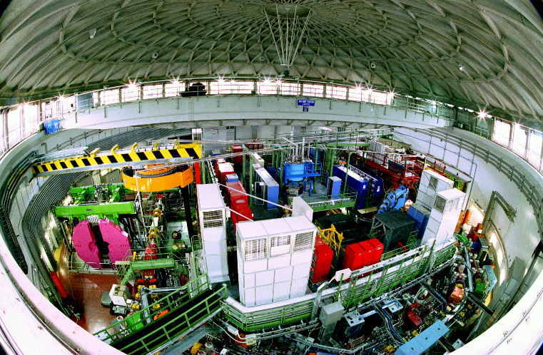
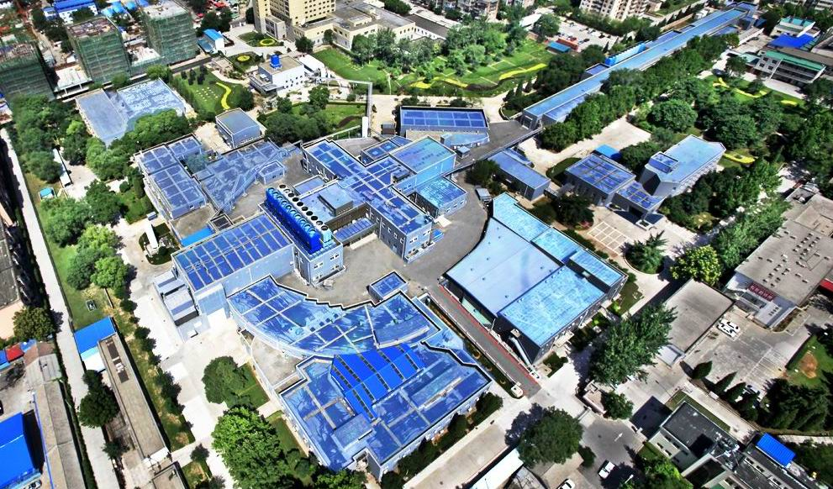
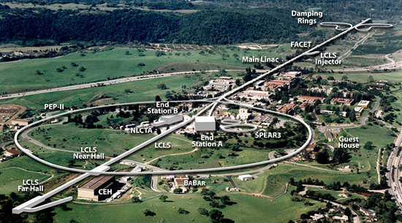
5
Measurements of σ_{had} – Energy Scan vs. Initial State Radiation
DAPHNE
σ_{had} [mbarn]
σ_{had} [mbarn]
γ_{ISR}
ISR
KLOE
e⁺
π⁺
ISR
BES III
E_{CM}
π⁻
ISR
BABAR
m_{had}
Hadrons
e⁻
No systematic variation of E_{beam}
High statistics thanks to high luminosity
Radiative corrections (H_{rad})
√s [GeV]
PEP-II
PHOKHARA event generator
BEPC II
Notes:
Now, indeed the energy range below 2 GeV, so the one relevant for g-2, is measured by summing up measurements of exclusive hadronic channels, 2pi, 3pi, 4pi, KK, Kkpipi and so on,
While the range relevant for Delta_alpha is essentielly measured in inclusive R ratio measurements
The two methods are quite complementary ... While exclusive measurements can be individually quite precise, it is important not to miss one of the many channels. Both energy scans (Novosibirsk) nand ISR measrements have been carried out

Slide 6
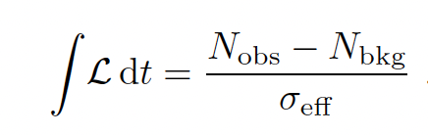
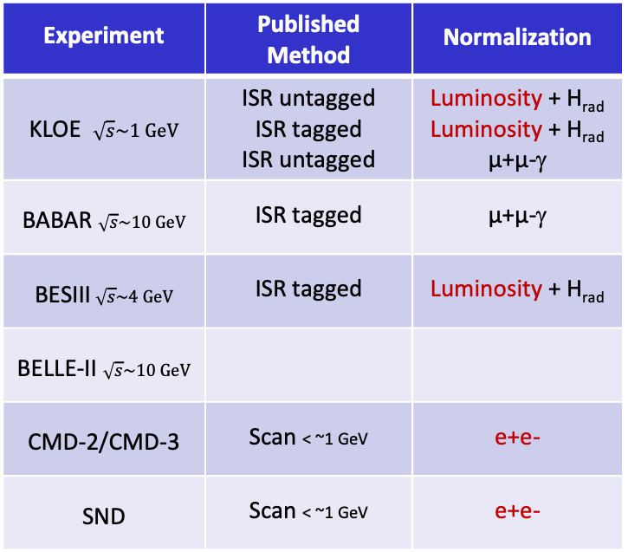
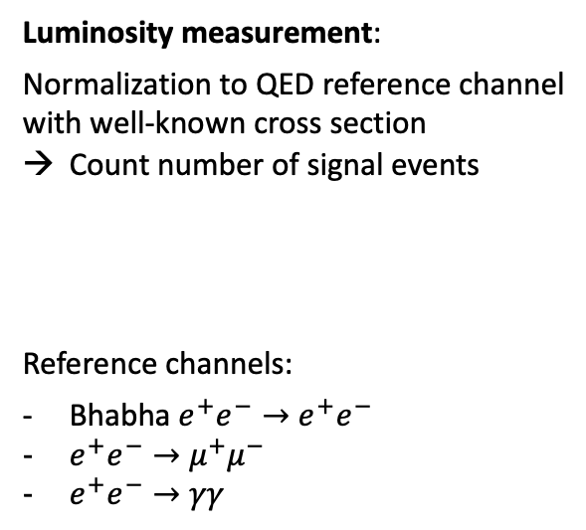
Overview Experiments
Experiment | Published Method | Normalization
KLOE $\sqrt{s}\sim 1 GeV$ | ISR untagged ISR tagged ISR untagged | Luminosity + H_{rad} Luminosity + H_{rad} µ+µ-γ
BABAR $\sqrt{s}\sim 10 GeV$ | ISR tagged | µ+µ-γ
BESIII$\sqrt{s}\sim 4 GeV$ | ISR tagged | Luminosity + H_{rad}
BELLE-II $\sqrt{s}\sim 10 GeV$
CMD-2/CMD-3 | Scan < ~1 GeV | e+e-
SND | Scan < ~1 GeV | e+e-
Luminosity measurement:
Normalization to QED reference channel
with well-known cross section
Count number of signal events
Reference channels:
Bhabha $e^{+}e^{−}→$ $e^{+}e^{−}$
$e^{+}e^{−}→$ $μ^{+}μ^{−}$
$e^{+}e^{−}→$ $γγ$

Slide 7
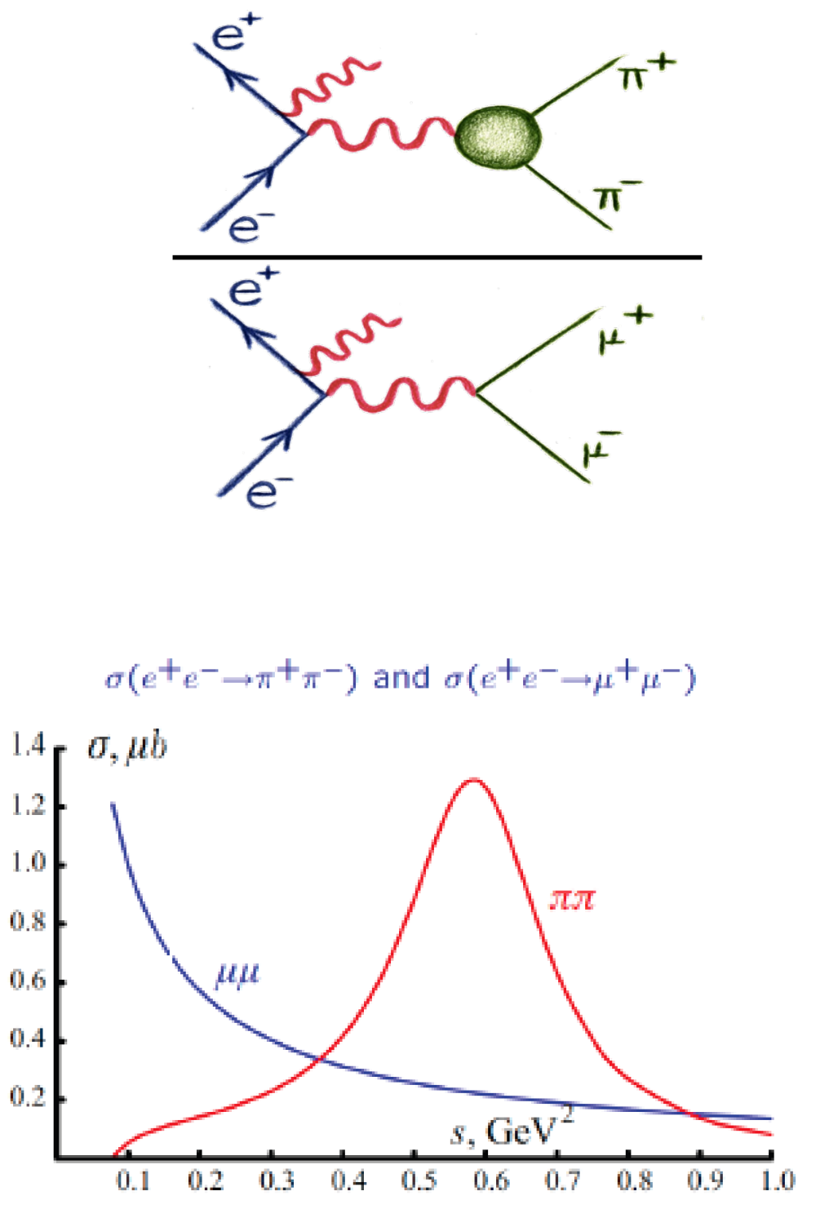
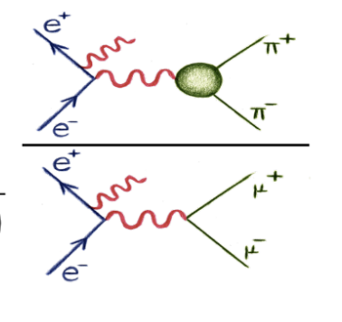
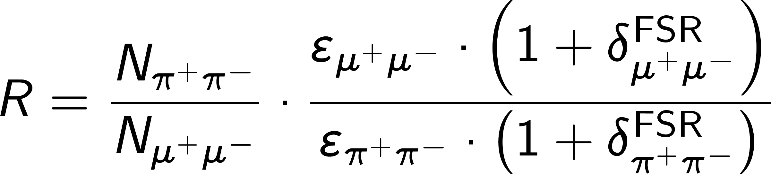

Initial State Radiation - Normalization
Two independent normalization methods:
1) normalization to L_{int} (obtained from Bhabha events) and H_{rad}; subtraction of background (µ+µ-γ, … )
2) normalization to µ+µ-γ events, i.e. R ratio (ππγ/µµγ)
→ L_{int}, H_{rad}, δ_{vac} cancel in ratio!
→ requires high statistics of µ+µ-γ

Slide 8
Initial State Radiation - Normalization
Two independent normalization methods:
1) normalization to L_{int} (obtained from Bhabha events) and H_{rad}; subtraction of background (µ+µ-γ, … )
2) normalization to µ+µ-γ events, i.e. R ratio (ππγ/µµγ)
→ L_{int}, H_{rad}, δ_{vac} cancel in ratio!
→ requires high statistics of µ+µ-γ

Slide 9
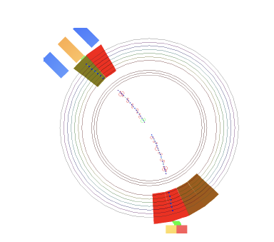
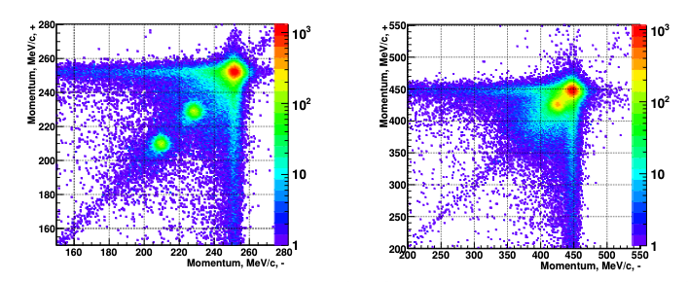
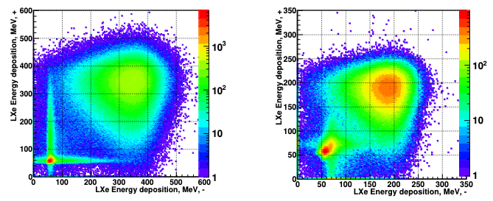










Normalization at CMD-3 ( Energy-Scan Experiment )
E₊
p₊
x IP
energy release
in calorimeter
Normalization directly to $e^{+}e^{−}$ via two methods
p₋
$\sqrt{s}$ = 500 MeV
$\sqrt{s}$ = 900 MeV
tracks in DC
E₋
p₊
$$e$$
p₊
$$μ$$
$$π$$
p₋
p₋
Most impressive feature: ππ/ee ratio determined
independently by two complementary methods
- Momentum based
- Calorimetric
$\sqrt{s}$ = 956 MeV
$\sqrt{s}$ = 548 MeV
E₊
E₊
$$e$$
agreement ~ 0.2% around rho peak
$$μ$$
$$π$$
E₋
E₋

Slide 10
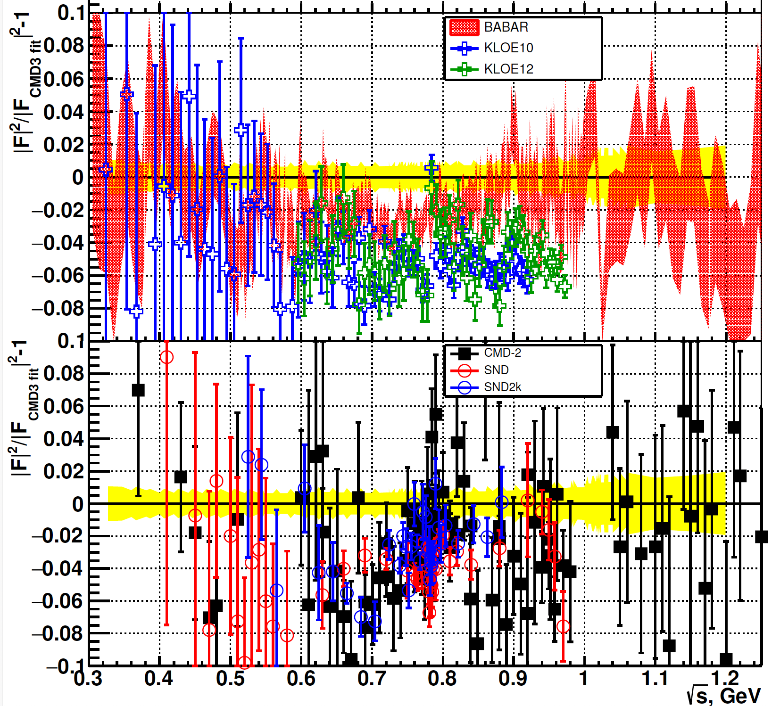
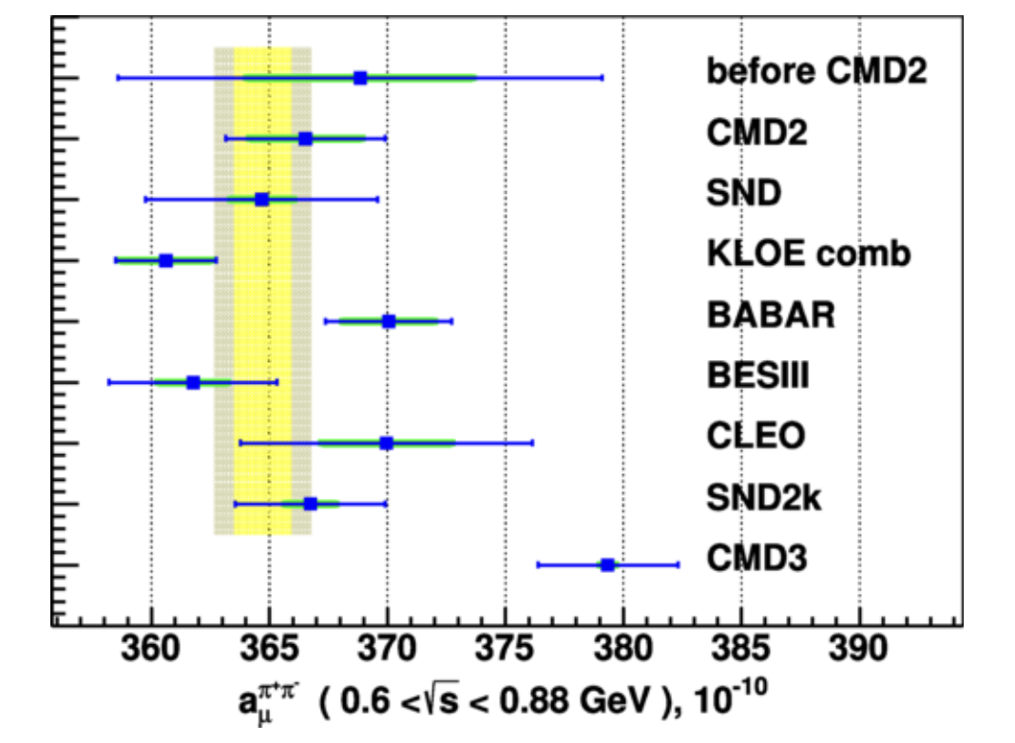
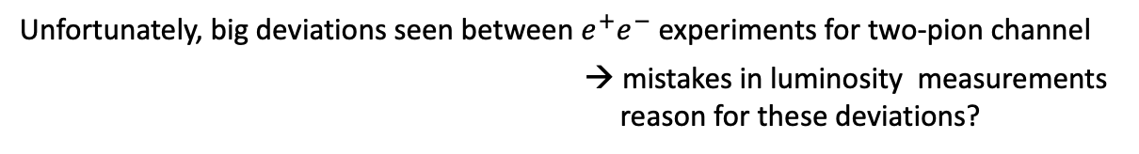
Big Deviations seen in Channel e⁺e⁻ → π⁺π⁻
Unfortunately, big deviations seen between $e^{+}e^{−}$ experiments for two-pion channel
→ mistakes in luminosity measurements
reason for these deviations?

Slide 11
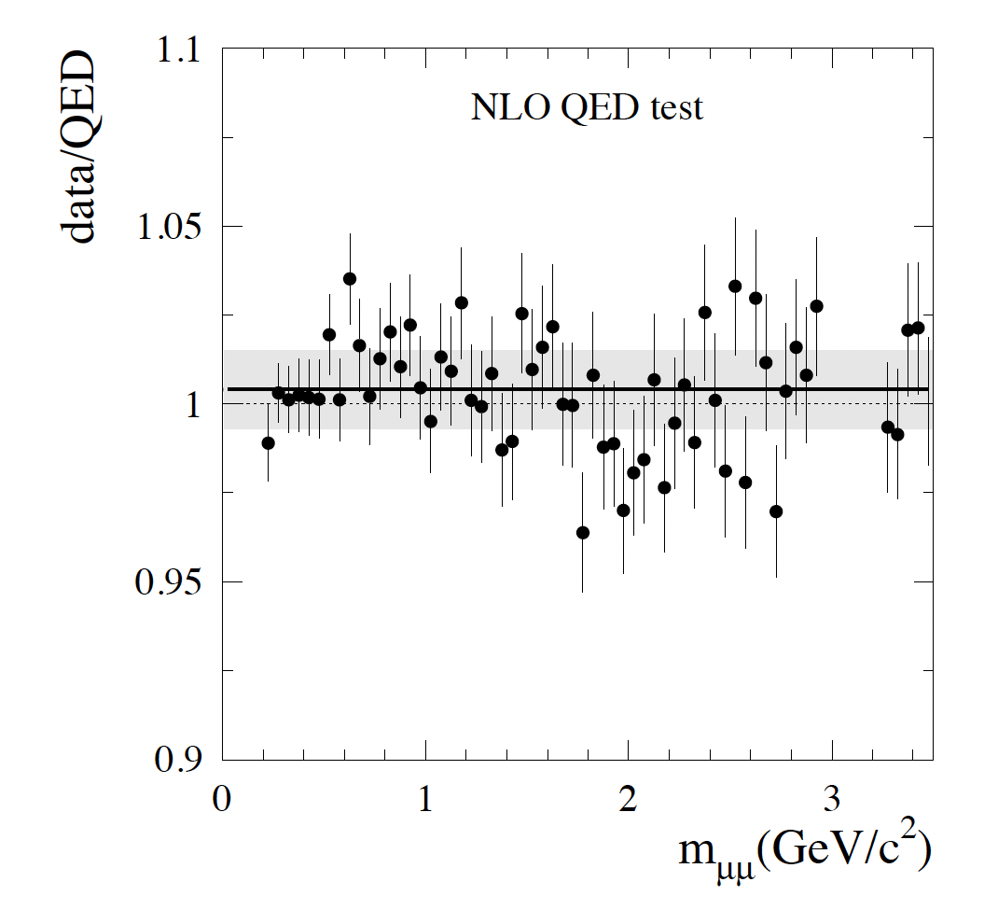
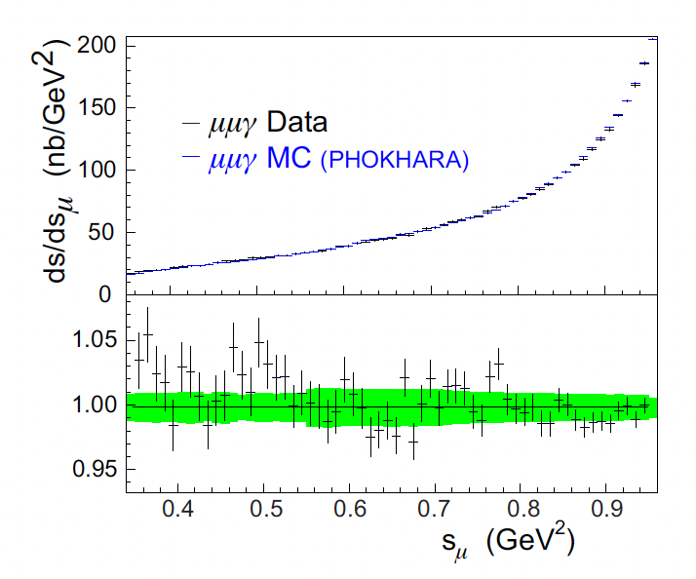
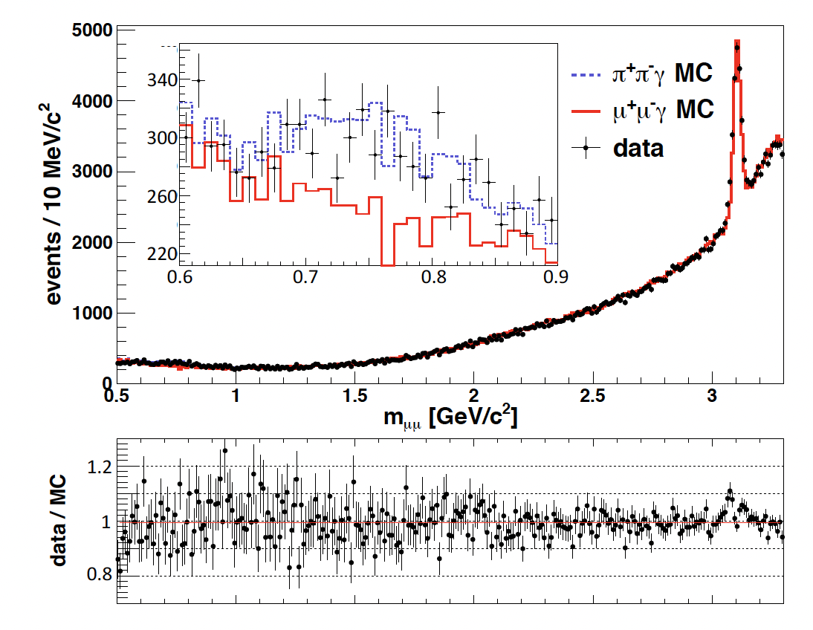



Cross Check: QED Test via e⁺e⁻ → μ⁺μ⁻
Independent cross check given by QED test
→ $e^{+}e^{−}$ $→$ $μ^{+}μ^{−}$ , however also dependence on radiator function (precision of QED generator)
Agreement <1.1%
Agreement <1.1%
Agreement <1.0%

Slide 12
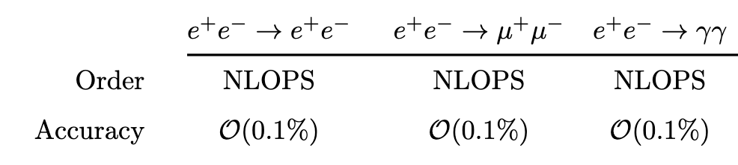
Need for High-Quality QED Generators
For pure luminosity measurement, high-quality Bhabha generator as well as
generator for di-muon and γγ - channel needed
Radiative corrections needed, however mainly Born-level selection (see below)
→ BABAYAGA@NLO serves as a high-precision tool for all three QED reference channels

Slide 13
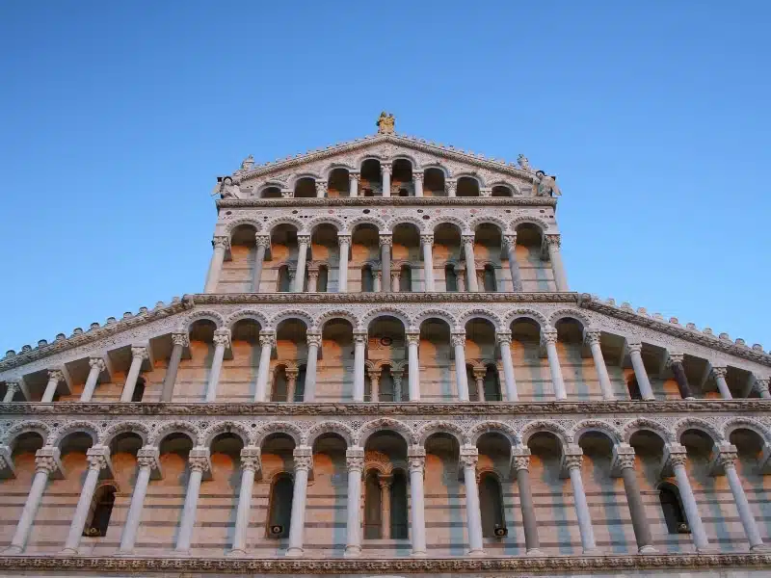
13
Experimental Details Luminosity Measurement

Slide 14
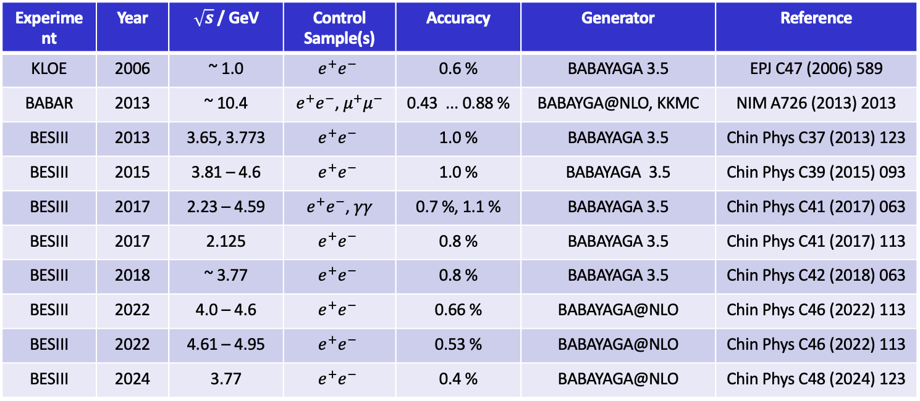
Overview Publications (likely not complete)
Experiment | Year | $\sqrt{s}$ / GeV | Control Sample(s) | Accuracy | Generator | Reference
KLOE | 2006 | ~ 1.0 | $$e^{+}e^{−}$$ | 0.6 % | BABAYAGA 3.5 | EPJ C47 (2006) 589
BABAR | 2013 | ~ 10.4 | $e^{+}e^{−}$, $μ^{+}μ^{−}$ | 0.43 ... 0.88 % | BABAYGA@NLO, KKMC | NIM A726 (2013) 2013
BESIII | 2013 | 3.65, 3.773 | $$e^{+}e^{−}$$ | 1.0 % | BABAYAGA 3.5 | Chin Phys C37 (2013) 123
BESIII | 2015 | 3.81 – 4.6 | $$e^{+}e^{−}$$ | 1.0 % | BABAYAGA 3.5 | Chin Phys C39 (2015) 093
BESIII | 2017 | 2.23 – 4.59 | $e^{+}e^{−}$, $γγ$ | 0.7 %, 1.1 % | BABAYAGA 3.5 | Chin Phys C41 (2017) 063
BESIII | 2017 | 2.125 | $$e^{+}e^{−}$$ | 0.8 % | BABAYAGA 3.5 | Chin Phys C41 (2017) 113
BESIII | 2018 | ~ 3.77 | $$e^{+}e^{−}$$ | 0.8 % | BABAYAGA 3.5 | Chin Phys C42 (2018) 063
BESIII | 2022 | 4.0 – 4.6 | $$e^{+}e^{−}$$ | 0.66 % | BABAYAGA@NLO | Chin Phys C46 (2022) 113
BESIII | 2022 | 4.61 – 4.95 | $$e^{+}e^{−}$$ | 0.53 % | BABAYAGA@NLO | Chin Phys C46 (2022) 113
BESIII | 2024 | 3.77 | $$e^{+}e^{−}$$ | 0.4 % | BABAYAGA@NLO | Chin Phys C48 (2024) 123

Slide 15
Overview Selection of Bhabha-Events
Electromagnetic
Calorimeter
(EMC)
Selection of two charged tracks with
opposite charge originating from IP
Require both tracks to be in fiducial volume
- Association of track to EMC cluster
3. Require back-to-back signature
- beam momenta close to half of cms energy
- accolinearity cuts (2dim. or 3dim.)
removes also gamma-gamma events
4. Particle Identification Cuts
- E/p: Energy release in EMC/mometum of track
Remove remaining background events
- mu+mu-, pi+pi- (percent level)
- gamma-gamma events
Drift
chamber
Time-of-flight
detector
transversal view

Slide 16
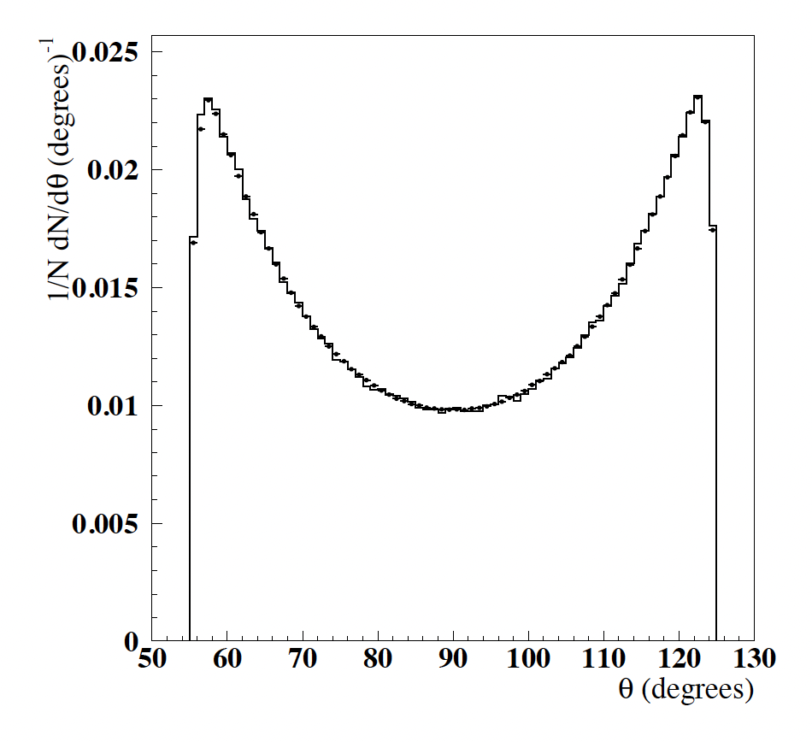
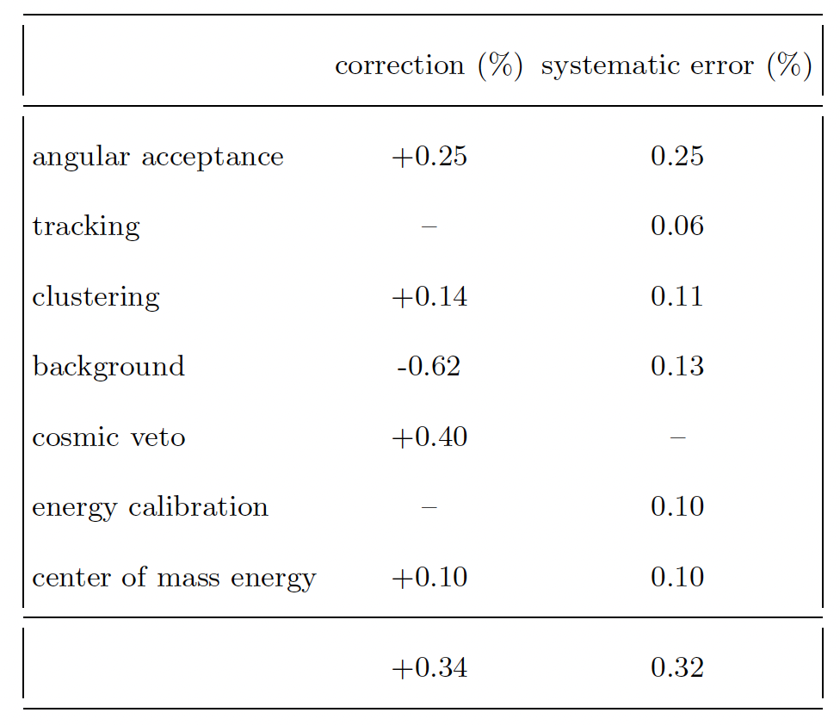
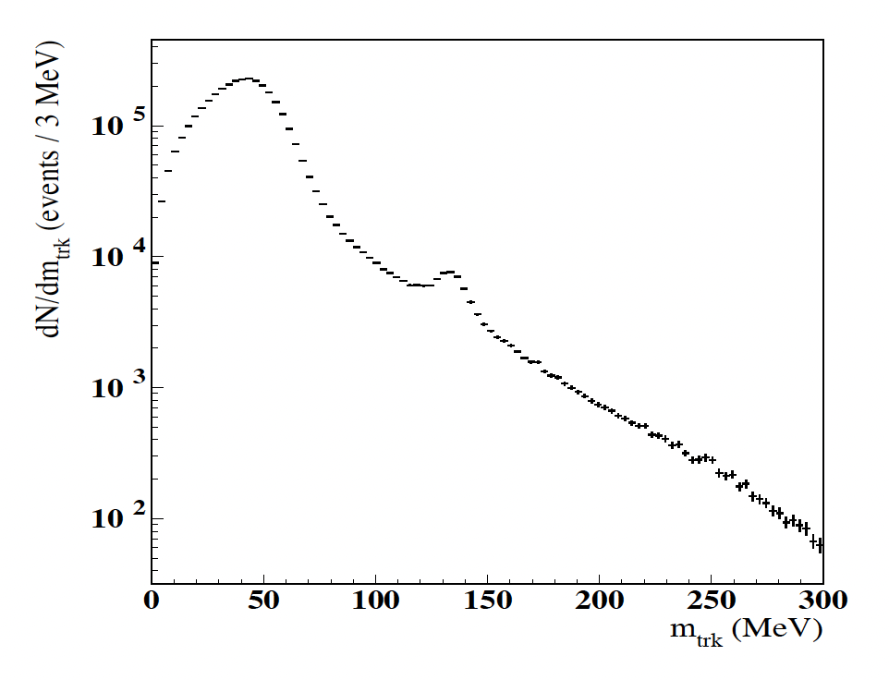
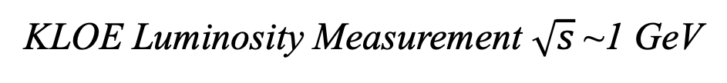
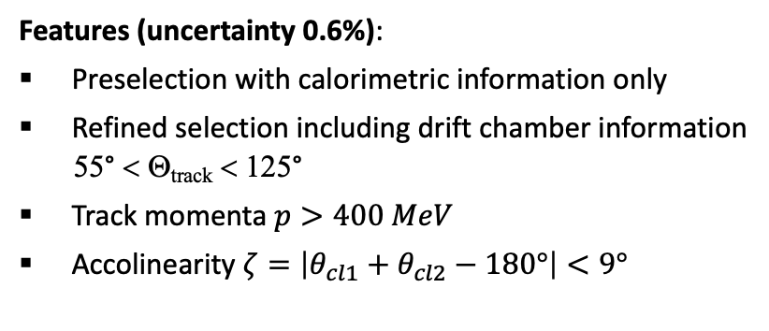
KLOE Luminosity Measurement $\sqrt{s}$~1 GeV
Features (uncertainty 0.6%):
Preselection with calorimetric information only
Refined selection including drift chamber information
55° < Θ_{track} < 125°
Track momenta $p>400 MeV$
Accolinearity $ζ=\left|θ_{cl1}+θ_{cl2}−180°\right|<9°$
contamination
from ππγ/µµγ
+ BABAYAGA uncertainy 0.5%

Slide 17
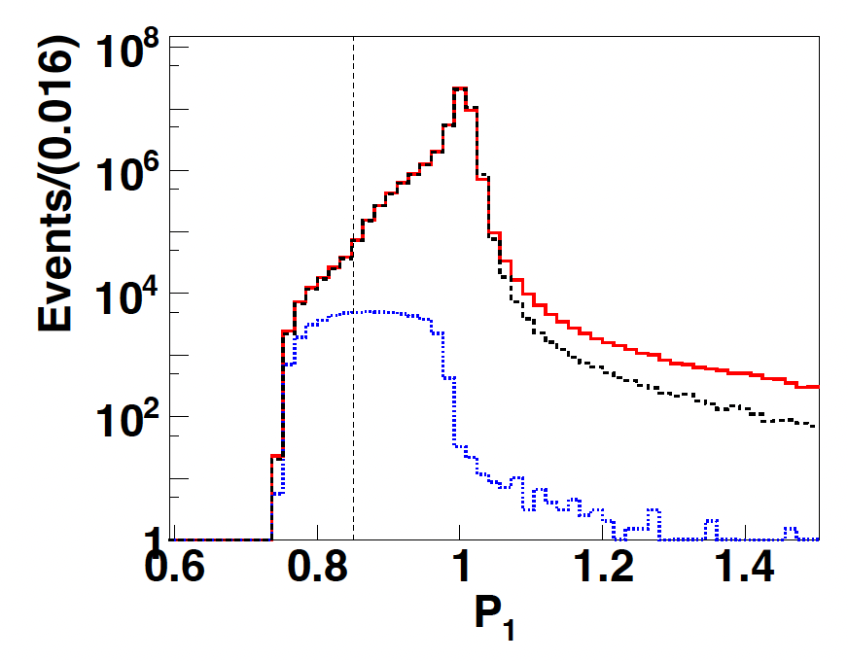
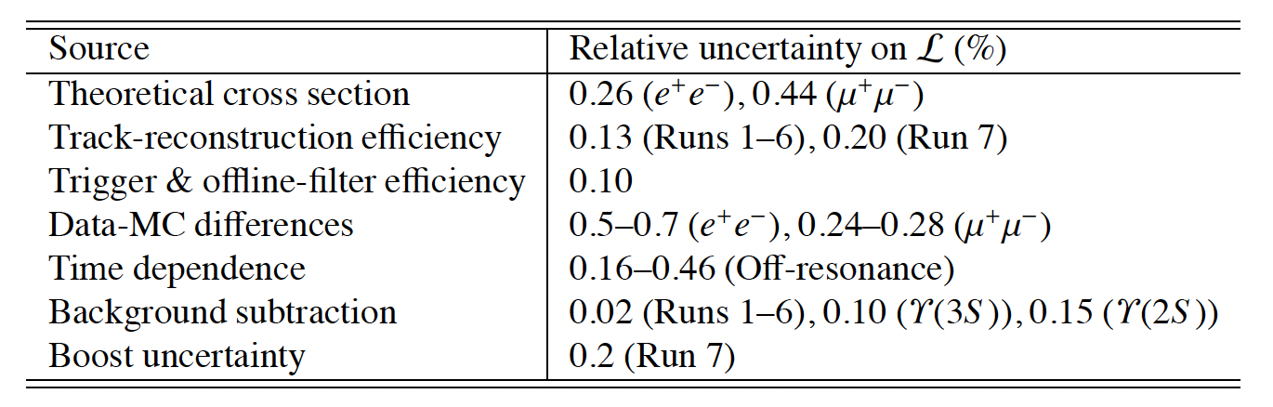
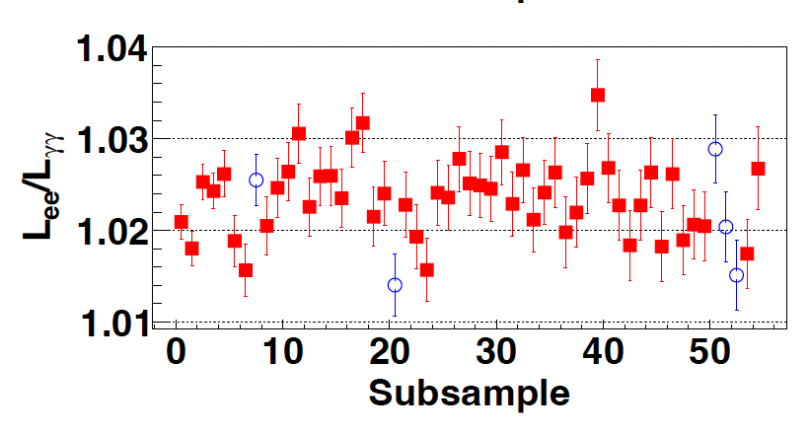
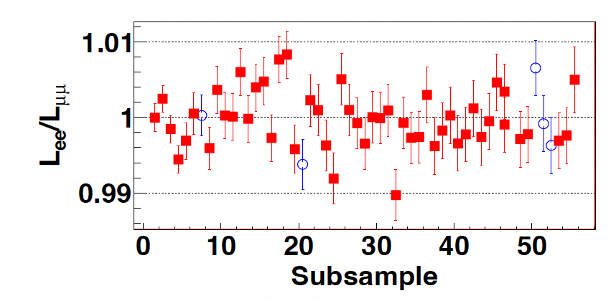
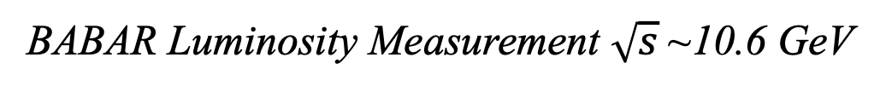
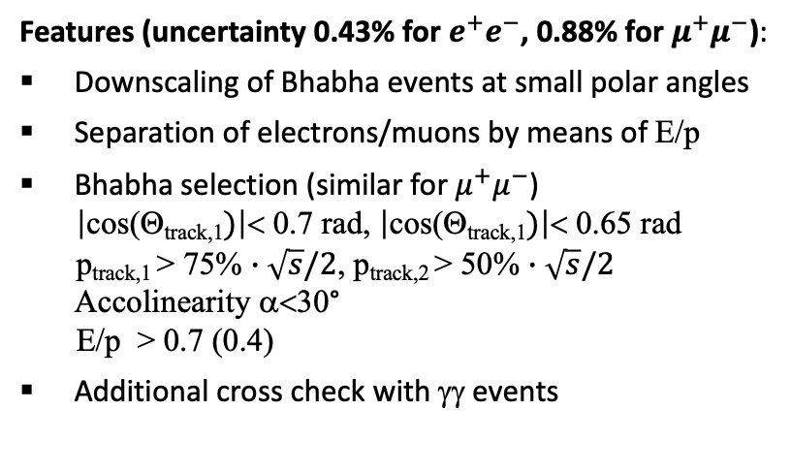
BABAR Luminosity Measurement $\sqrt{s}$~10.6 GeV
Features (uncertainty 0.43% for $e^{+}e^{−}$, 0.88% for $μ^{+}μ^{−}$):
Downscaling of Bhabha events at small polar angles
Separation of electrons/muons by means of E/p
Bhabha selection (similar for $μ^{+}μ^{−}$)
$\left|\text{cos}\text{(}\text{Q}\text{track}\text{,1})\right|$< 0.7 rad, $\left|\text{cos}\text{(}\text{Q}\text{track}\text{,1})\right|$< 0.65 rad
p_{track,1} > 75% $∙\sqrt{s}/2$, p_{track,2} > 50% $∙\sqrt{s}/2$
Accolinearity α<30°
E/p > 0.7 (0.4)
Additional cross check with γγ events
ee
µµ

Slide 18
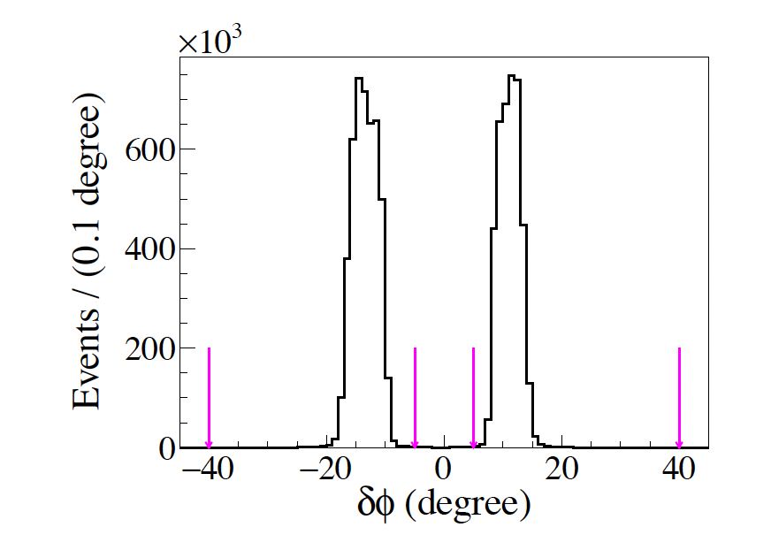
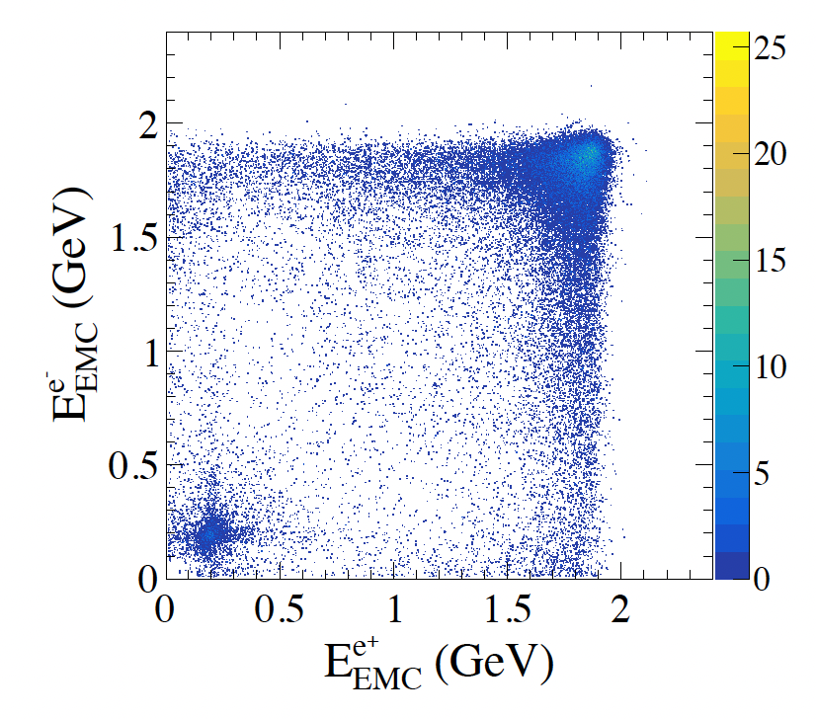
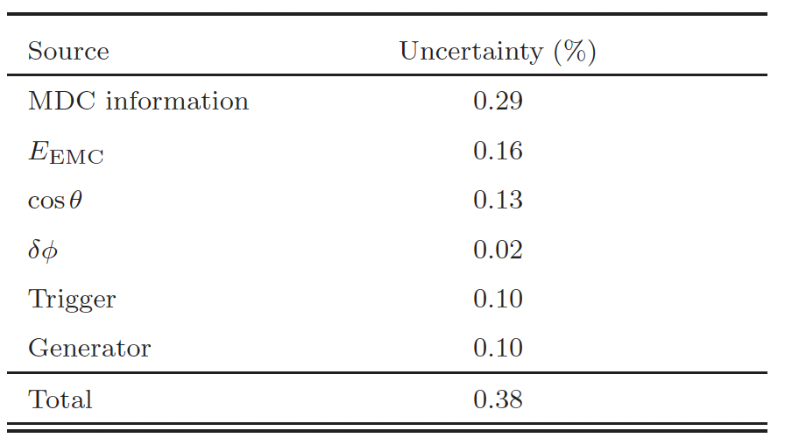
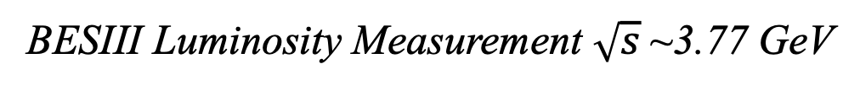
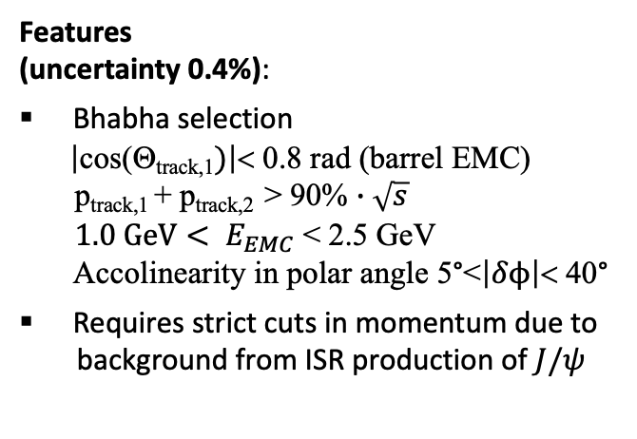
BESIII Luminosity Measurement $\sqrt{s}$~3.77 GeV
ee
µµ
Features
(uncertainty 0.4%):
Bhabha selection
$\left|\text{cos}\text{(}\text{Q}\text{track}\text{,1})\right|$< 0.8 rad (barrel EMC)
p_{track,1} + p_{track,2} > 90% $∙\sqrt{s}$
${1.0 GeV< E}_{EMC}$ < 2.5 GeV
Accolinearity in polar angle 5°<$\left|δϕ\right|$< 40°
Requires strict cuts in momentum due to
background from ISR production of $J/ψ$

Slide 19
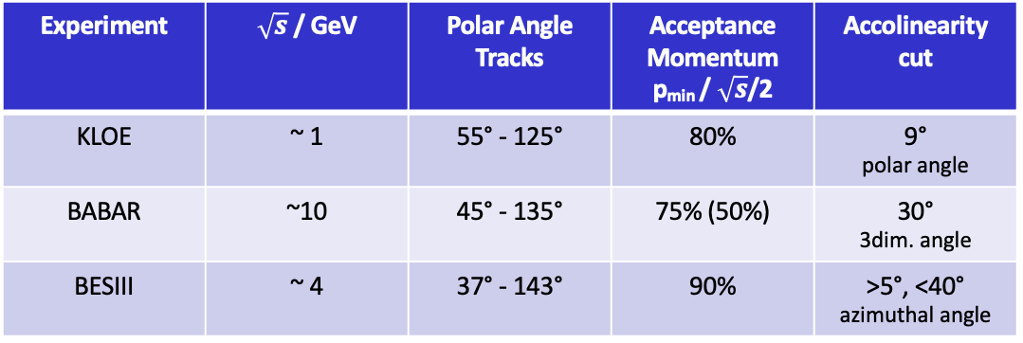
Overview Selection Cuts
Main control channel used for luminosity measurement: Large-angle Bhabha events
high statistics → optimal signal-to-background ratio
full energy deposit in EMC → clear signature
allows to combine tracking and EMC information → complementary information
Similar selection used by all modern collider experiments:
Experiment | $\sqrt{s}$ / GeV | Polar Angle Tracks | Acceptance Momentum p_{min} / $\sqrt{s}$/2 | Accolinearity cut
KLOE | ~ 1 | 55° - 125° | 80% | 9° polar angle
BABAR | ~10 | 45° - 135° | 75% (50%) | 30° 3dim. angle
BESIII | ~ 4 | 37° - 143° | 90% | >5°, <40° azimuthal angle

Slide 20

20
Conclusions

Slide 21
Conclusions
Luminosity measurements mainly based on Bhabha reference channel
→ cross checks with di-muon and γγ – channel
Selection mainly based on Born process and (relatively) soft radiation
→ BABAYAGA@NLO provides already very high accuracy ~0.1%
Experimental issues in luminosity measurement beyond event
generator currently limiting the overall accuracy
→ trigger, background, electronics, hidden inefficiencies, saturation, ...
Bhabha event generator with Born and hard radiation needed for many
applications in precision physics – presently not existing
→ Background processes, multi-photon background, ...

Slide 22
22
Thank you !

